Slide 1


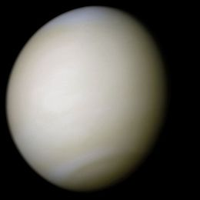
Sensitivity of net thermal flux to abundance of trace gases in the Venus atmosphere below the clouds
Venus 2016 conference, Oxford, U.K., Apr 4th-8th
Y.J. Lee¹, H. Sagawa², R. Haus³,
S. Stefani⁴, D. Titov⁵, T. Imamura¹, and G. Piccioni⁴
1. ISAS/JAXA, Japan
2. Kyoto Sangyo University, Japan
3. Westfälische Wilhelms-Universität Münster, Germany
4. INAF-IAPS, Italy
5. ESTEC/ESA, The Netherlands

Slide 2
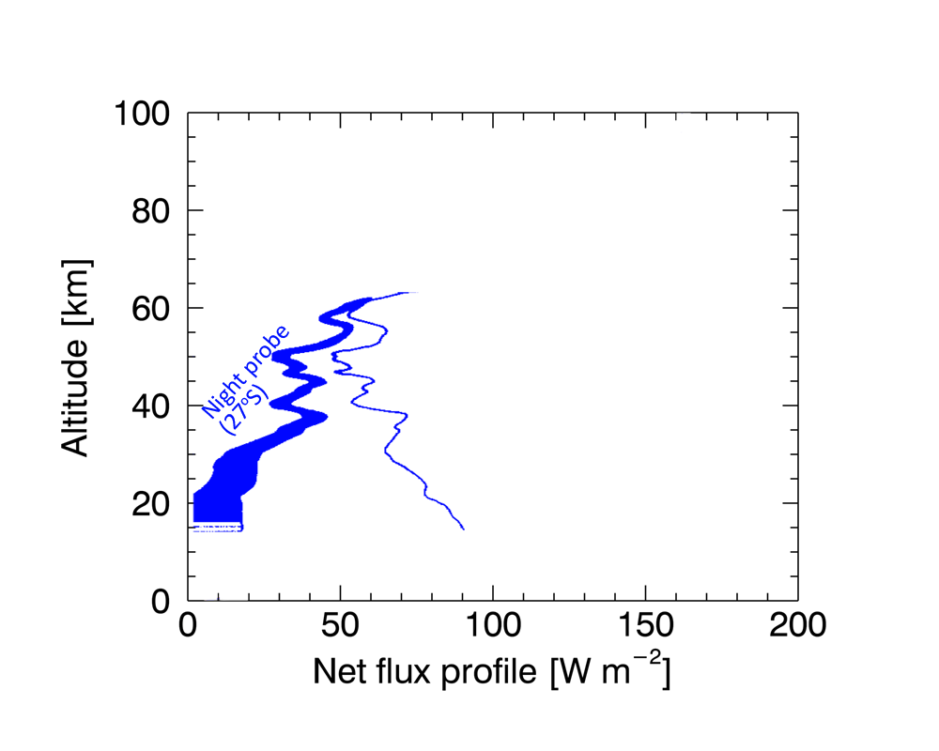
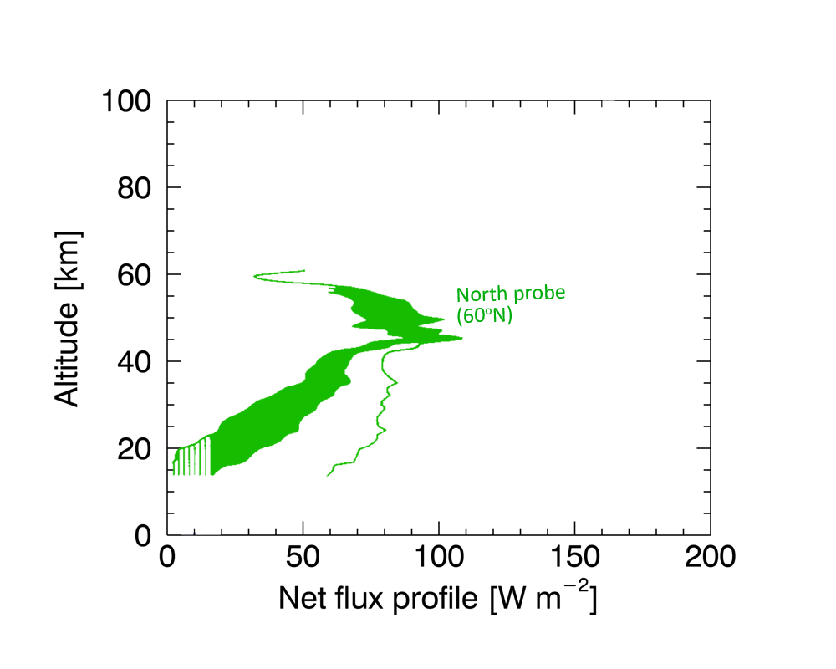
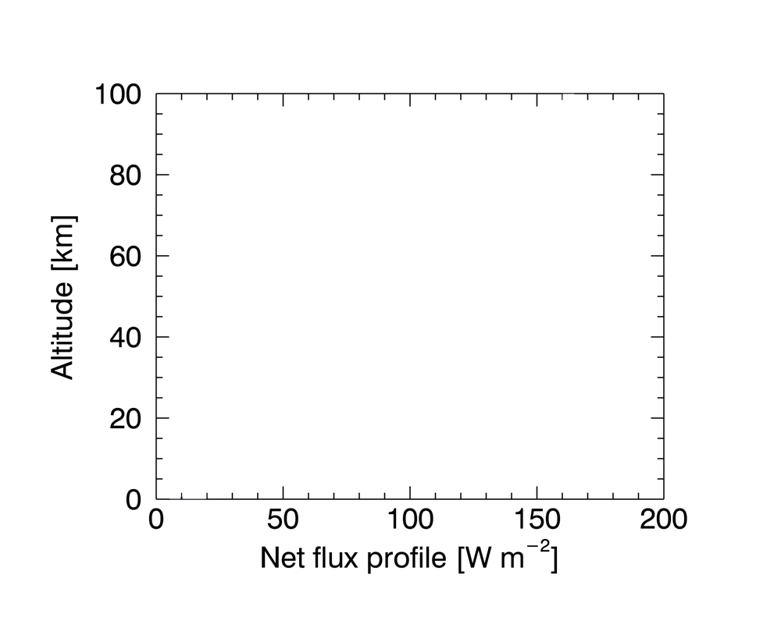
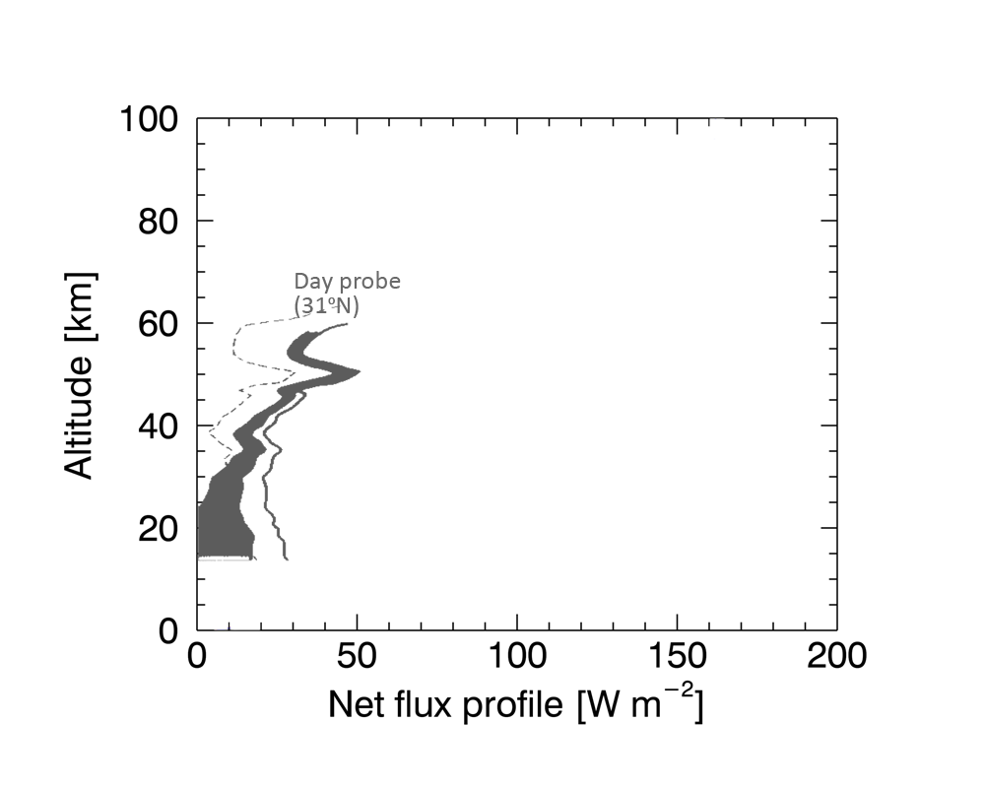
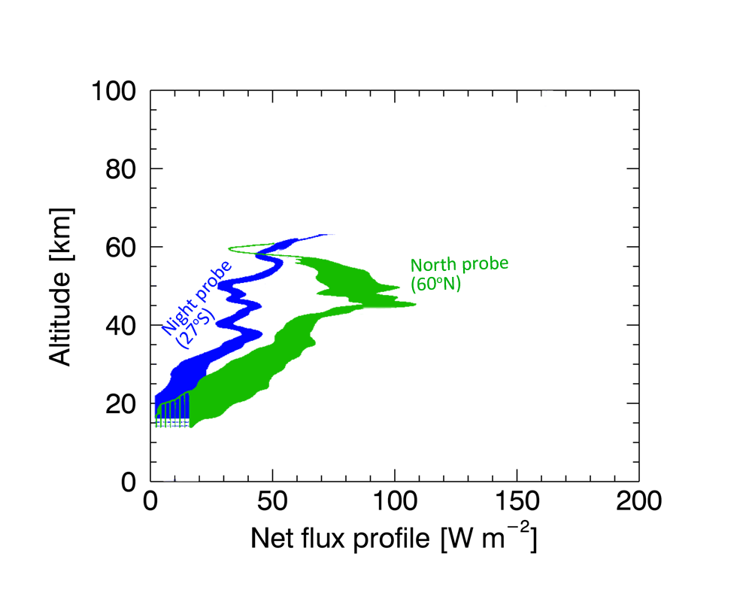

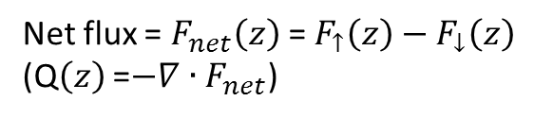
In-situ observation from Pioneer Venus
Net flux = $F_{net}\left(z\right)$ =$F_{↑}\left(z\right)−F_{↓}\left(z\right)$
(Q$\left(z\right)$ =$−∇∙F_{net}$)
Revercomb et al. (1985)
suggested that 100-200 ppmv H₂O vapor abundance would explain the Night probe profile.
They also suggested that this is a significant implication of the global circulation, by cooling at high latitudes.
200 ppmv H₂O
100 ppmv H₂O
20 ppmv H₂O
[Revercomb et al. 1985]
https://heasarc.gsfc.nasa.gov

Slide 3
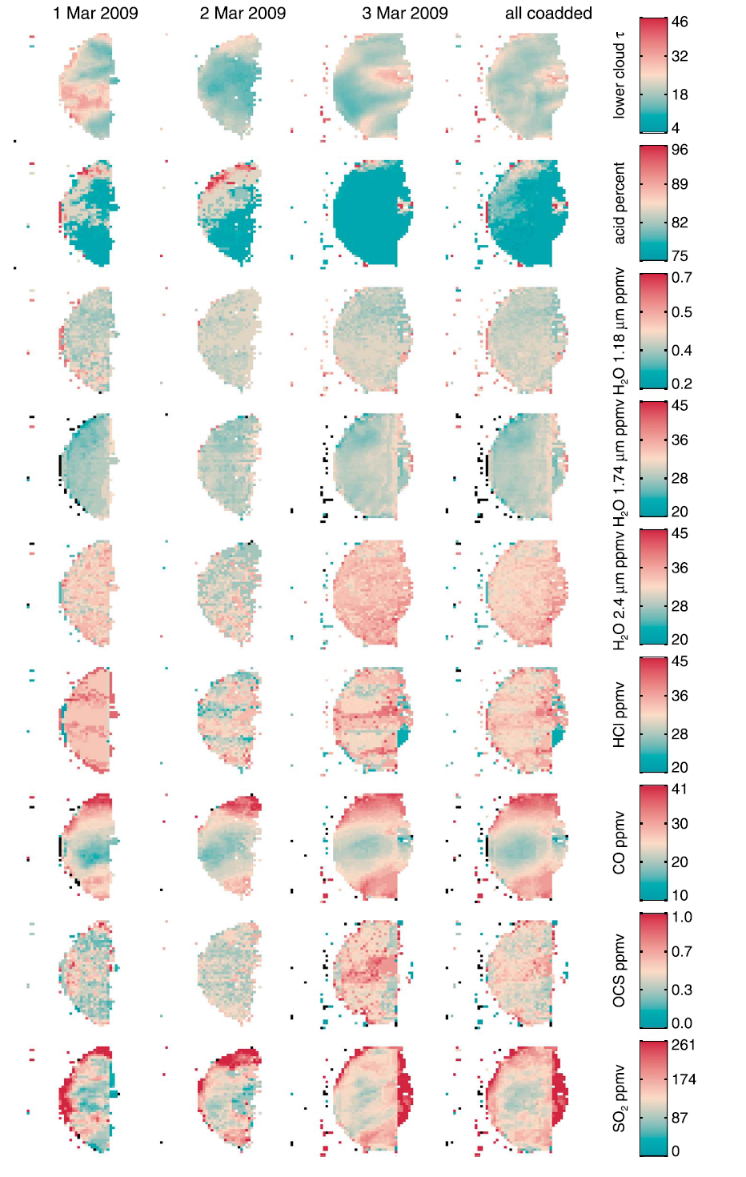
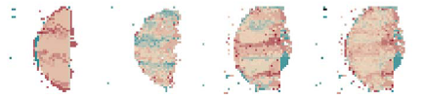
Minor gases below the clouds
Ground-based observation through the 2.3 μm window [Arney et al., 2014]

Slide 4
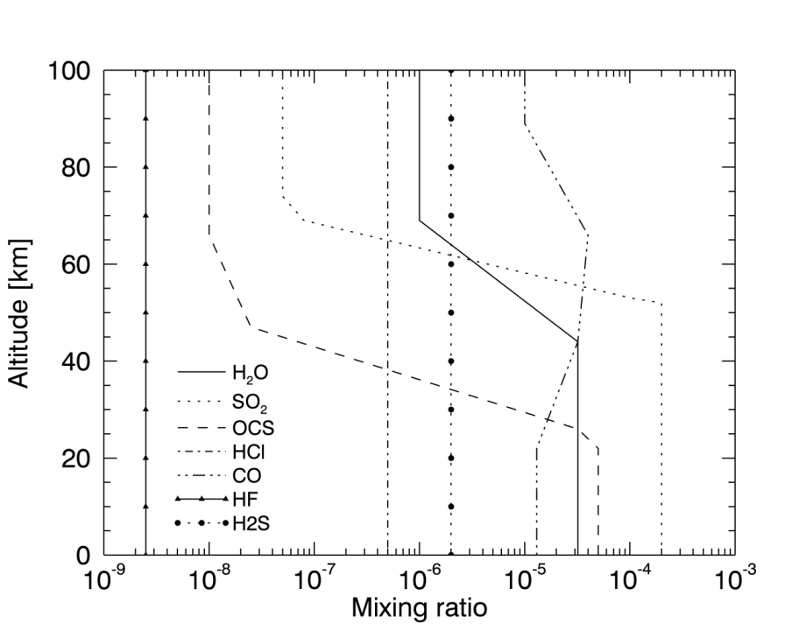
Data and method (1)
Line-by-line method
(50-8300 cm⁻¹, 1.2-200 μm), ∆ν=0.1 cm⁻¹
1-D radiative transfer model calculation, using SHDOM.
T(z) and P(z) taken from Venus International Reference Atmosphere (VIRA)
z=0-100 km, ∆z=1 km
Sulfuric acid (75%) cloud aerosols
Atmospheric gases (96.5% CO₂, 3.5% N₂, etc.); HITEMP2010, HITRAN2012, …
→ Greatly improved from
Lee et al. (2015, PSS)
STANDARD (‘STD’) CONDITION
[Titov et al., 2007]

Slide 5
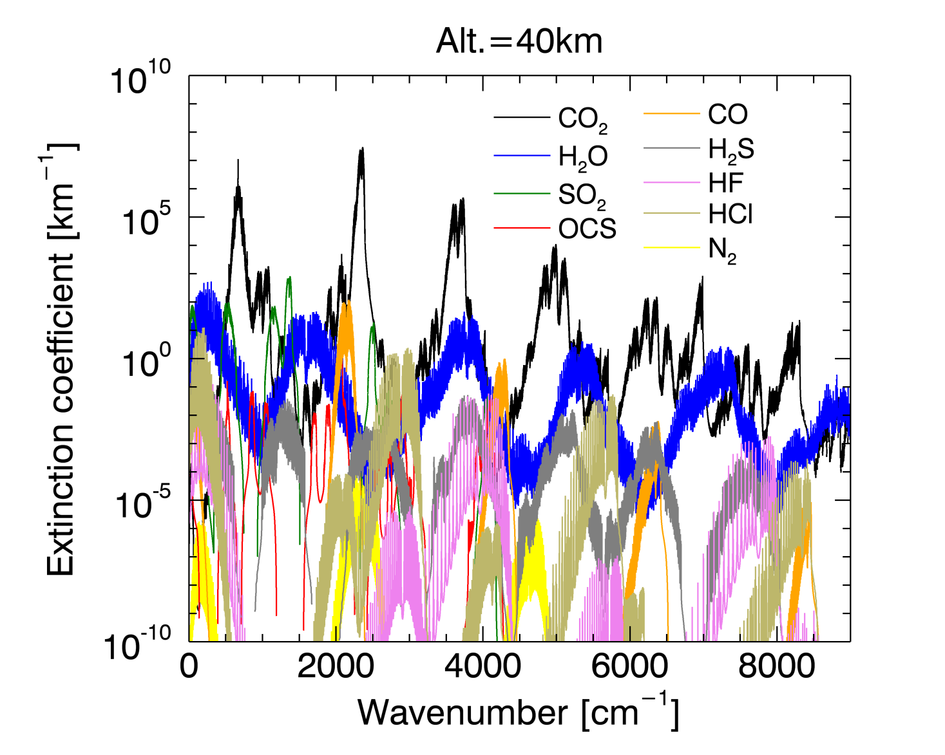
Data and method (2)
Collision-induced absorption (CIA): CO₂ and H₂O
CO₂-CO₂ collision-induced absorptions (CIA) are included
ν <250 cm⁻¹
(Grunszka and Borysow 1997)
1200-1500 cm⁻¹
(Baranov et al. 2004)
2650-3130 cm⁻¹
(Stefani et al 2013)
continua at 1.7 and 2.3 μm (Marcq et al. 2006 and Bezard et al. 1990)
+

Slide 6
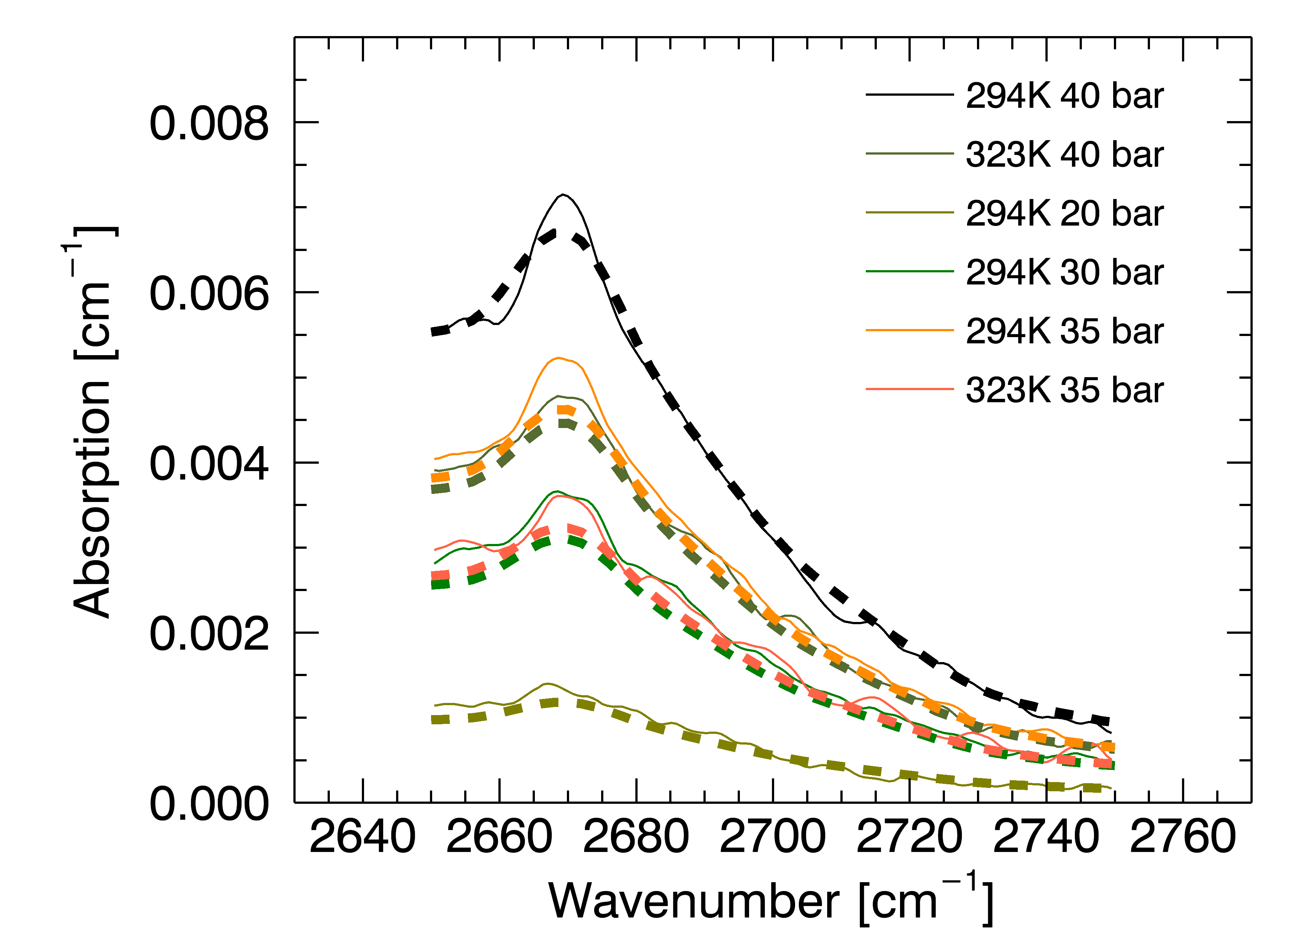
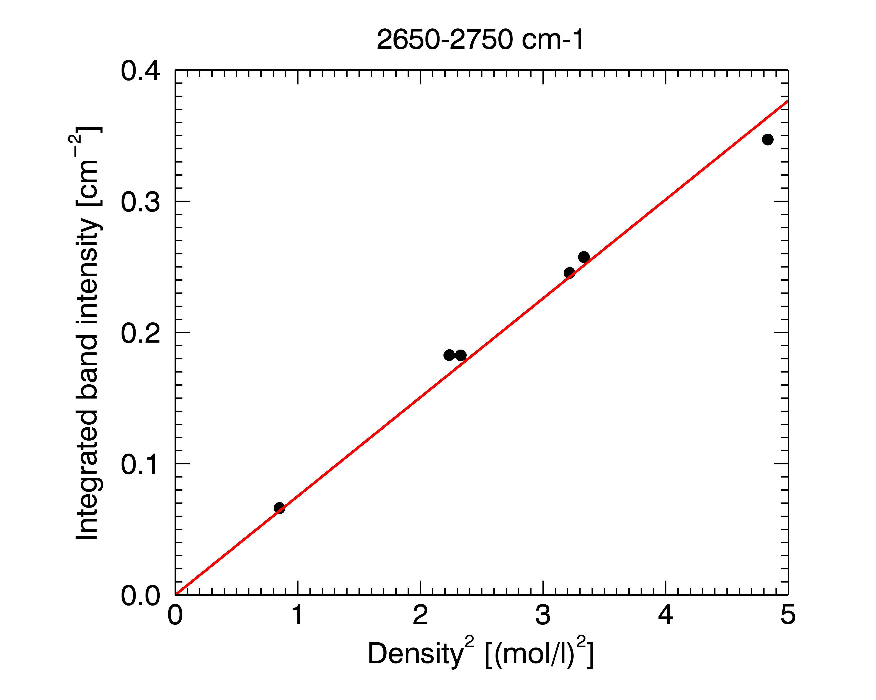
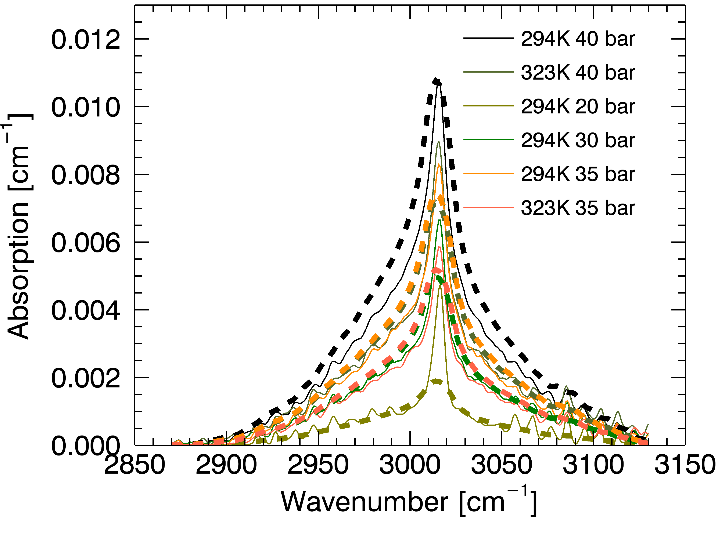
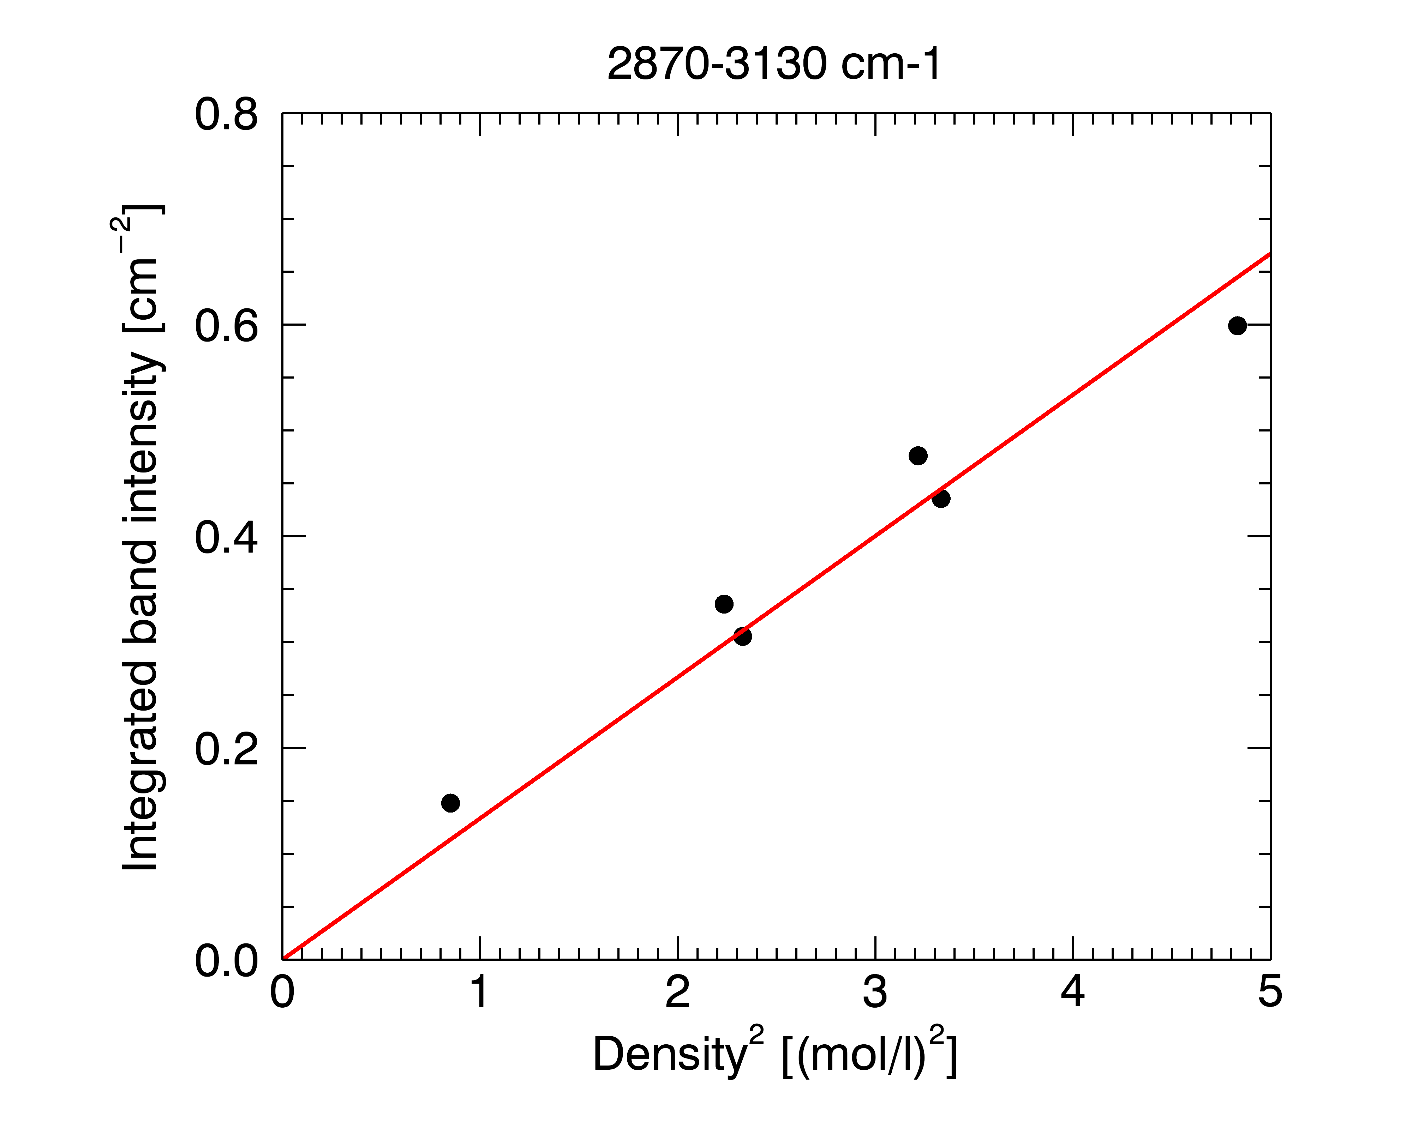

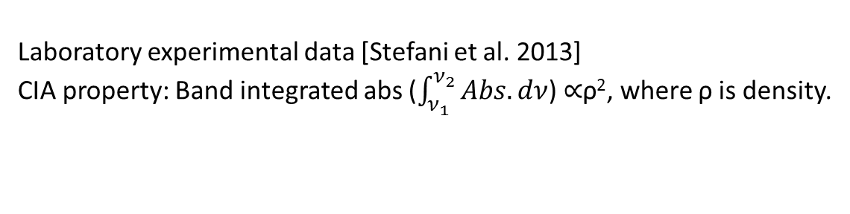
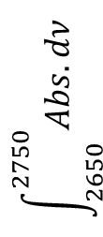

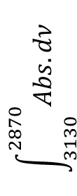
CO₂-CO₂ CIA new data (2650-3130 cm⁻¹)
Laboratory experimental data [Stefani et al. 2013]
CIA property: Band integrated abs ($\int_{ν_{1}}^{ν_{2}}{Abs. dν}$) $∝$ρ², where ρ is density.
$$\int_{2650}^{2750}{Abs. dν}$$
ρ² $(×$10⁶ [mol²/m⁶]))
$$\int_{3130}^{2870}{Abs. dν}$$
ρ² ($×$10⁶ [mol²/m⁶])
ρ²

Slide 7
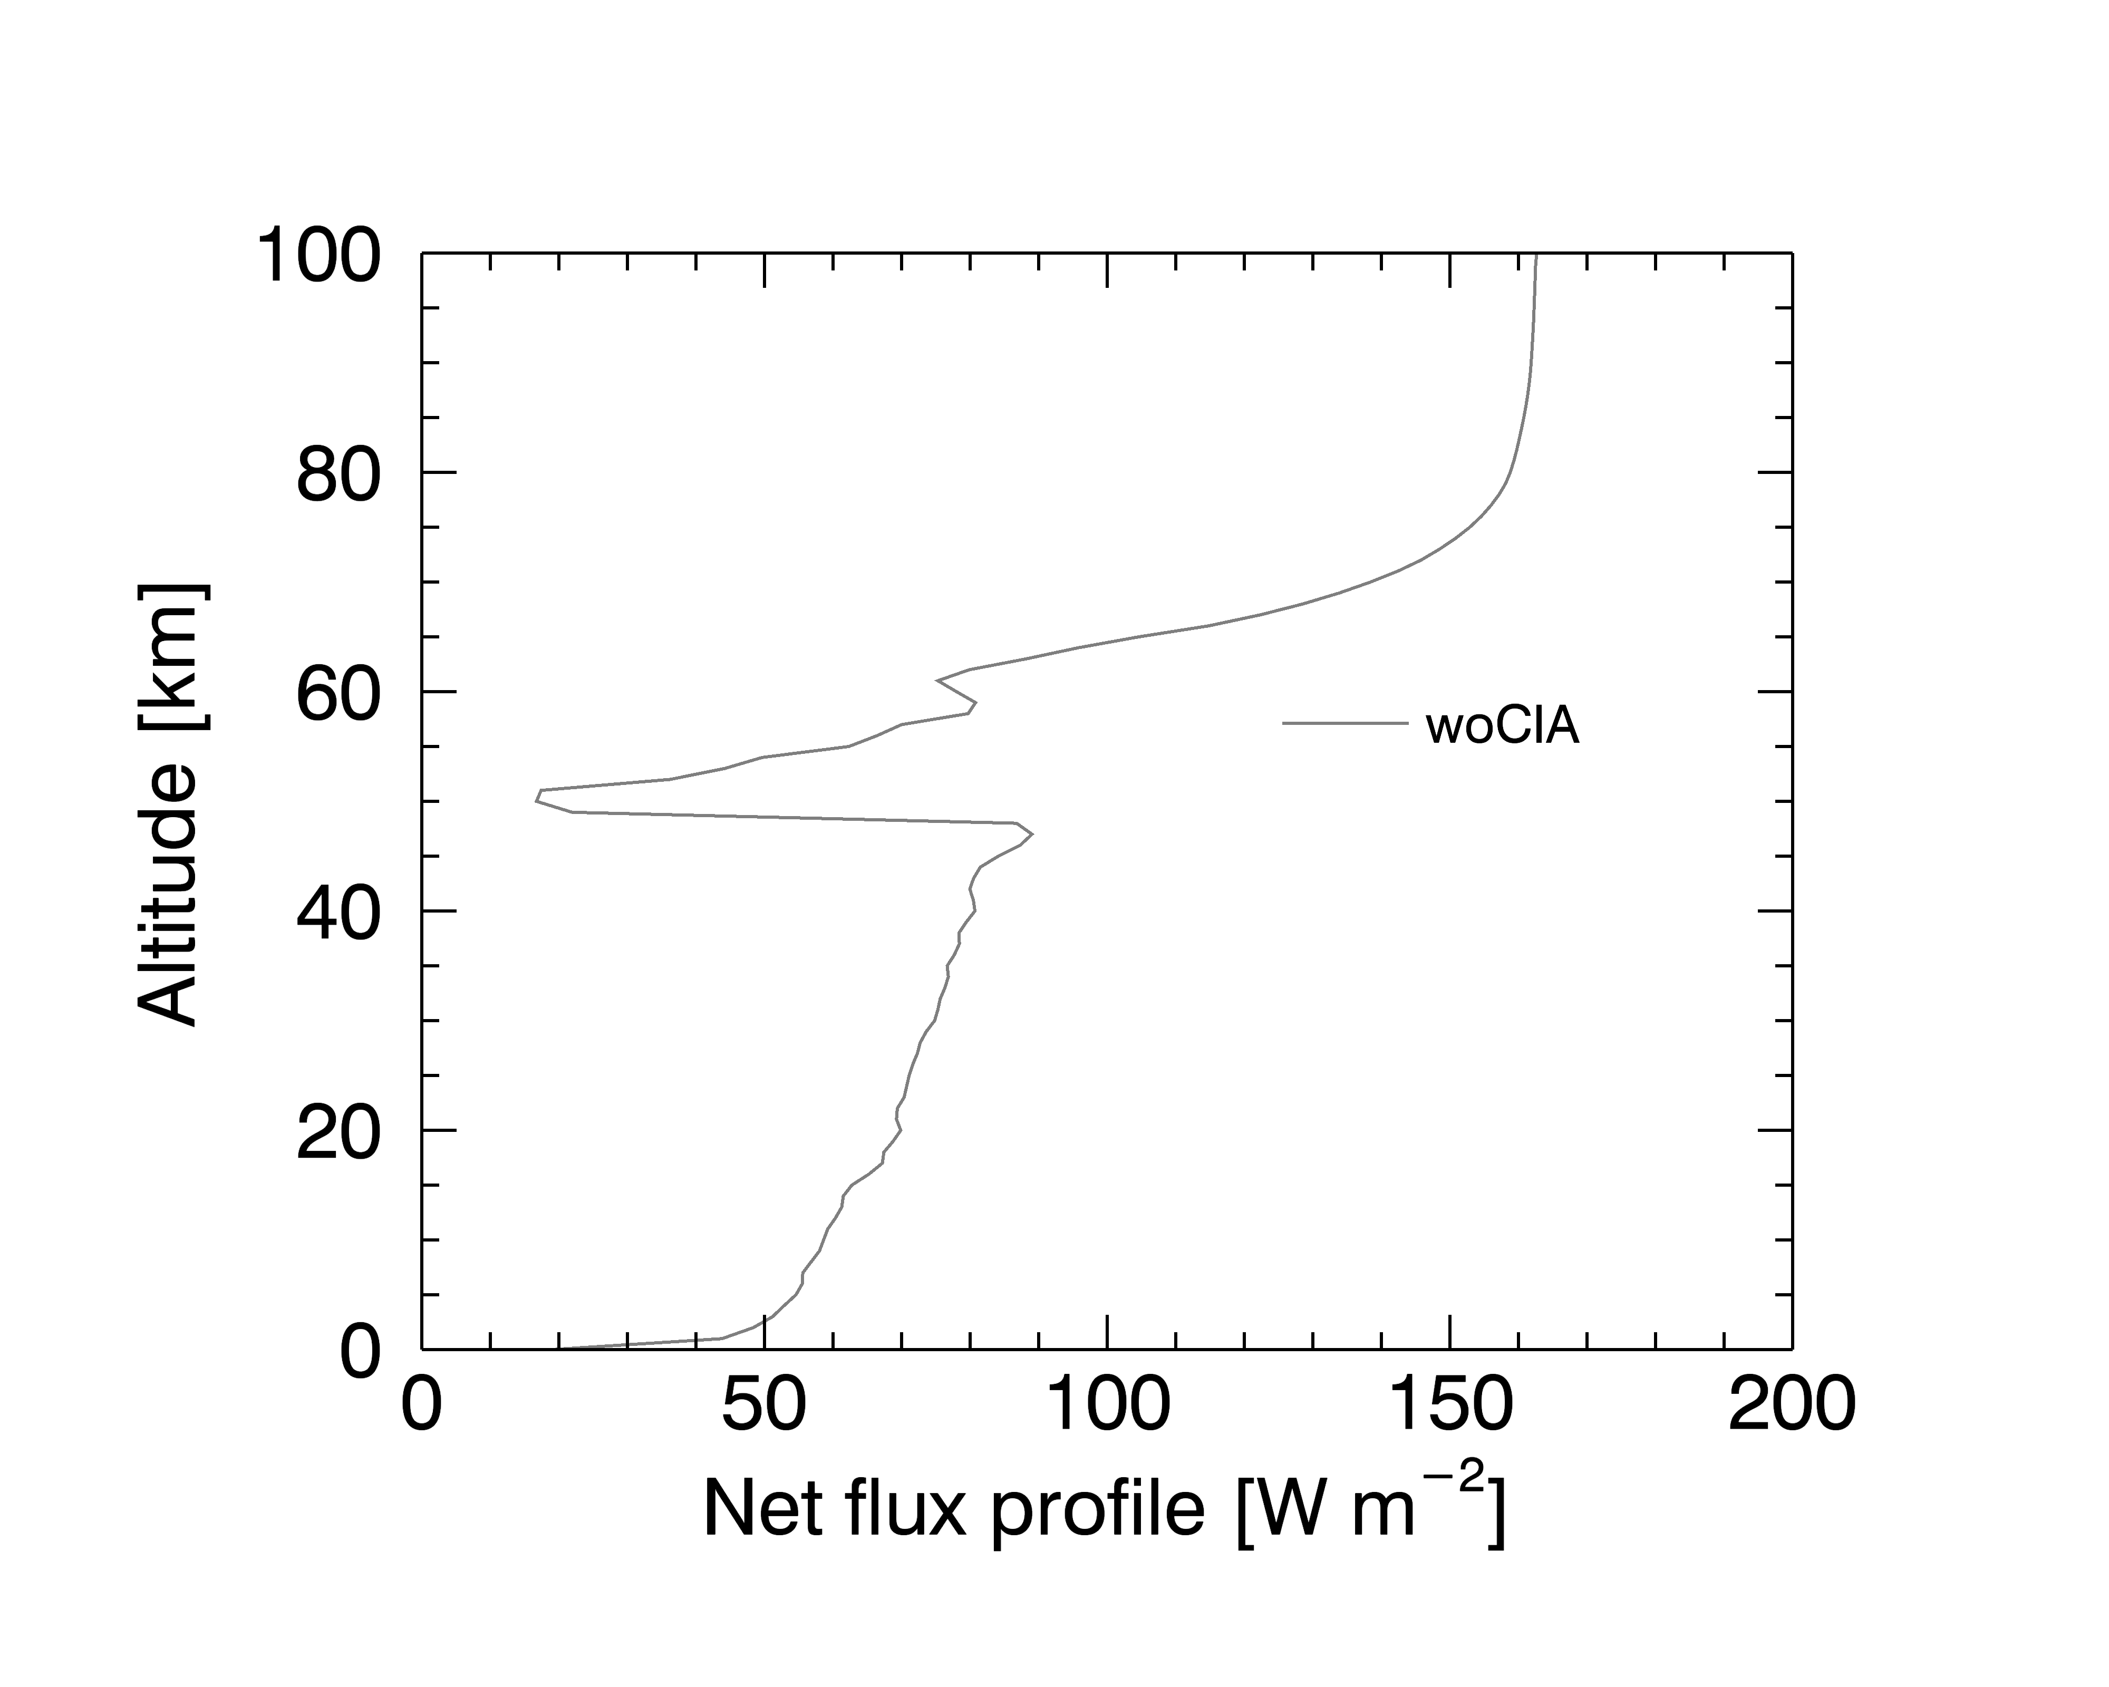
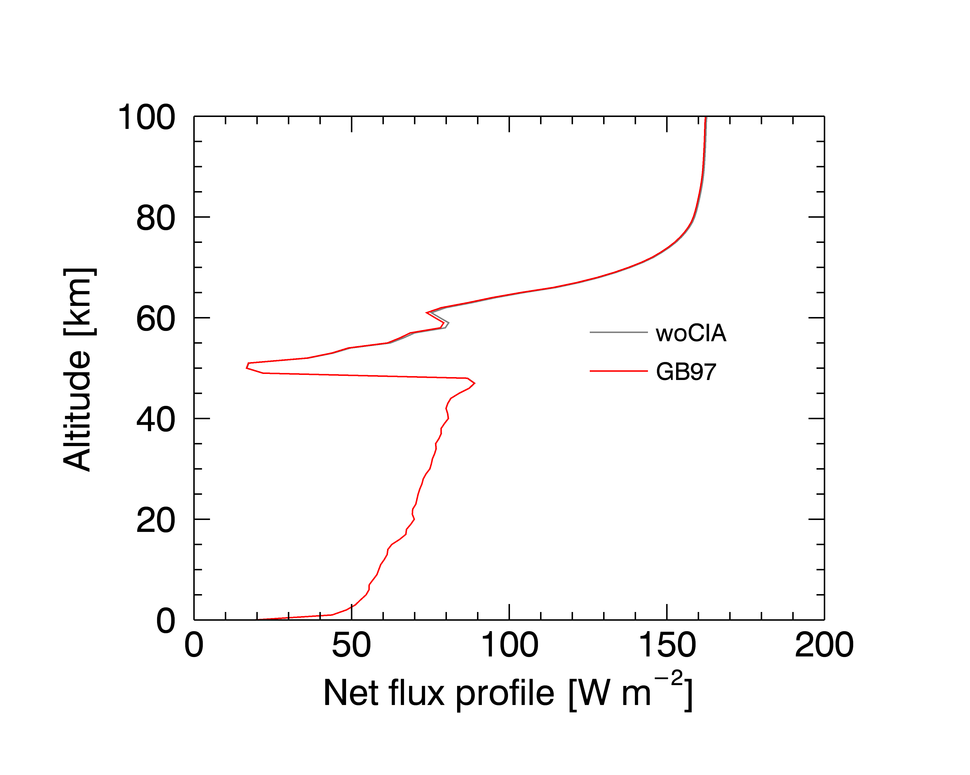
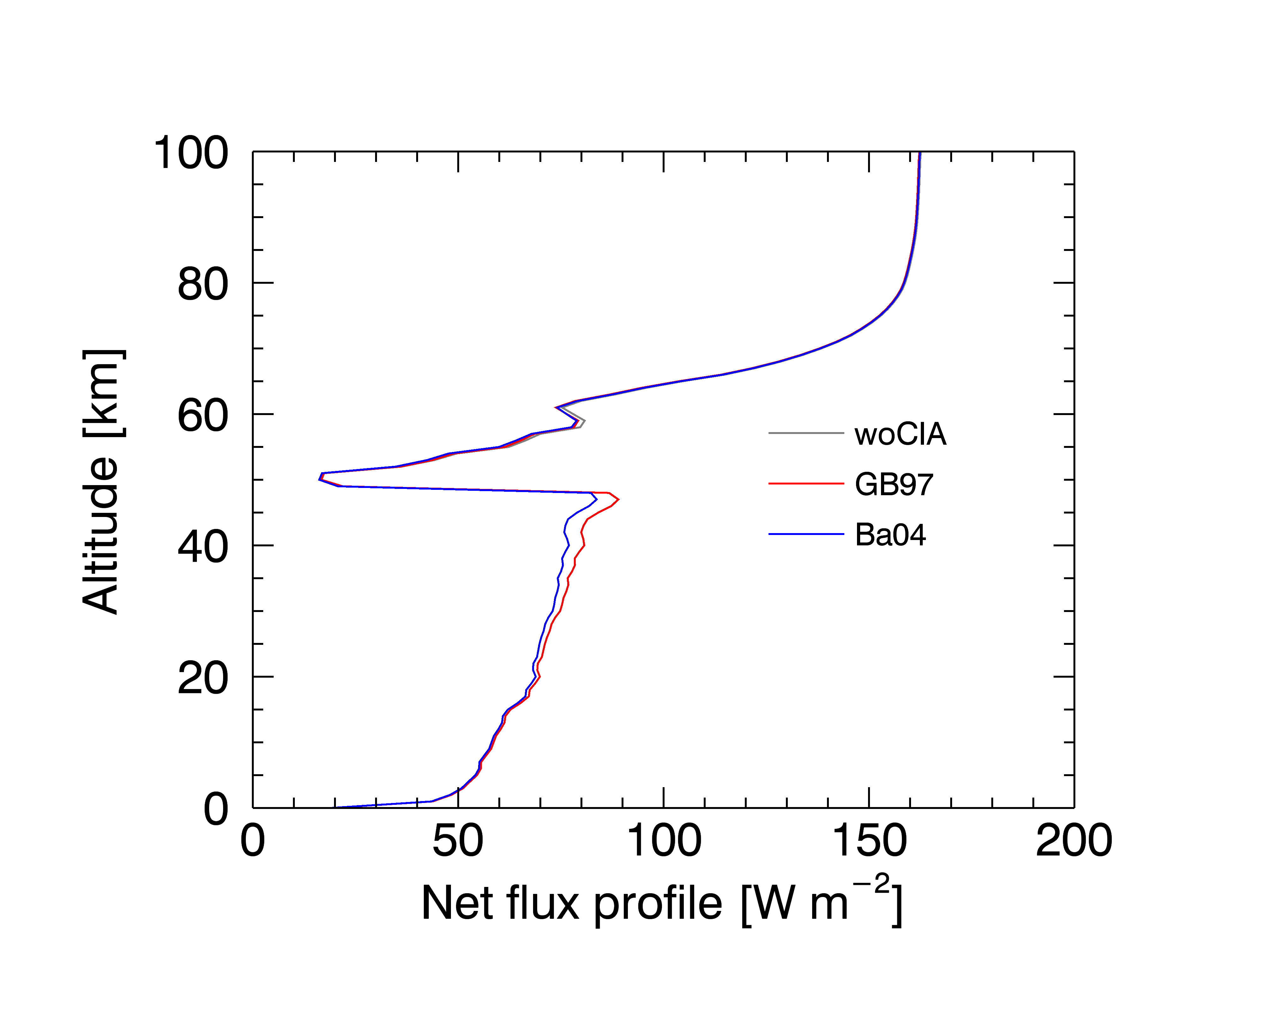
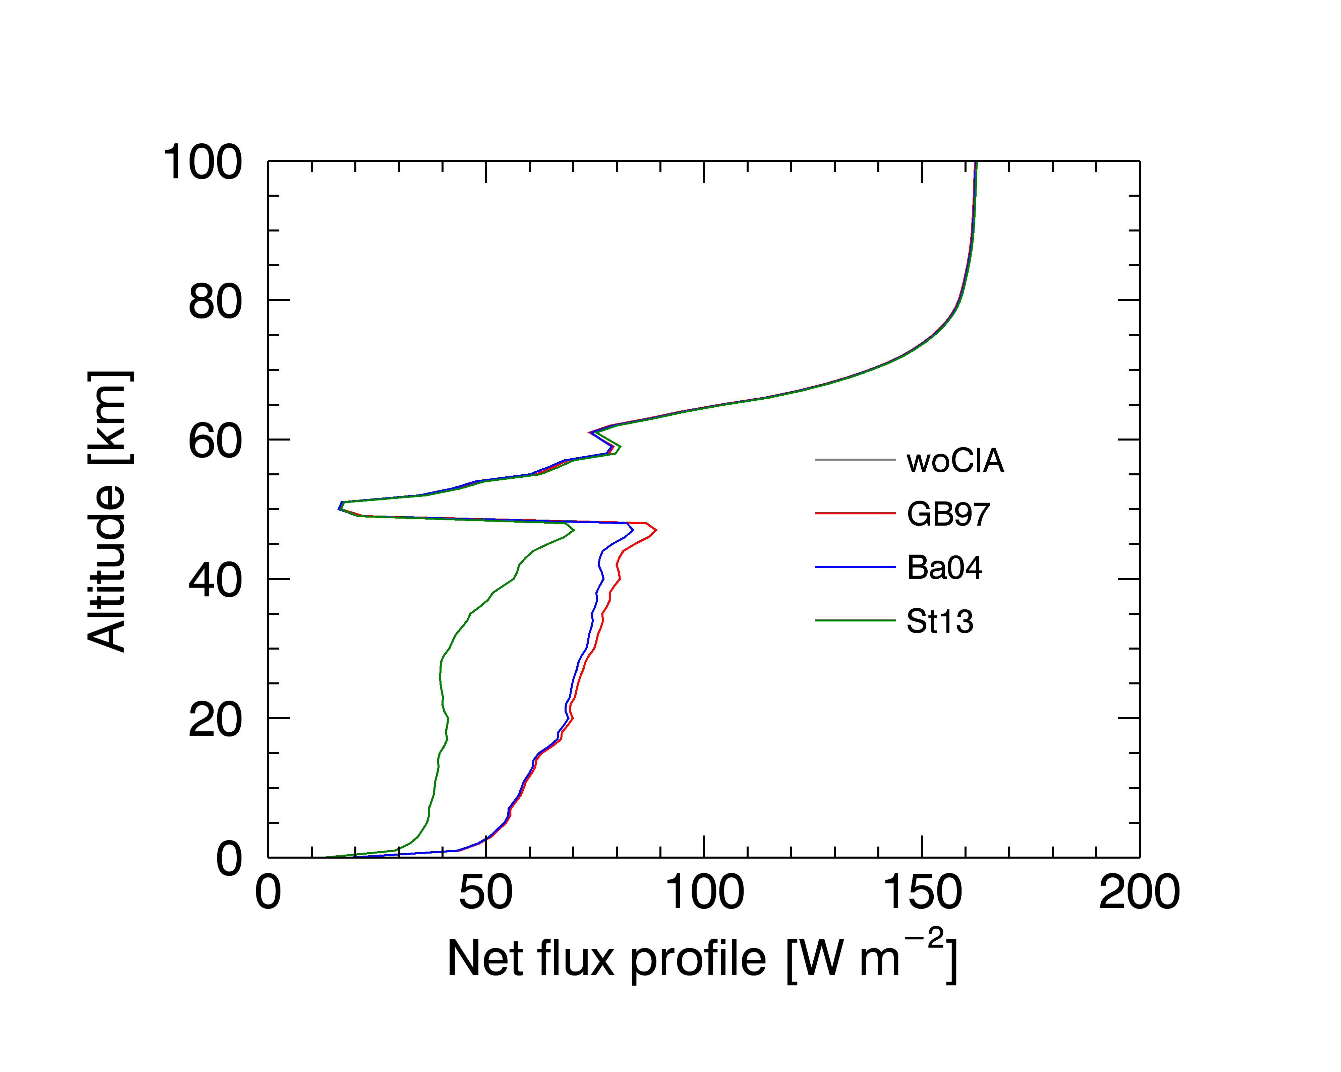
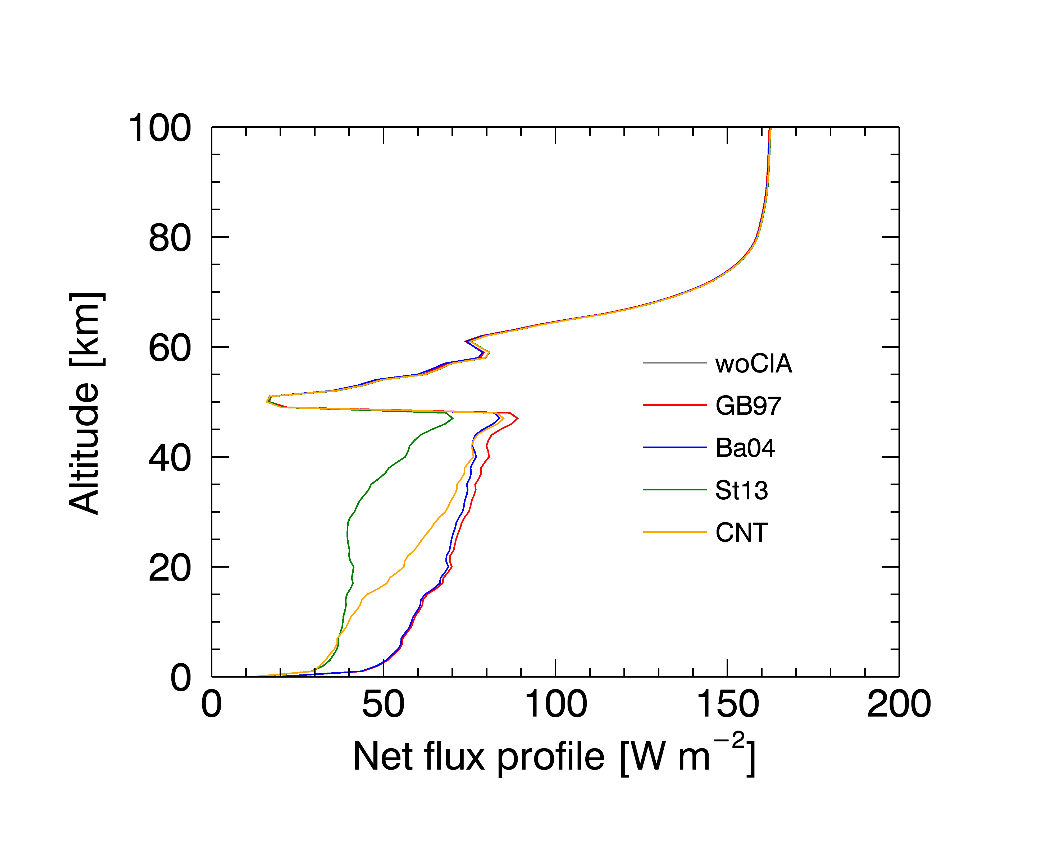
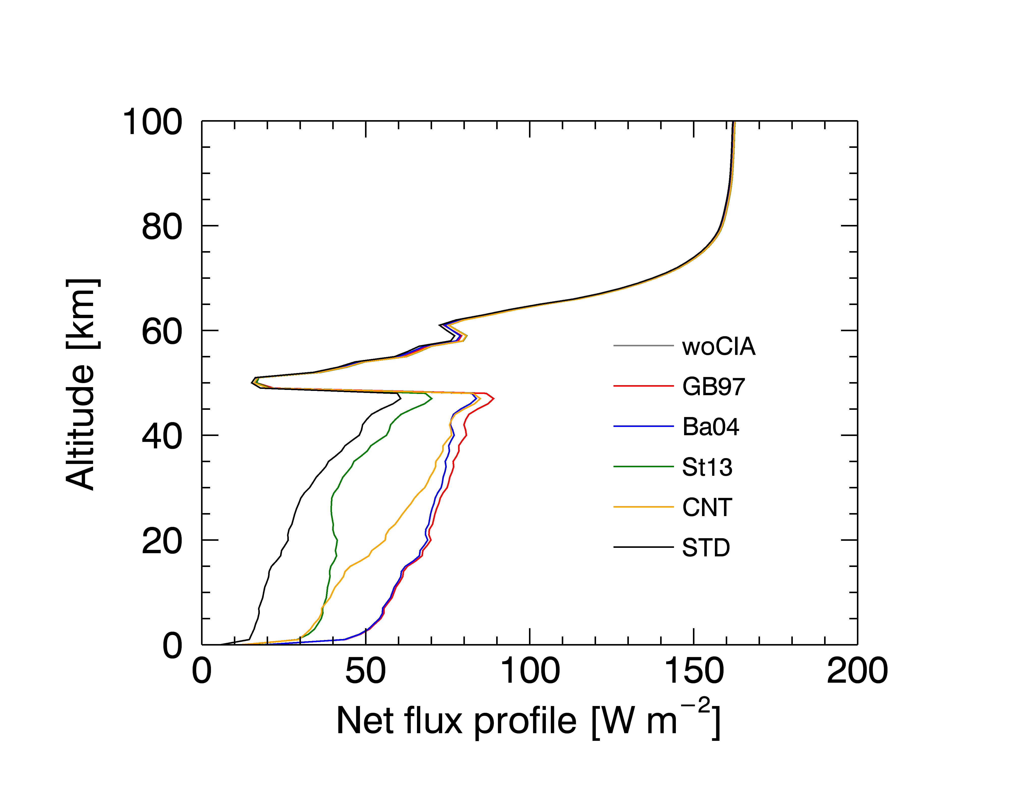
Data and method (4) CO₂
<250 cm⁻¹
<1200-1500 cm⁻¹
New CIA data (this study)
at 2.3 μm and 1.7 μm
all included

Slide 8
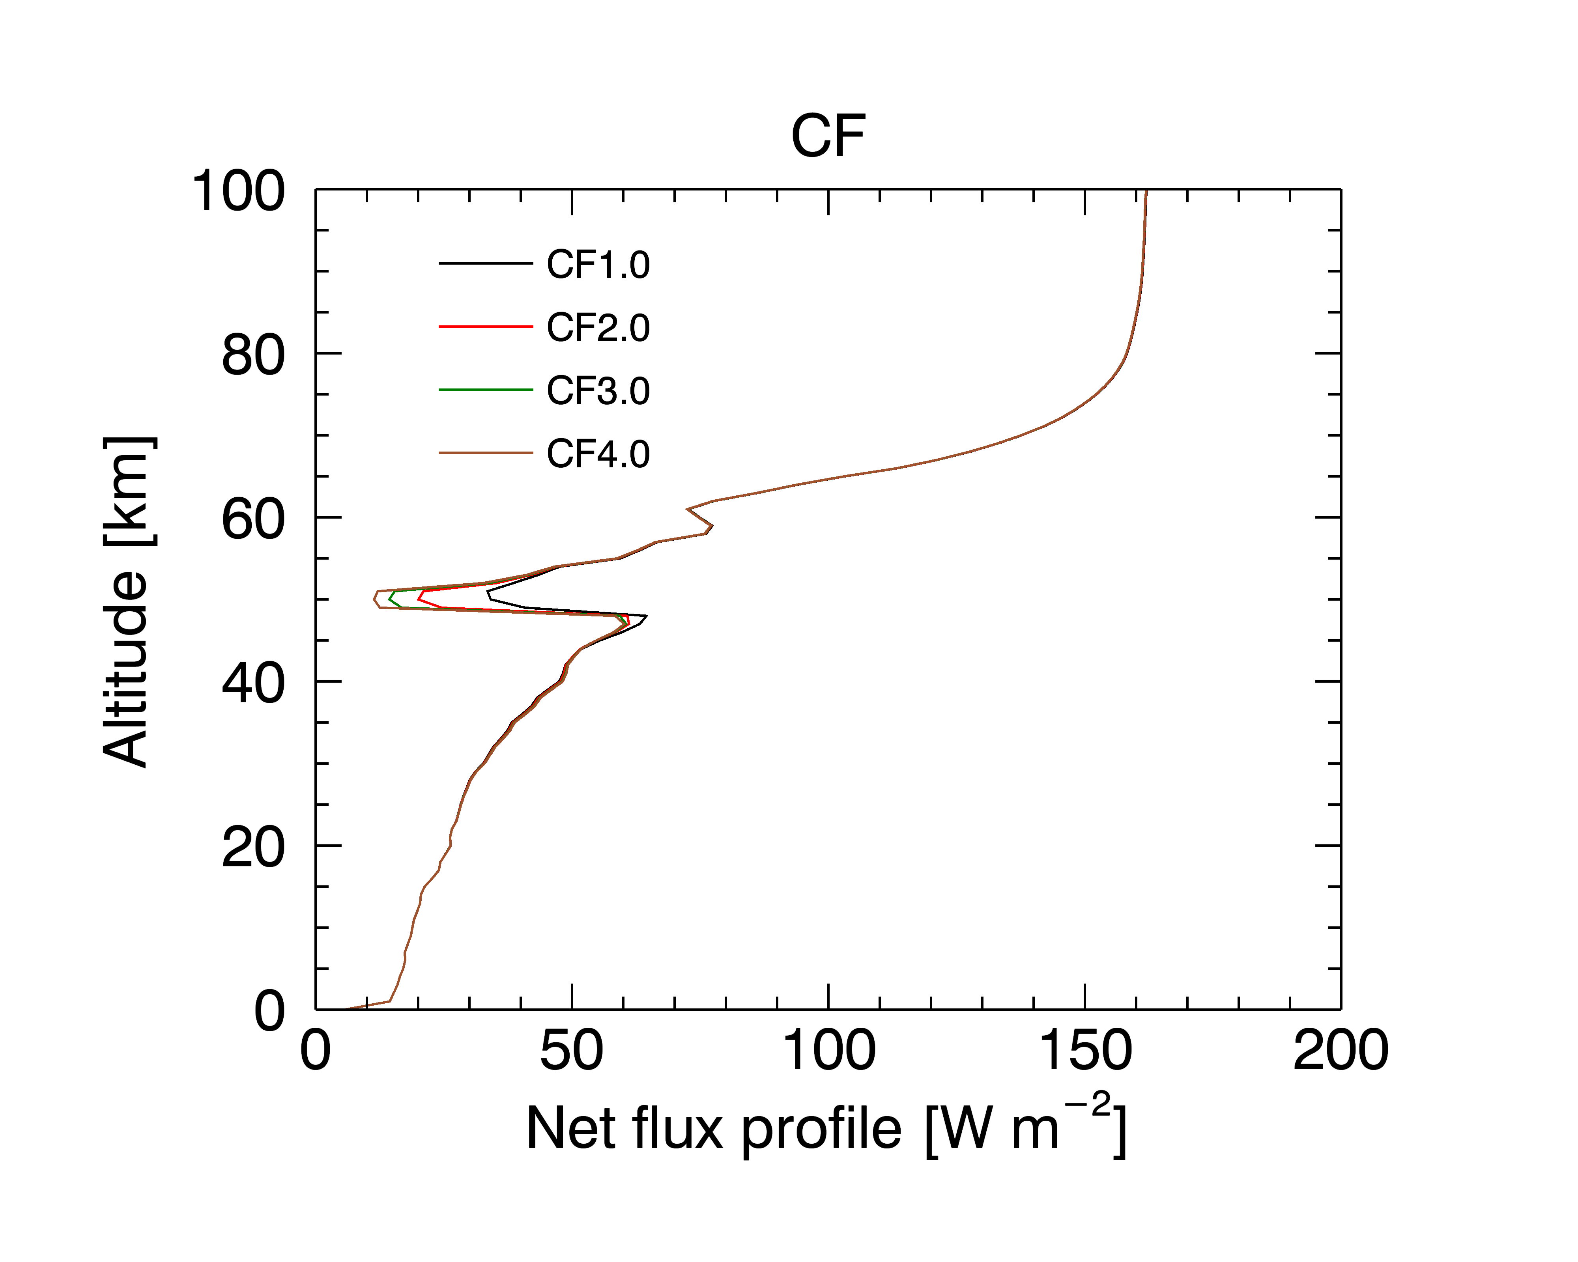
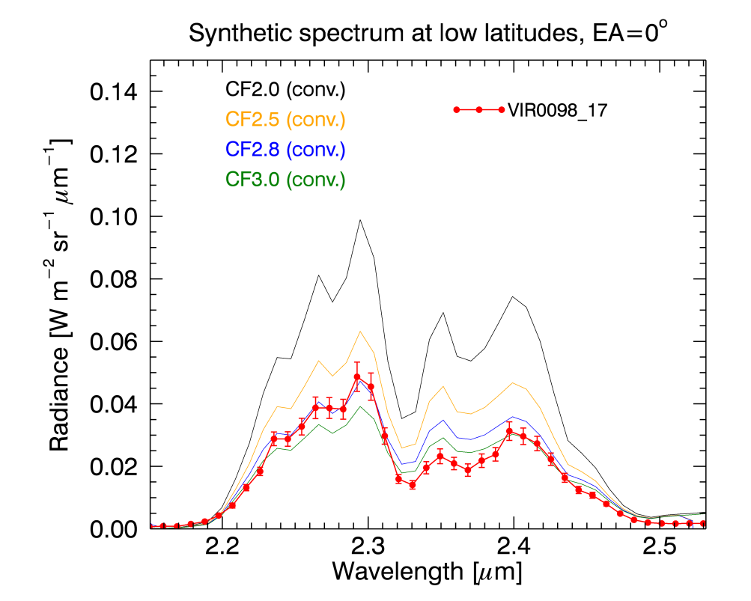
Results (1) Clouds
Cloud models: Haus et al. 2015, Lee et al. 2015, and Crisp 1986
Lower haze
Crisp’s lower clouds’ opacity at 48-50 km is increased by a factor of 1-4 (CF1 – CF4).
CF2.8 became our ‘STD’, which reproduces observation reasonably.
(VIRTIS-M)

Slide 9
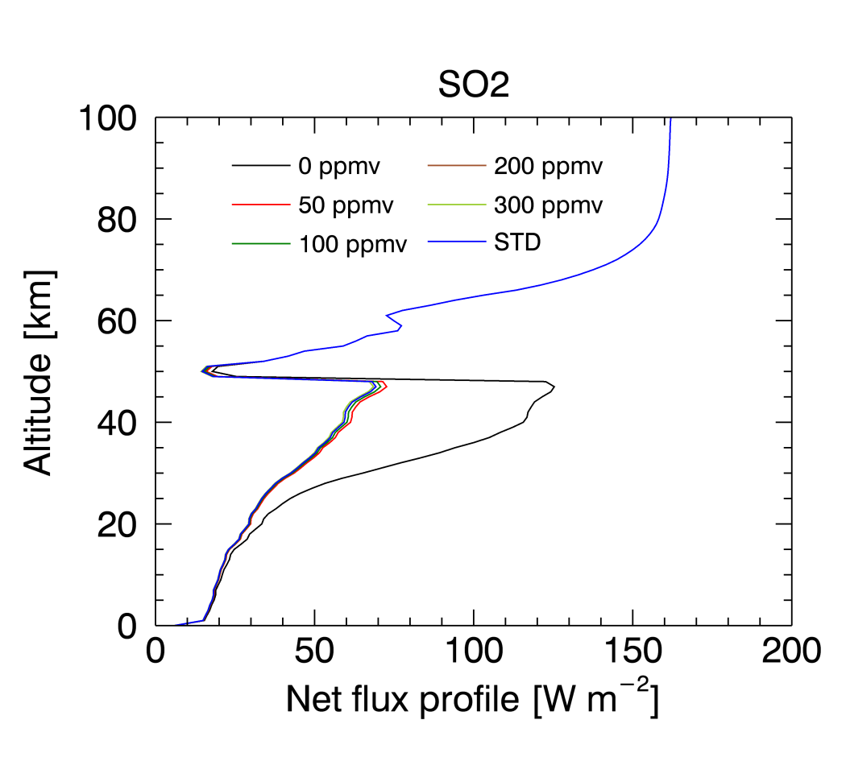
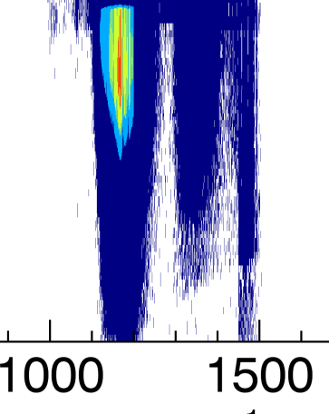
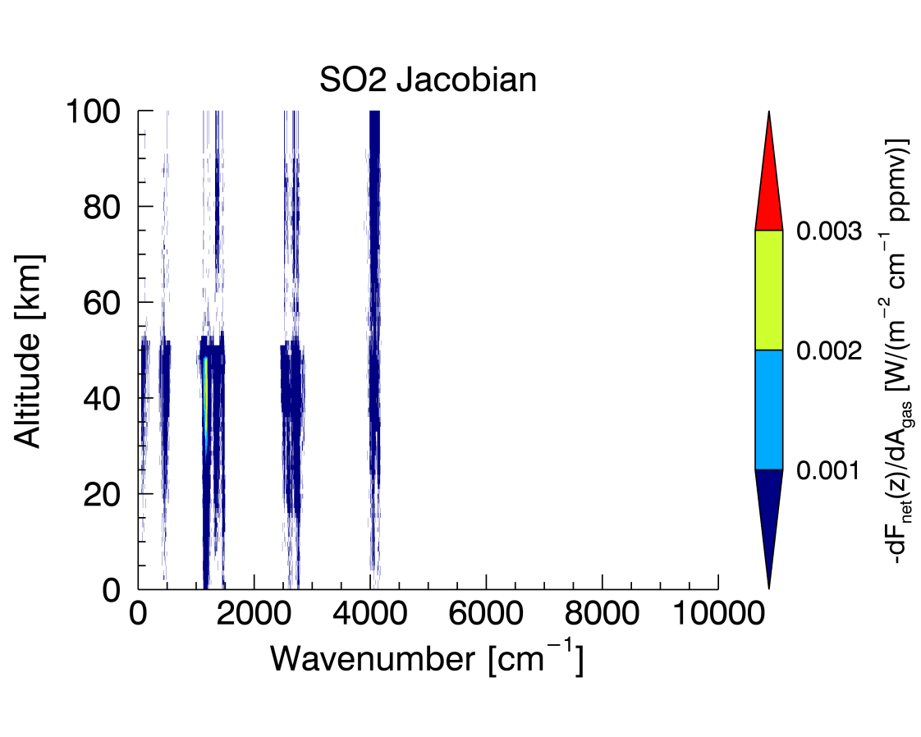
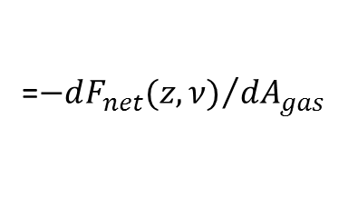
Results (2) Minor gases
SO₂ 0-300 ppmv (z<52 km)
=${−dF_{net}(z,ν)}/{dA_{gas}}$
Monochromatic sensitivity on SO₂

Slide 10
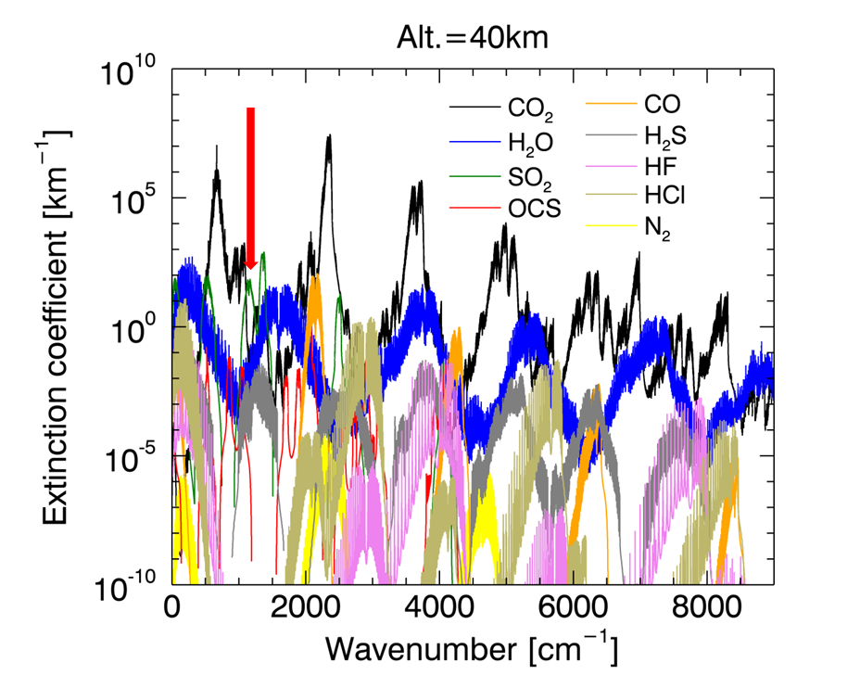
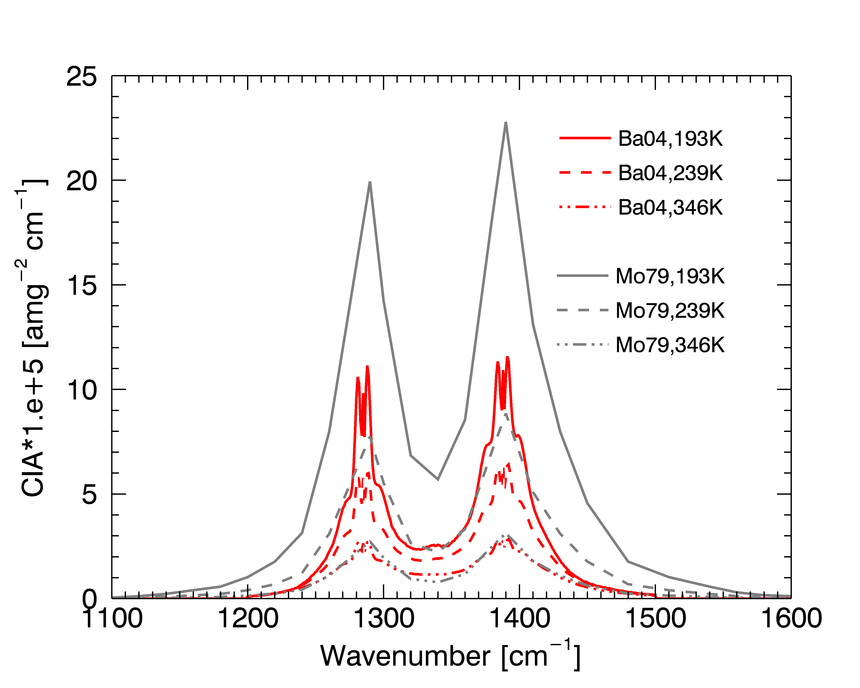
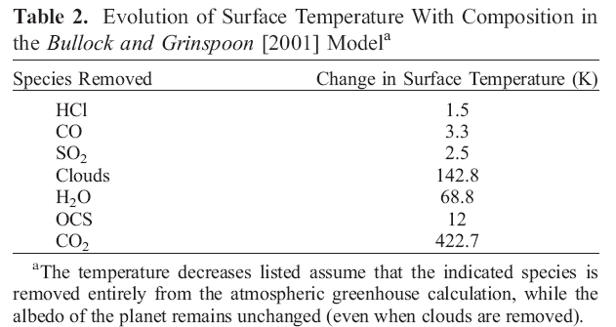
Influence of SO₂
(Baranov et al. 2004)
(Moskalenko
et al. 1979)
[Taylor and Grinspoon, 2009]

Slide 11
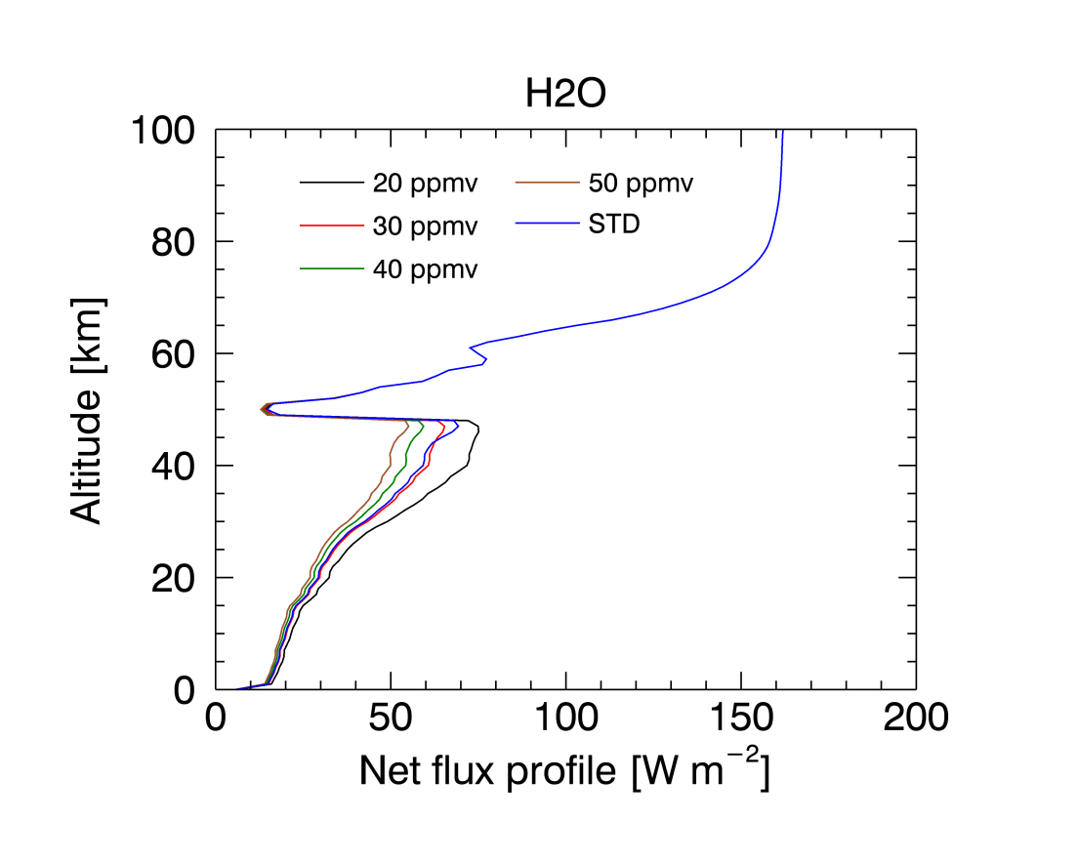
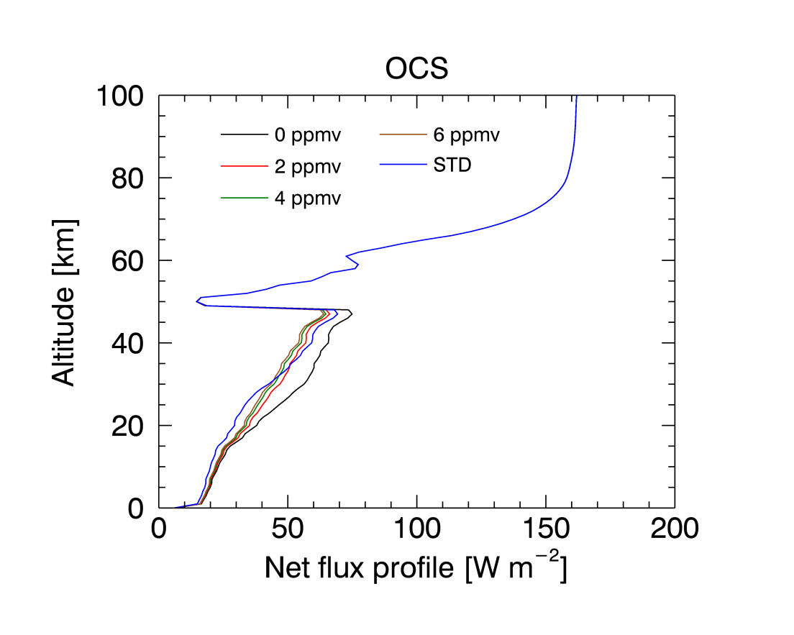
Results (2) Minor gases
H₂O and OCS
H₂O 20-50 ppmv (z<52 km) OCS 0-6 ppmv (z<52 km)

Slide 12
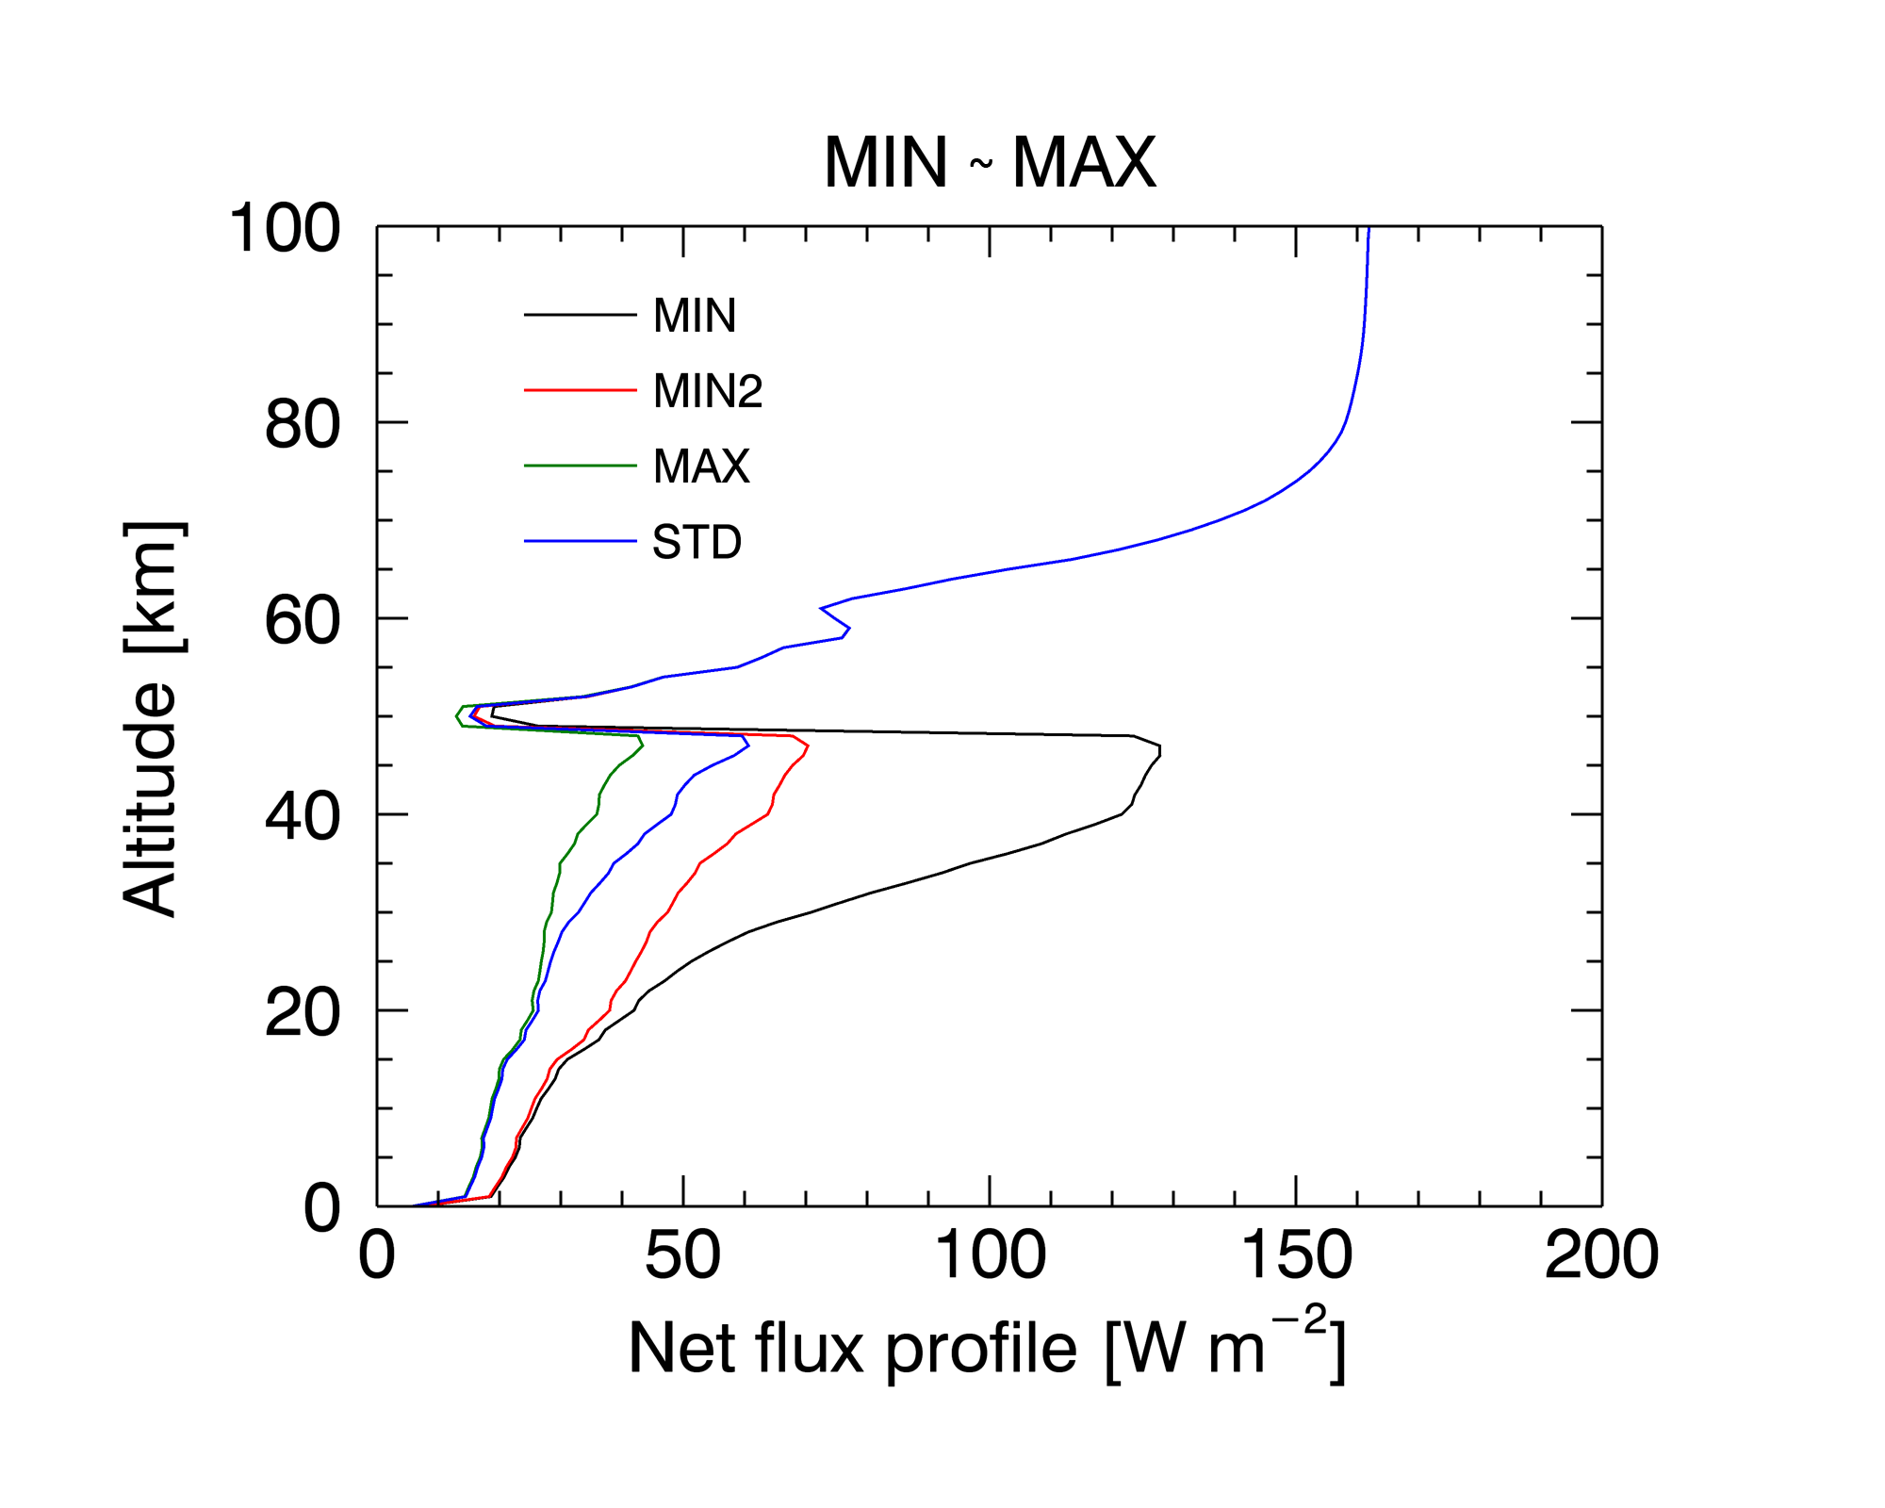
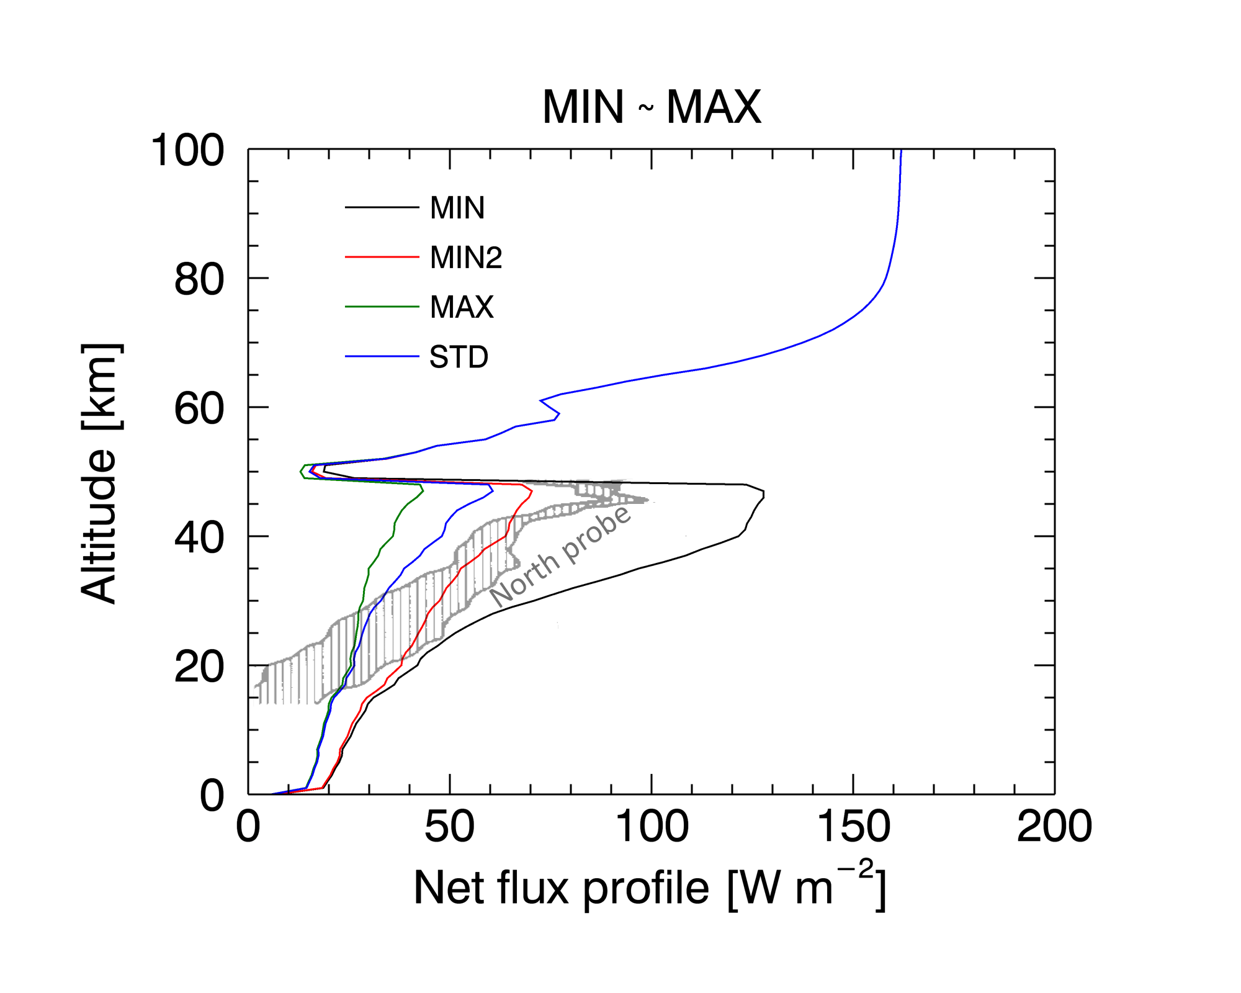
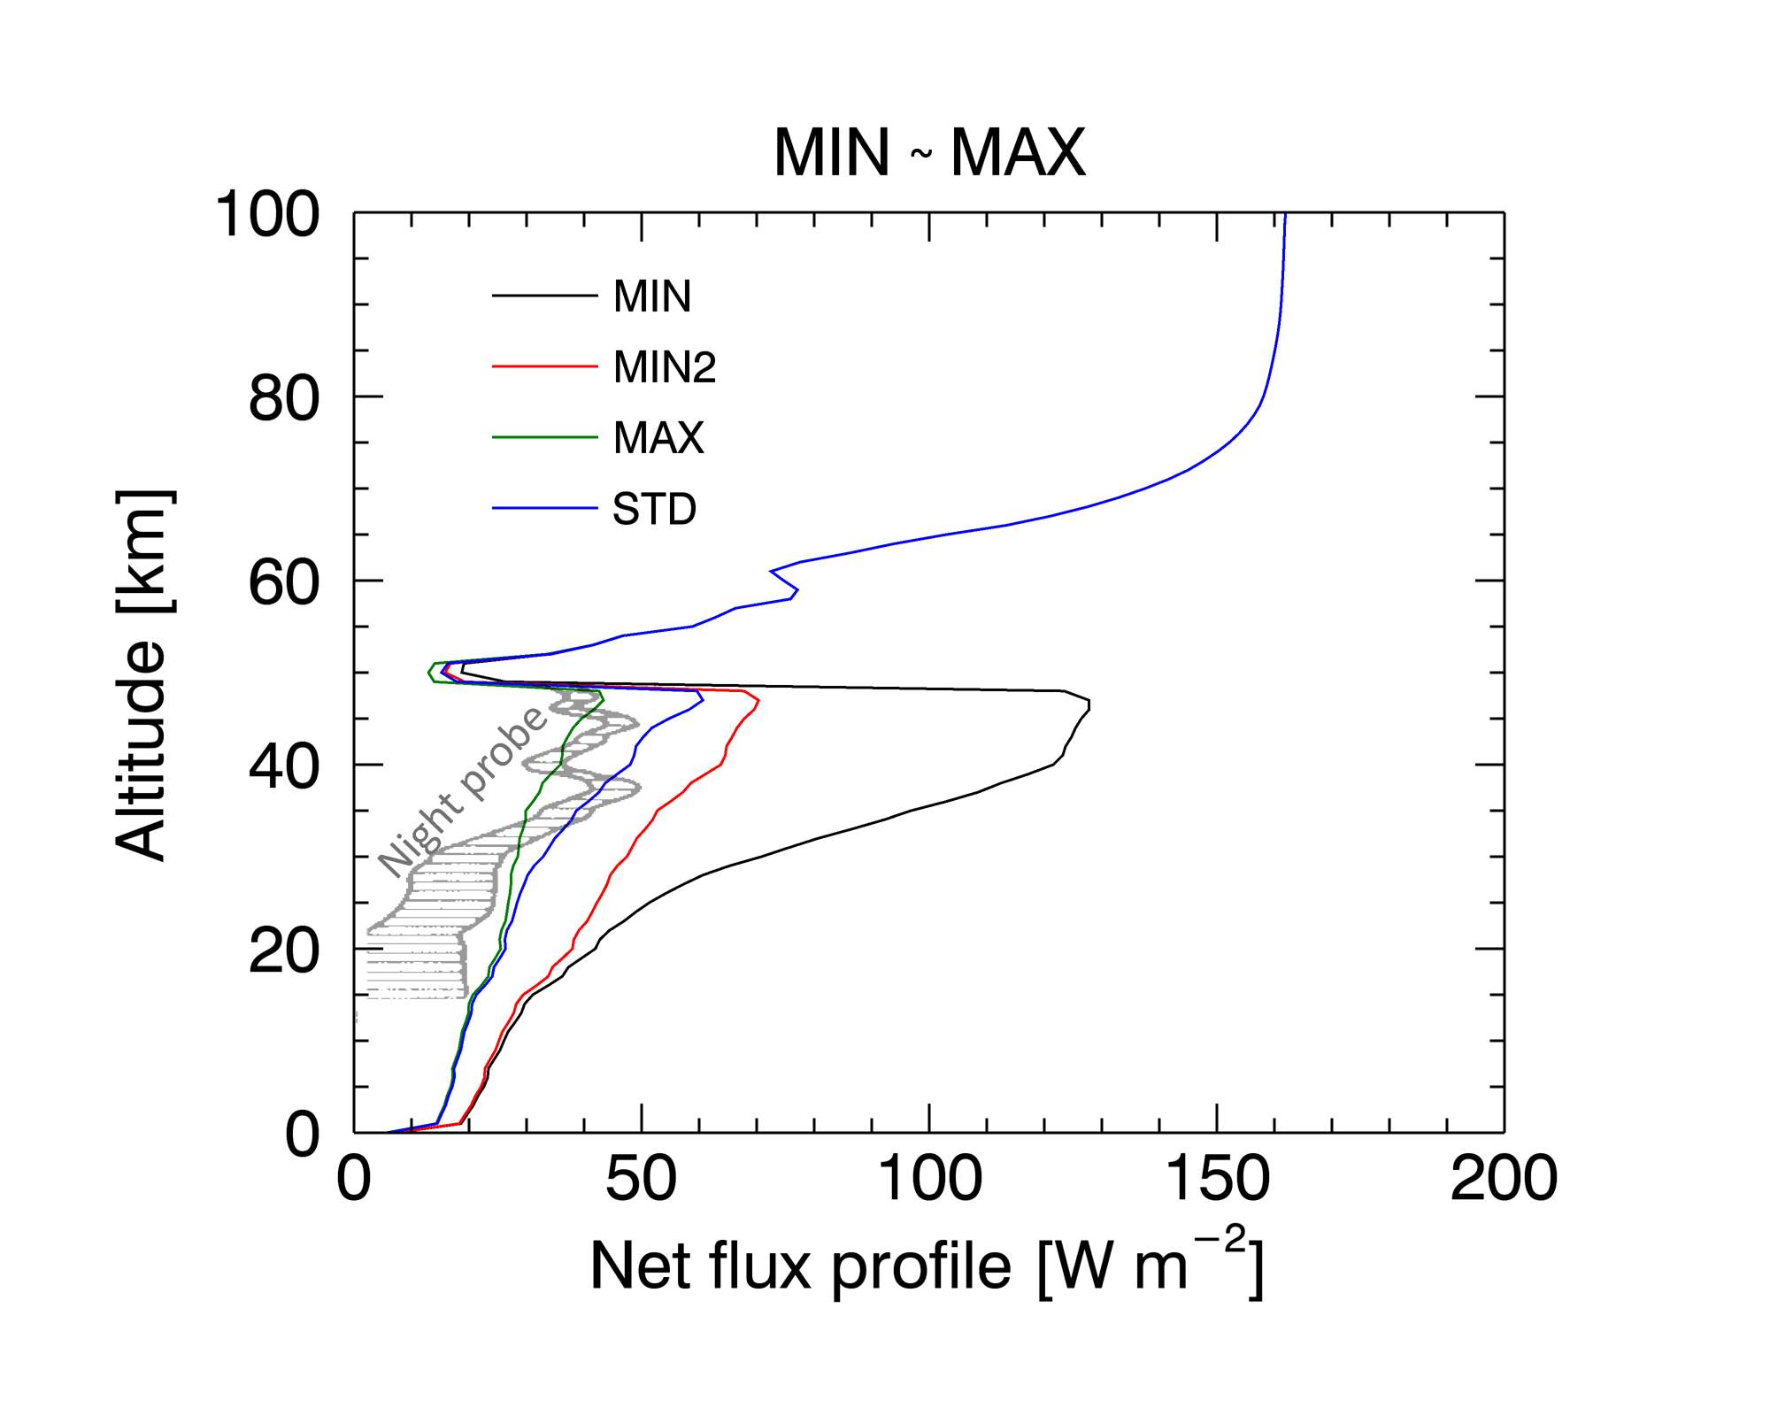
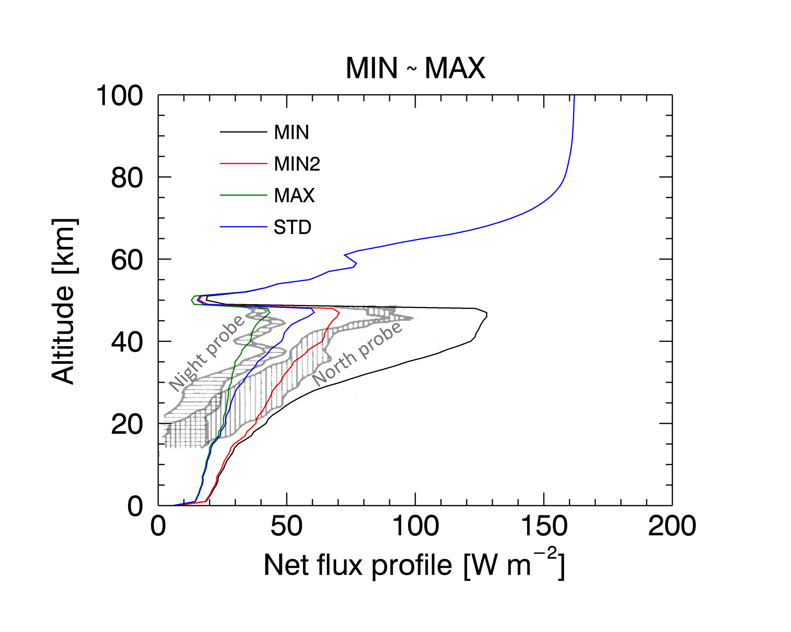
Results (3) Minimum and Maximum minor gases’ abundances
MIN: H₂O 20 ppmv, SO₂ 0 ppmv, CO 10 ppmv, OCS 0 ppmv (z< 52 km)
MIN2: Same as MIN, but SO₂ 80 ppmv (z< 52 km)
MAX: H₂O 50 ppmv, SO₂ 300 ppmv, CO 50 ppmv, OCS 5 ppmv (z< 52 km)
Revercomb et al. (1985) used 100-200 ppmv water vapor.
But the observed range of H₂O abundance (20-50 ppmv) is sufficient to simulate the in-situ measurement data.

Slide 13
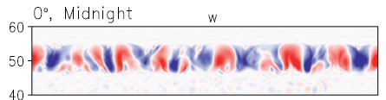
Results (3) Minimum and Maximum minor gases’ abundances
MIN: H₂O 20 ppmv, SO₂ 0 ppmv, CO 10 ppmv, OCS 0 ppmv (z< 52 km)
MIN2: Same as MIN, but SO₂ 80 ppmv (z< 52 km)
MAX: H₂O 50 ppmv, SO₂ 300 ppmv, CO 50 ppmv, OCS 5 ppmv (z< 52 km)
Poster #11
Note that the thermal heating would be altered significantly → Cloud level convection [Baker et al.1998]
[km]
[Imamura et al. 2013]

Slide 14
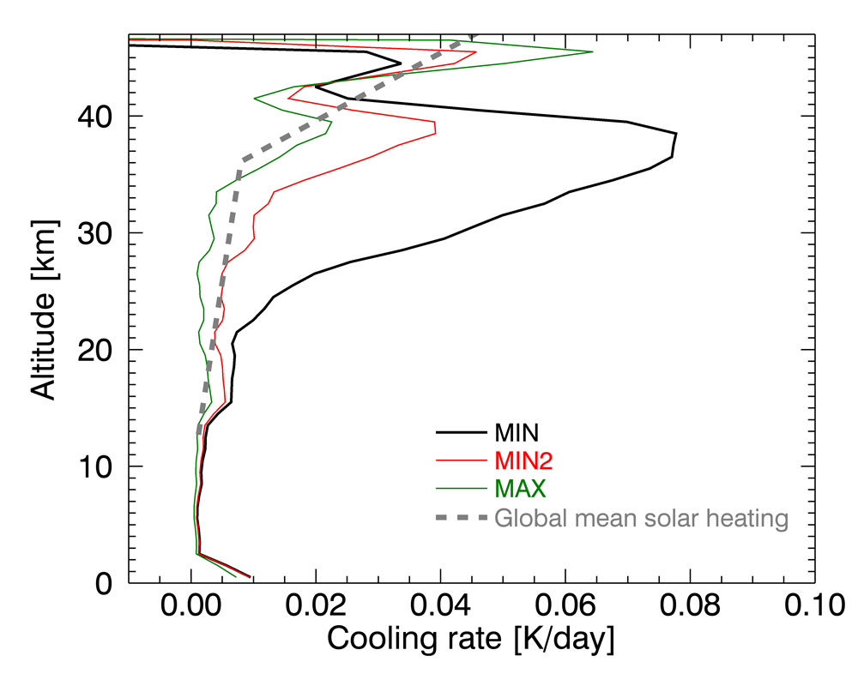
Results (3) Minimum and Maximum minor gases’ abundances
MIN: H₂O 20 ppmv, SO₂ 0 ppmv, CO 10 ppmv, OCS 0 ppmv (z< 52 km)
MIN2: Same as MIN, but SO₂ 80 ppmv (z< 52 km)
MAX: H₂O 50 ppmv, SO₂ 300 ppmv, CO 50 ppmv, OCS 5 ppmv (z< 52 km)
(Tomasko 1985)

Slide 15
Summary
We calculated thermal flux of Venus from 0 km to 100 km altitude.
The in-situ net thermal flux profiles are successfully simulated using the observed range of minor gaseous abundances.
Sensitivity of net thermal flux on minor gases abundance below the clouds:
  Important opacity sources are SO₂ (0-300 ppm), H₂O (20-50 ppm, but high potential), OCS.
  Weak influences from clouds, lower haze, HCl, and CO.
  All cases do not affect net thermal flux above the clouds.
Further studies: Solar heating comparison, cloud level convection with variable thermal heating at the cloud bottom, volcanic degassing effects on the atmosphere.
The result will be submitted very soon.

