Slide 1

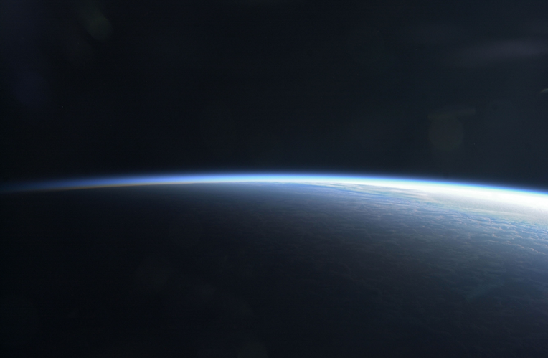

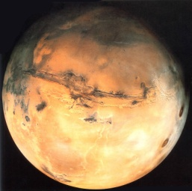
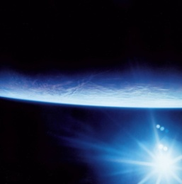

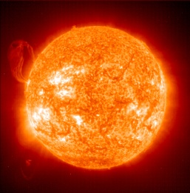

Neutral composition of the Venus atmosphere measured by SPICAV/SOIR on board VEX: a compendium
KONINKLIJK BELGISCH INSTITUUT VOOR RUIMTE-AERONOMIE INSTITUT ROYAL D’AERONOMIE SPATIALE DE BELGIQUE ROYAL BELGIAN INSTITUTE OF SPACE AERONOMY KONINKLIJK BELGISCH INSTITUUT VOOR RUIMTE-AERONOMIE INSTITUT ROYAL D’AERONOMIE SPATIALE DE BELGIQUE ROYAL BELGIAN INSTITUTE OF SPACE AERONOMY KONINKLIJK
A.C. Vandaele, A. Mahieux, V. Wilquet, S. Chamberlain, B. Ristic,
S. Robert, I.R. Thomas, L. Trompet, and J.-L. Bertaux
(1) Royal Belgian Institute for Space Aeronomy (BIRA-IASB), Brussels, Belgium
(2) LATMOS, Paris, France
KONINKLIJK BELGISCH INSTITUUT VOOR RUIMTE-AERONOMIE INSTITUT ROYAL D’AERONOMIE SPATIALE DE BELGIQUE ROYAL BELGIAN INSTITUTE OF SPACE AERONOMY KONINKLIJK BELGISCH INSTITUUT VOOR RUIMTE-AERONOMIE INSTITUT ROYAL D’AERONOMIE SPATIALE DE BELGIQUE ROYAL BELGIAN INSTITUTE OF SPACE AERONOMY KONINKLIJK

Slide 2
Outline
The SOIR instrument
SOIR thermal profiles
Trace gases
  SO₂
  HCl, HF
  CO
  H₂O/HDO
Aerosols: Wilquet et al. (Poster Session 1)
Last updates to the PSA

Slide 3
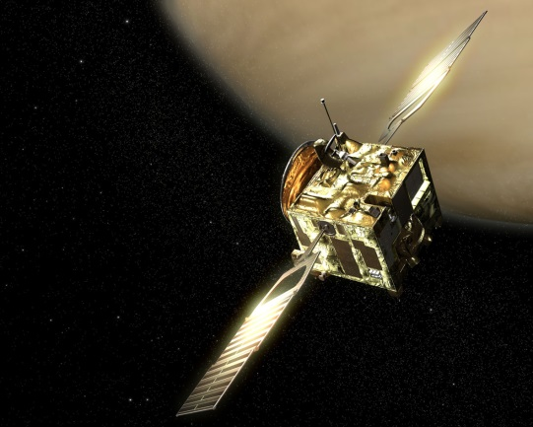
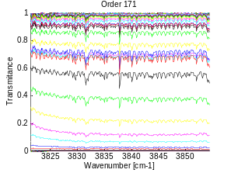
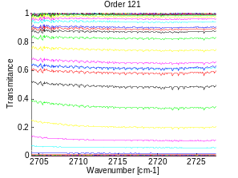
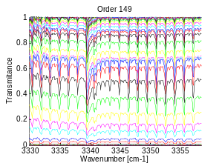
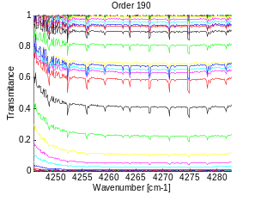
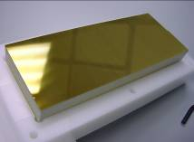
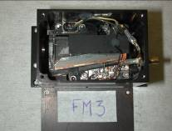
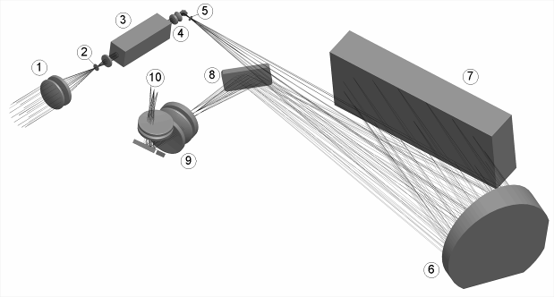
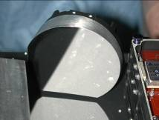
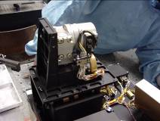
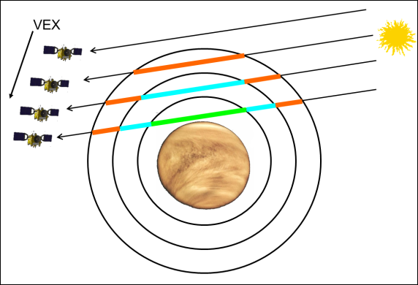
The SOIR instrument
Venus Express (VEx) - ESA
  Launch in Baikonur in 2006
  End in Dec. 2014
SOIR spectrometer
  Channel of SPICAV/SOIR on VEx
  Echelle grating + AOTF
  2200 cm⁻¹ to 4400 cm⁻¹ (2.2 µm to 4.4 µm)
  Divided in 94 diffracting orders
  Order width: 20 to 37 cm⁻¹
  Spectral resolution: 0.1 to 0.25 cm⁻¹
Measures 4 orders per second during an occultation
AOTF
Echelle grating
Collimation and camera lens together in 1 parabolic mirror
Detector optics
and detector

Slide 4
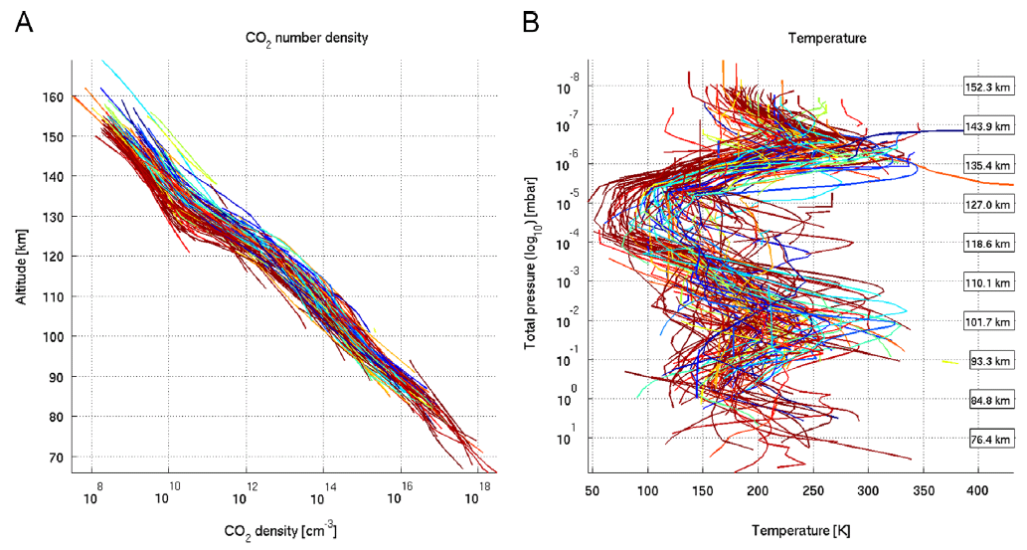
SOIR thermal profiles: Introduction
SOIR measures the CO₂ number density between 70 and 170 km (at max)
  Measured in different wavelength regions simultaneously
  In each wavelength domain, atmospheric saturation is accounted for
  Profiles from 4 wavelength domains are joined using a moving average procedure
The temperature is derived assuming the hydrostatic equilibrium
  The top boundary condition is set to
    VAST model if z_{top} < 140 km
    dT/dz = 0 if z_{top} > 140 km
All profiles present the same vertical, with a
succession of warm and cold layers
A very large variability is observed with time
on the short term
  Weak dependence with terminator side
  Weak dependence with the latitude

Slide 5
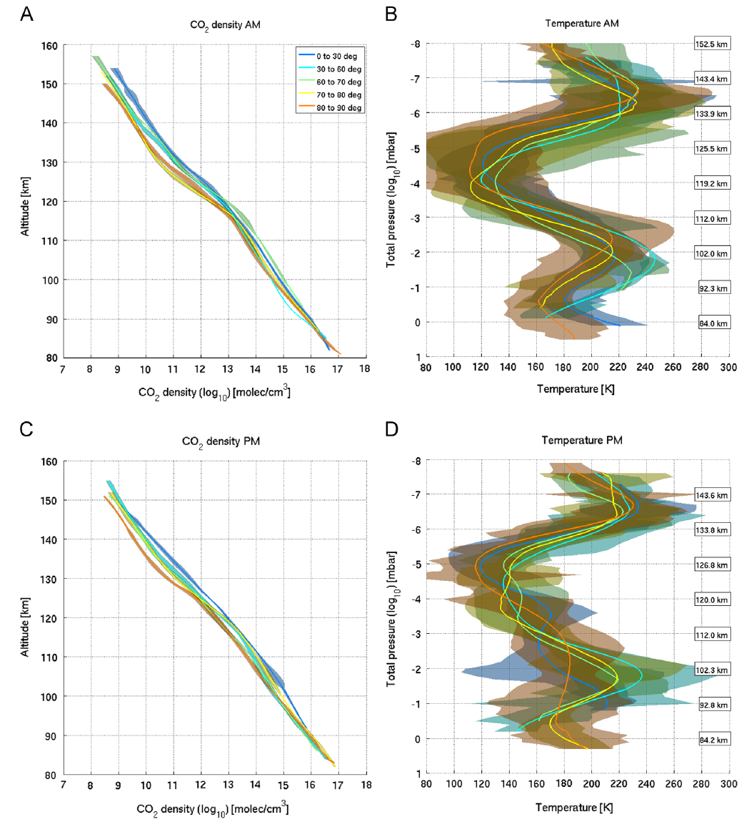
SOIR thermal profiles: CO₂ density and temperatures
Focus on CO₂ observed on a wide range of altitudes
Dataset = 122 occultations (62 dusk, 60 dawn)
Model validation:
  Bougher et al (Thursday)
  Mahieux et al (Poster 2)

Slide 6
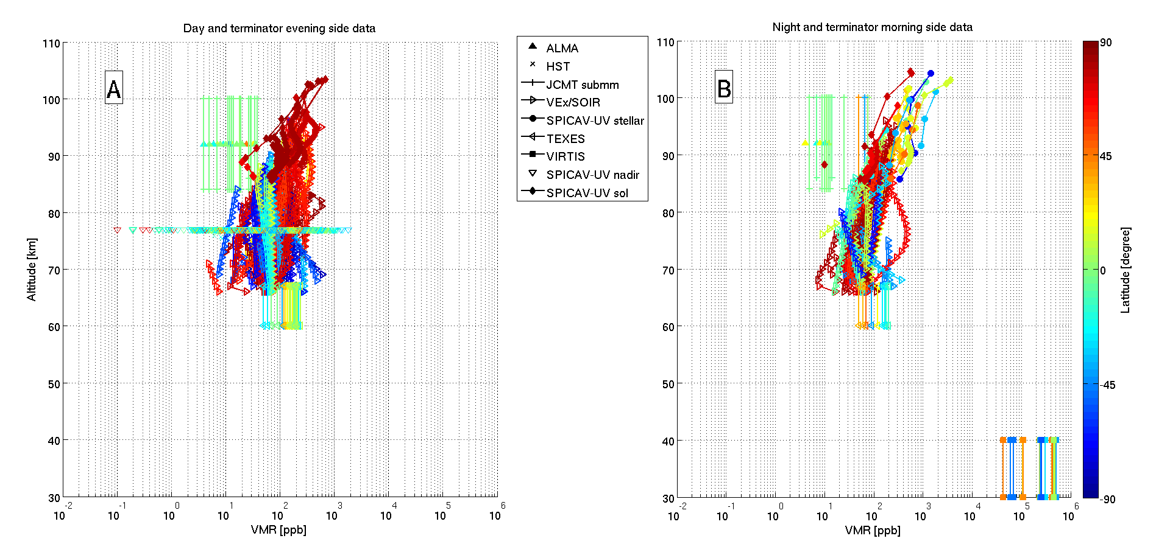
Trace gases: SO₂
Long term variations
ISSI international Team
(poster session)

Slide 7
Trace gases: HCl & HF
H³⁵CL
H³⁷CL

Slide 8
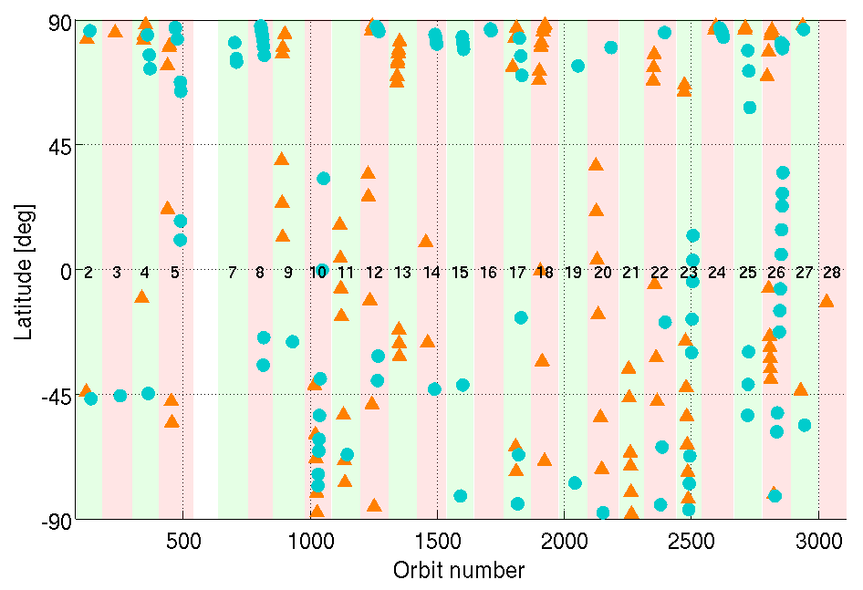
Trace gases: CO (1- Observations)
Morning T obs.
Evening T obs.
Nb Obs. | North hemisphere |  | South hemisphere
 | MT | ET | MT | ET
0°-30° | 8 | 9 | 11 | 15
30°-60° | 3 | 3 | 16 | 20
60°-70° | 3 | 7 | 6 | 6
70°-80° | 12 | 13 | 4 | 5
80°-90° | 38 | 26 | 6 | 7
Total | 64 | 58 | 43 | 53
Vandaele et al., Icarus (2016)

Slide 9
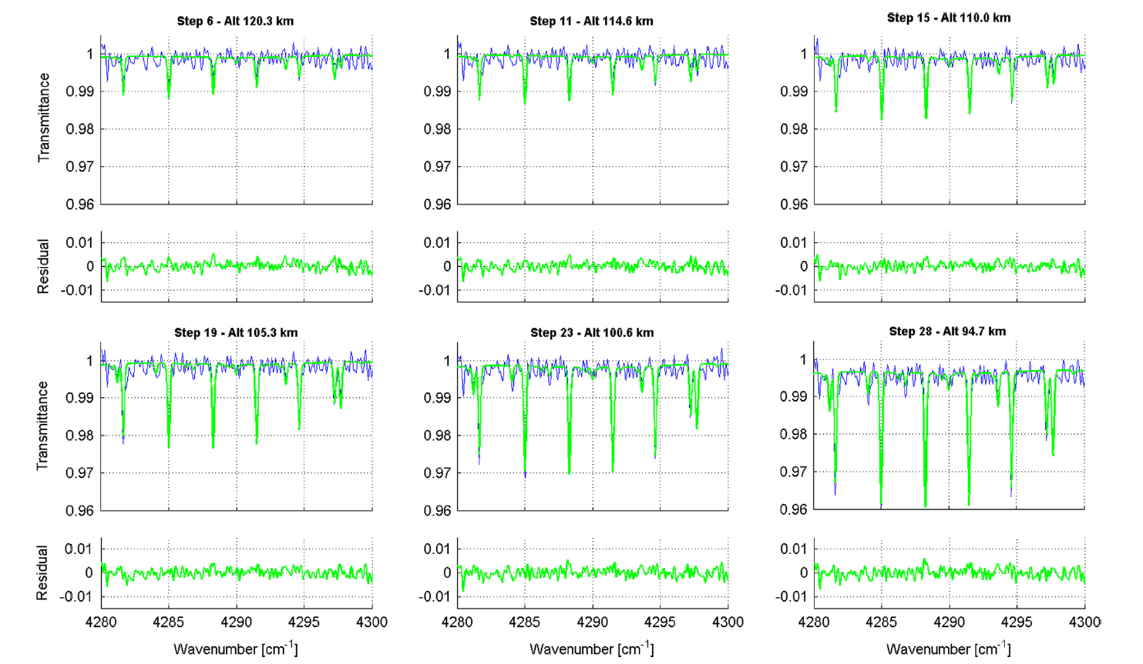
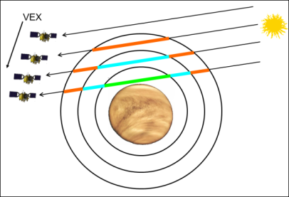
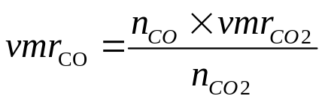
Trace gases: CO (2- Retrieval)

Slide 10
Trace gases: CO (3- Densities)
160
Lat 60-70 N
Lat 60-70 S
Altitude
60
Morning T obs.
Evening T obs.
160
Lat 80-90 N
Lat 80-90 S
Altitude
60
CO density
CO density
VIRA
(LST 24h)
VIRA (LST 12h)

Slide 11
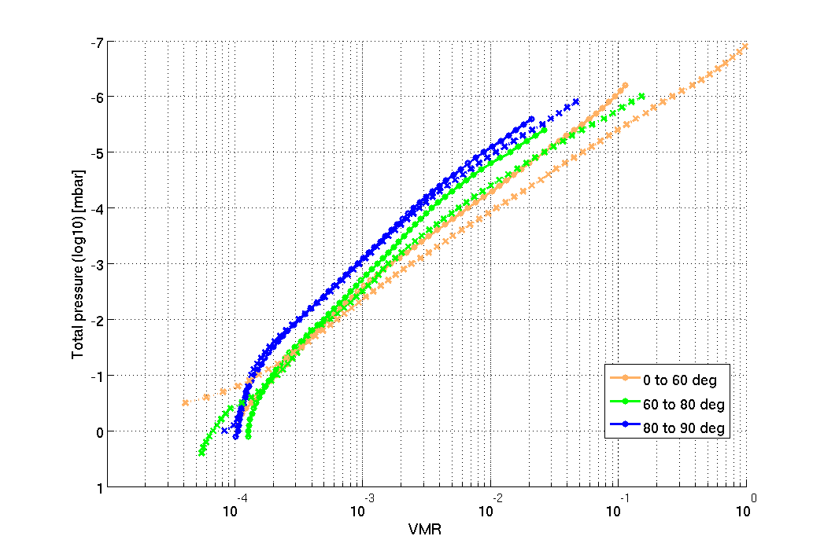
Trace gases: CO (4- Morning/Evening)
<
<
Poles
Mid-Latitudes
Equator
<
MT
ET
3 Latitude bins
  Equator region
  High-latitudes
  Poles
Morning & Evening observations separated
138 km
129 km
120 km
111 km
102 km
Inversion
93 km
84 km
>
CO vmr
MT
ET

Slide 12
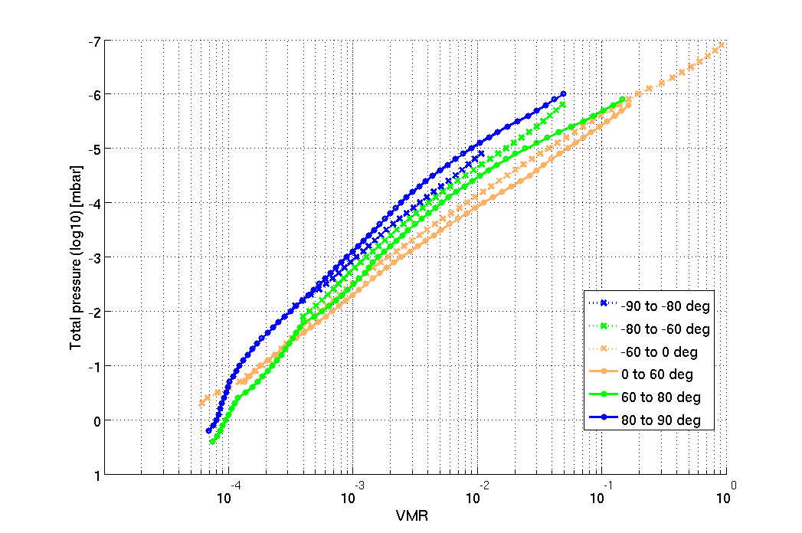
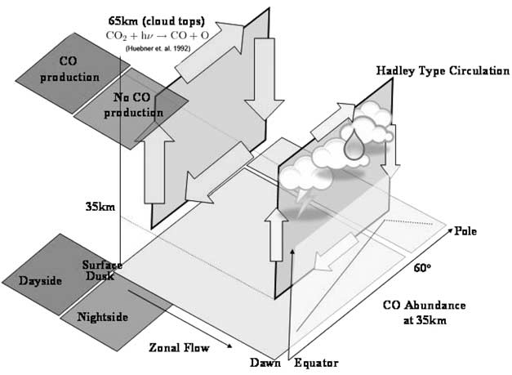
Trace gases: CO (5- Latitudinal variations)
<
<
Poles
Mid-Latitudes
Equator
MT & ET together
N – S hemispheres:
  Same trend
  Less variations in S
138 km
129 km
120 km
111 km
102 km
93 km
84 km
CO vmr
<
<
Equator
Poles
Mid-Latitude

Slide 13
Trace gases: H₂O/HDO (1 – Introduction)
H₂O and HDO are both detected by the SOIR instrument
  Fedorova et al., JGR 2008 showed that
    VMR for H₂O is 1.16 ± 0.24 ppm
    VMR for HDO is 0.086 ± 0.020ppm
    HDO/H₂O 240 times larger than on Earth
  Analysis was only performed on 22 orbits mainly from high latitudes, taken between April 2006 – August 2007
We have extended the study to include 244 orbits that contain either H₂O and/or HDO that were taken across most latitudes and obtained over approx. 9 years.
These results are still a work in progress.

Slide 14
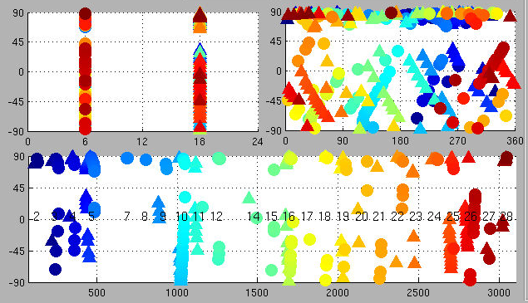
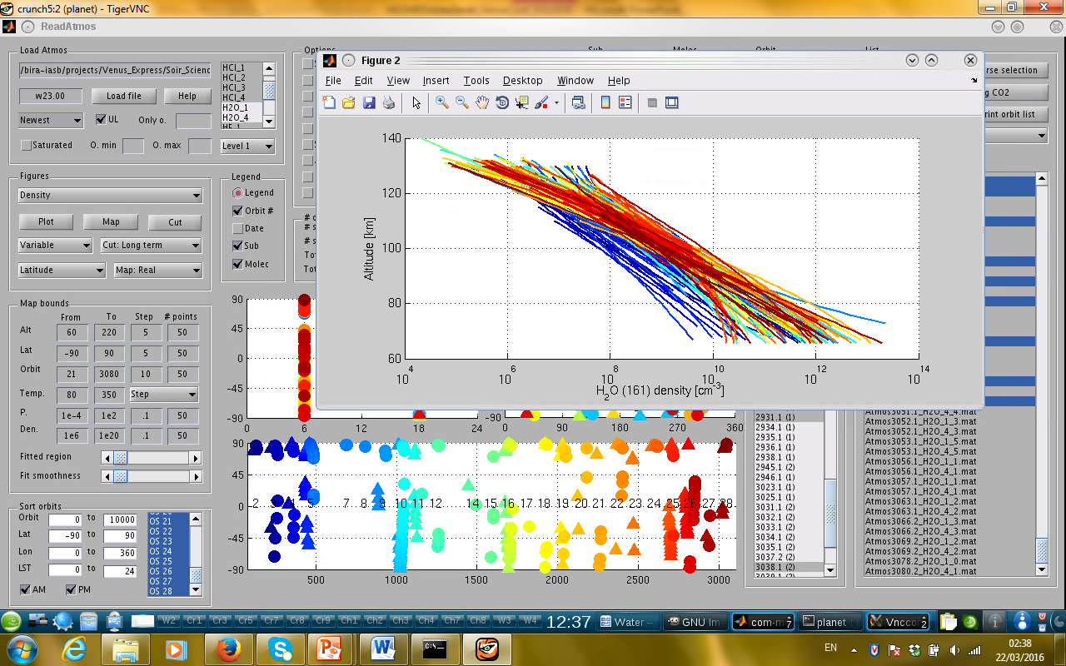
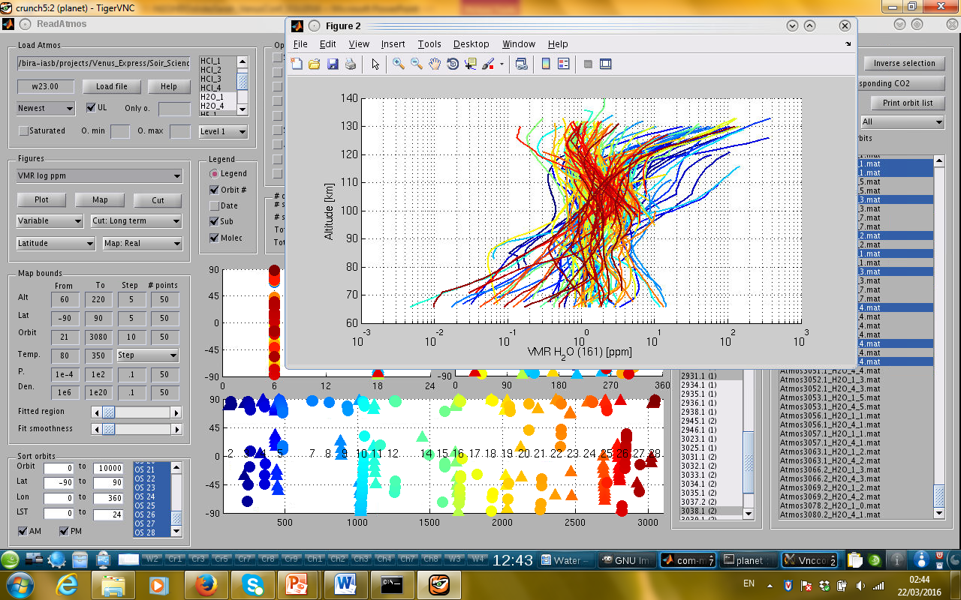
Trace gases: H₂O/HDO (2 – Observations)
H₂O: 244 orbits
Density
VMR

Slide 15
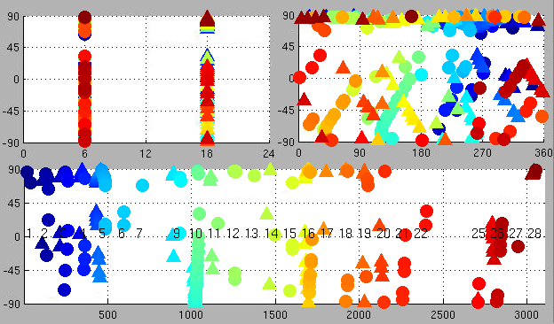
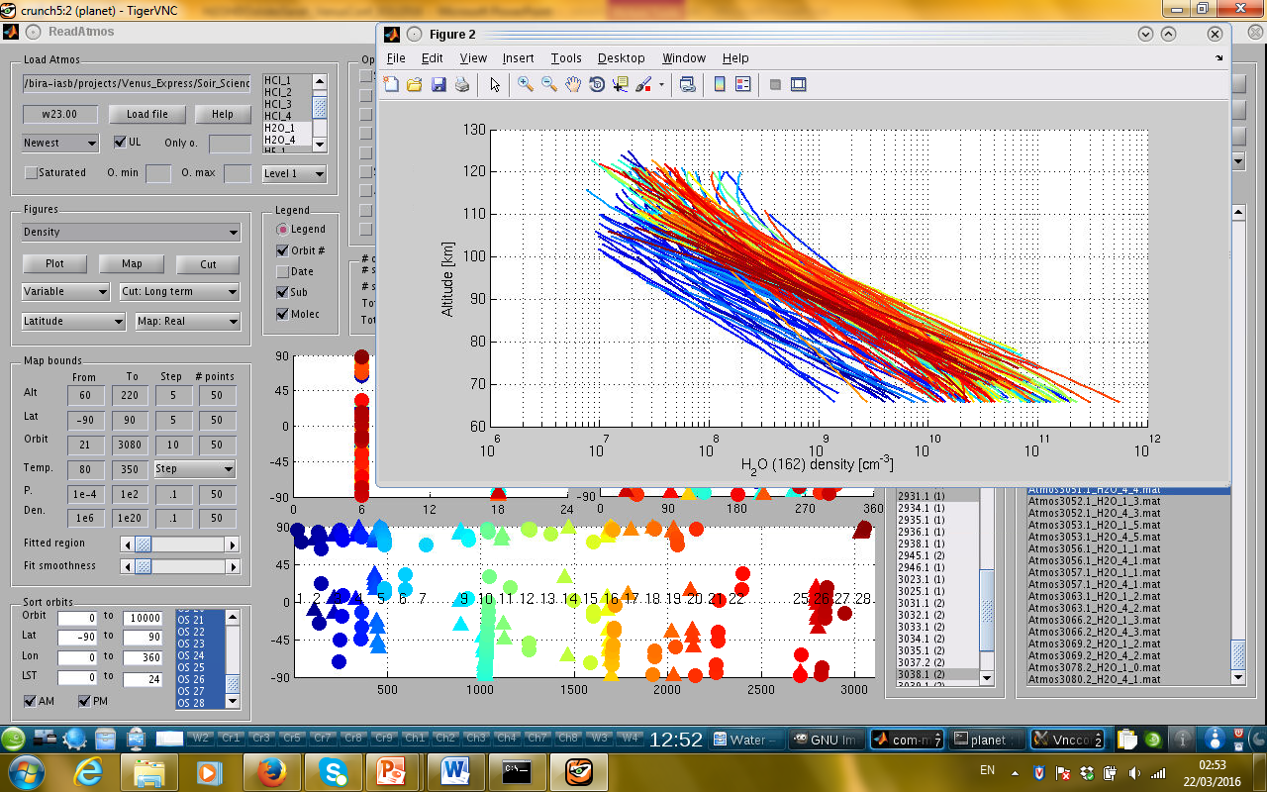
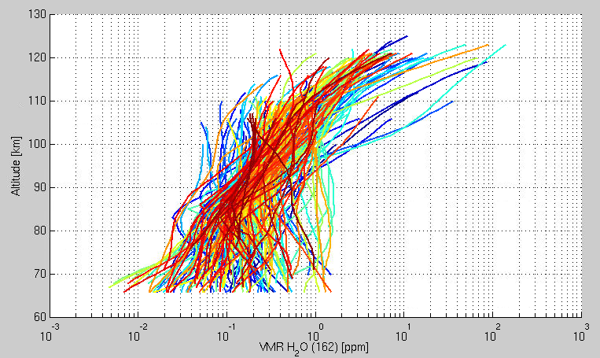
Trace gases: H₂O/HDO (2 – Observations)
HDO: 213 orbits
Density
VMR

Slide 16
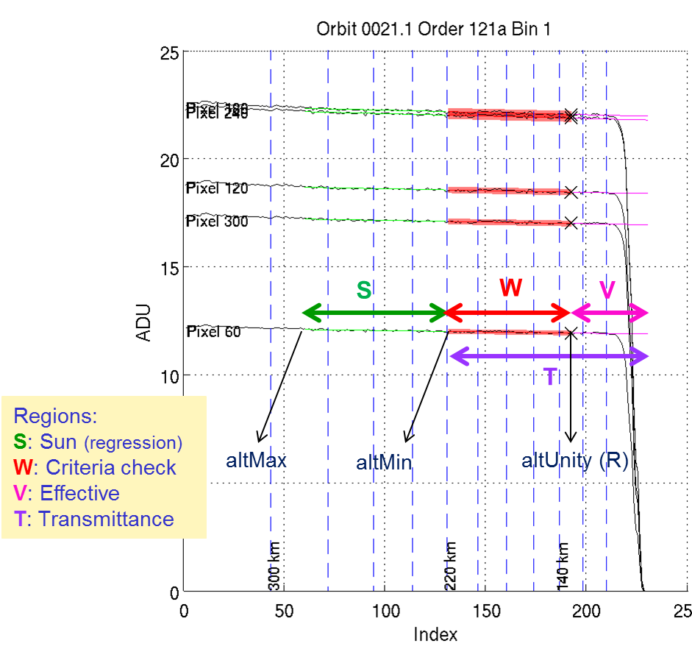
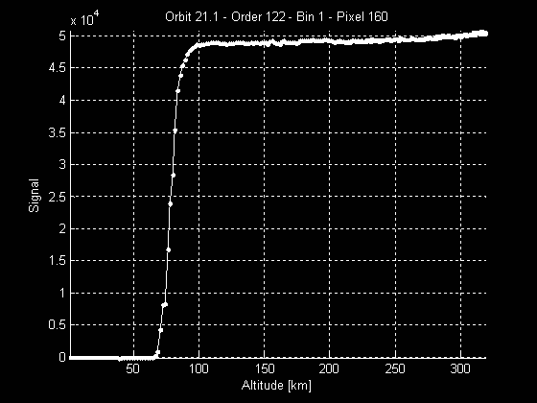
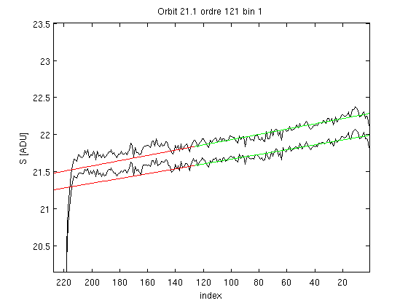
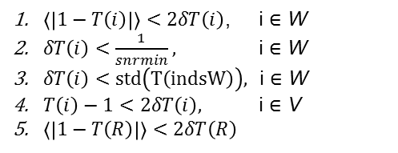
Last updates to PSA
Improved way of defining the ‘Solar Reference’ spectrum
Occultation
zone
Regression
zone
OLD situation
Transmittance values are
> 1
$〈\left|1−T\left(i\right)\right|〉<2δT\left(i\right)$, i $∈$ W
$δT\left(i\right)<\frac{1}{snrmin},$ i $∈$ W
$δT\left(i\right)<std\left(T\left(indsW\right)\right),$ i $∈$ W
$T\left(i\right)−1<2δT\left(i\right),$ i $∈$ V
$〈\left|1−T\left(R\right)\right|〉<2δT\left(R\right)$
Criteria

Slide 17
Conclusions
Re-analyse of the updated transmittances is on-going
Still A LOT to do with this incredible data set
  Improve the retrieval from the existing SOIR spectra
    Include the Detection Limits (OCS, etc)
    Correlation between the detected species (H₂O, SO₂) and aerosols
  Perform comparison/synergy with other VEX datasets and/or with ground-based/HST observations
  Validation wrt existing Venus atmosphere Models (GCM, 1-d RT)
Come to the « Venus Express Legacy session »
  Wedn. afternoon

