Slide 1
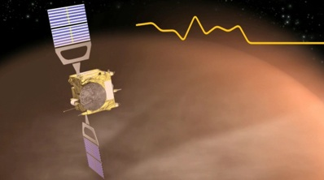
VENUS THERMOSPHERIC DENSITIES AS REVEALED BY VENUS EXPRESS TORQUE MEASUREMENTS
C.F. Wilson, Oxford University, Oxford, UK (wilson@atm.ox.ac.uk), M. Persson, Swedish Institute of Space Physics, Kiruna, Sweden. E. Grotheer, ESAC, Spain, I. Müller-Wodarg, Imperial College London, UK, S. Damiani, M. Müller, ESA/ESOC, Germany, H. Svedhem, ESA/ESTEC, Noordwijk, the Netherlands, P. Rosenblatt, Royal Observatory of Belgium, S. Bruinsma, CNES/GRGS, Toulouse.
Venus 2016 conference, Oxford

Slide 2
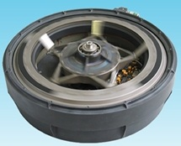
Accelerometers: measure densities up to 150 km altitude
Gyros / reaction wheels: measure densities up to 200 km altitude
Torque data
Compensate via reaction wheels
Torque_{AD}
vector
Wind
~8-10 km/s

Slide 3
VEx Torque data reduction
Much of the introductory work was done by ESOC Flight dynamics team: Michael Müller, Sylvain Damiani, and others.
  Described in papers such as Damiani et al., 2013; Lorenzo et al., 2012.
However, the densities derived from their analyses were not made available for scientific analyses and are no longer available
Emmanuel Grotheer (ESTEC, now ESAC) recreated the data pipeline (2014).
Moa Persson (MSc student at Oxford) refined this pipeline (2015).

Slide 4
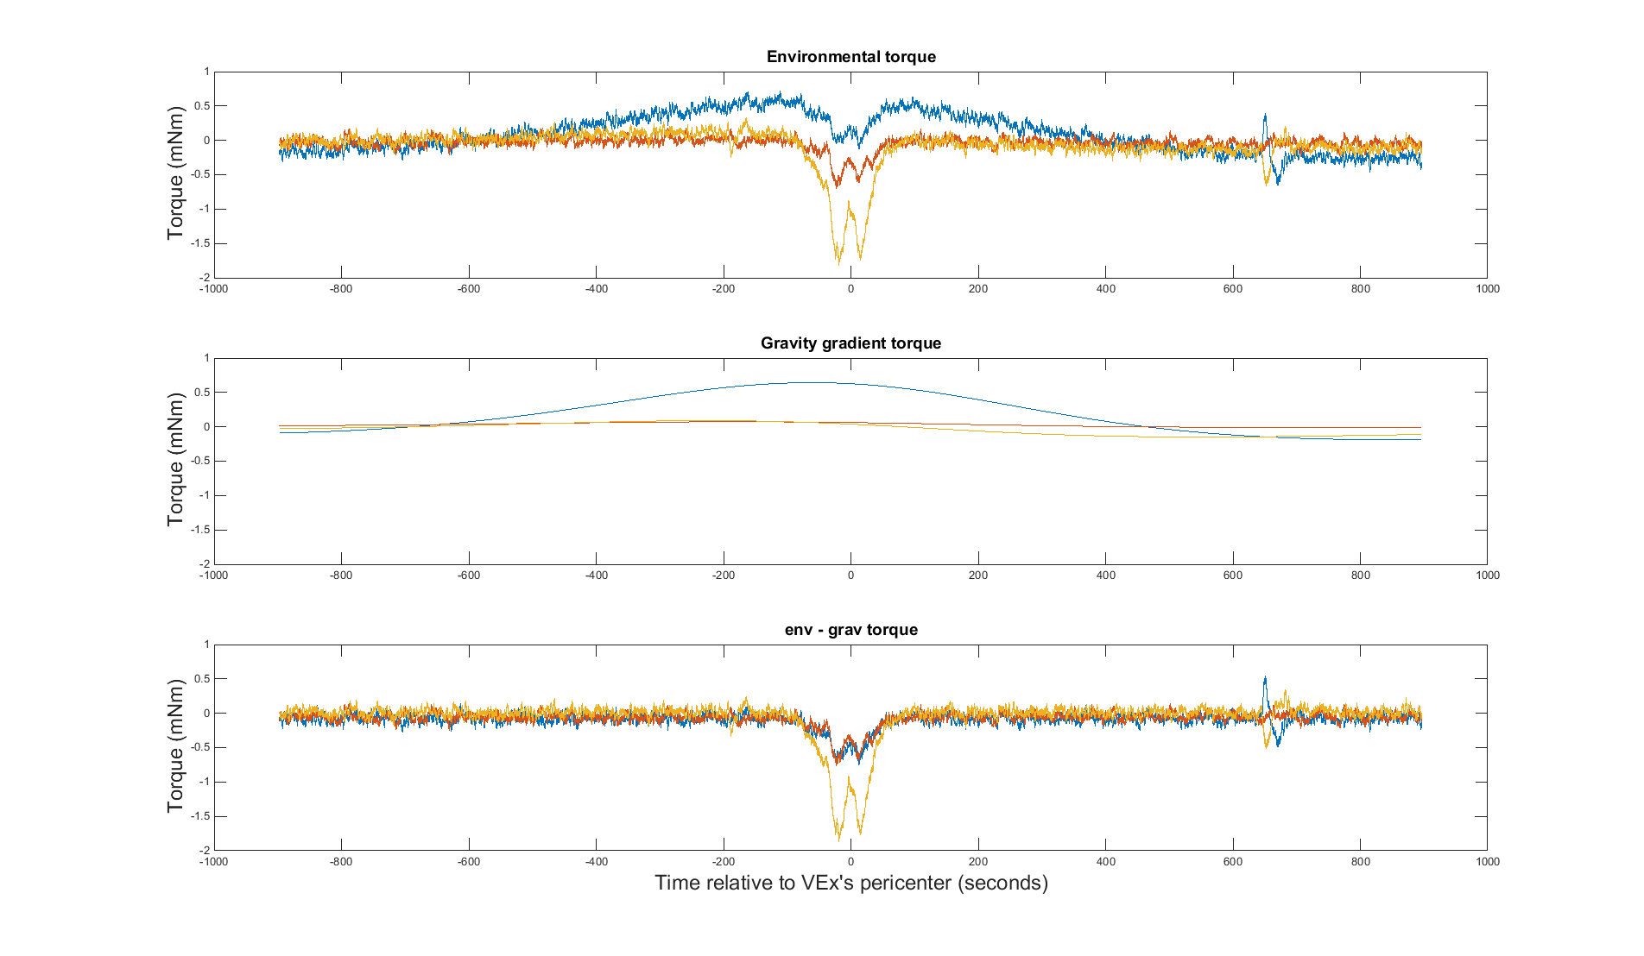
Torque data reduction in order to get the aerodynamic torque
Gravity gradient torque
Solar radiation torque
X-axis
Y-axis
Z-axis

Slide 5
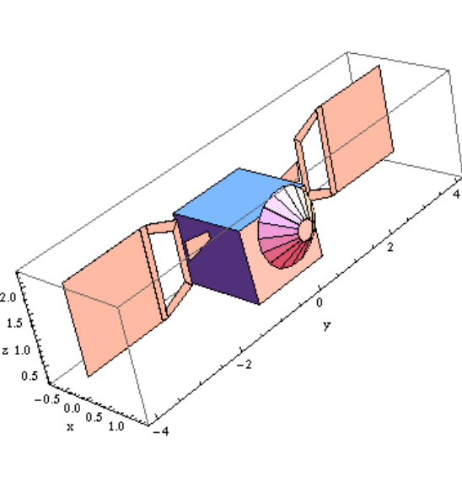
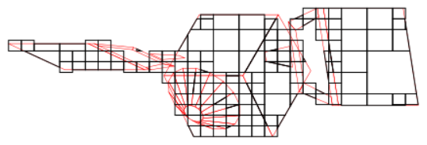
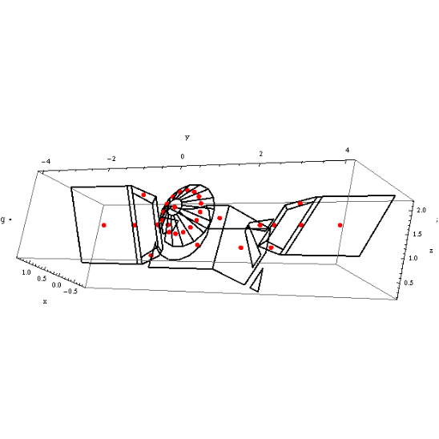
Torque data reduction
ESOC calculated aerodynamic forces on dozens of faces (removing shaded faces)
Virtually all of the torque is due to the solar panels
Using only solar panel torques to calculated ρ leads to errors of up to 5% for VExADE geometries [Damiani et al 2013]
Therefore we have used only torque from aerodynamic pressure on solar panels to calculate densities

Slide 6
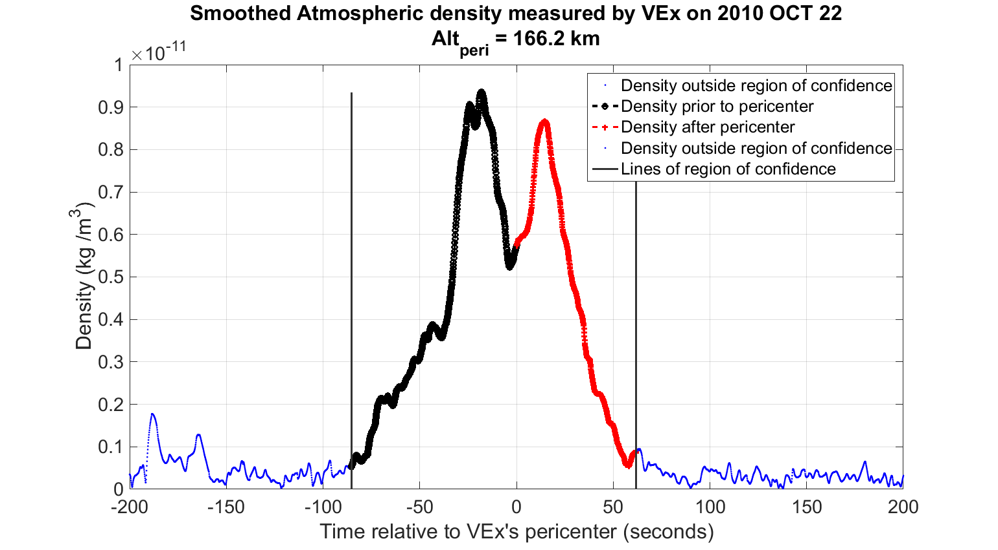
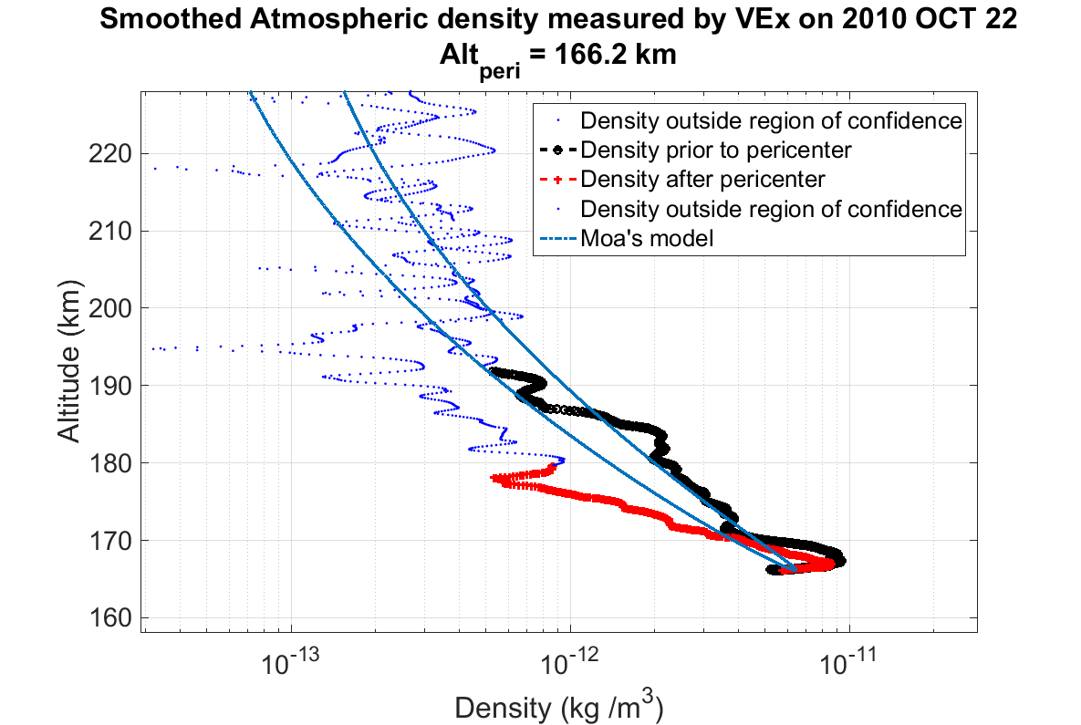
Torque data reduction
Exclusion criteria:
  SNR < 15
  Calculated torque vector direction deviates from measured torque direction by > 20°
  “Sensitivity” < 2 x 10⁷ m⁵s⁻²
  Limits data to typically < 200 km

Slide 7
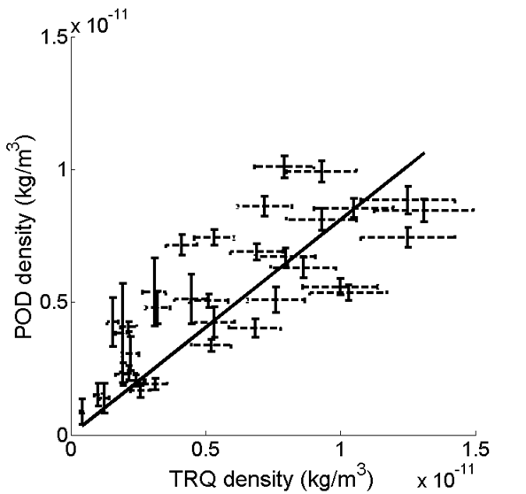
Validation against Precise Orbit Determination (tracking) results
Our densities are correlated with those obtained from tracking data
They are on average 20% lower than those from tracking.
Discrepancy with values from ESOC may be due to different geometry parameters used (spacecraft position & velocities, CoM & CoP vectors, SA rotation angles)
  Solar Array rotation angles stored in SPICE are different (by up to 0.5°) from those reported in “VEx Aerodrag Measurements” report (VEX-ESC-RP-5520_i1r0). Why?

Slide 8
Uncertainties
Systematic errors | Change in parameter | Effect on density | Source
Accommodation coefficient, α | ± 0.02 | ± 10 % | Damiani et al. (2012)
Wind velocity | ± 1 % | ± 2 % | Calculations
Wind direction | Up to ± 5 deg from pericentre value | Up to ± 4 % | Damiani et al. (2012)
Altitude | ± 1 % | ± 0.1 % | Calculations
Solar array angles | ± 0.5 deg | ± 3 % | Calculations
Only using solar arrays in calculations |  | Up to ± 5 % | Damiani et al. (2012)
Centre of mass | 1 % | Negligible | Calculations
→ Total systematic uncertainty: up to 25%

Slide 9
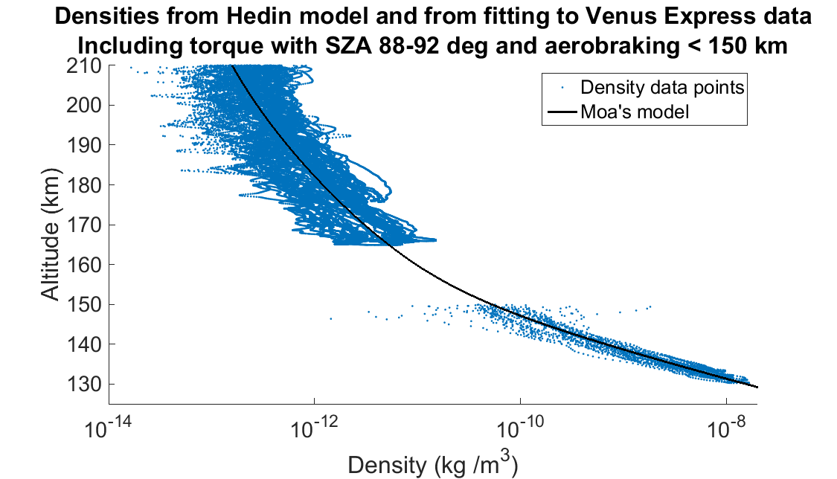
Densities from Torque & aerobraking
100 pericentre passes, all at 75° - 90°N
Note: only data with 88° < SZA < 92° are plotted

Slide 10
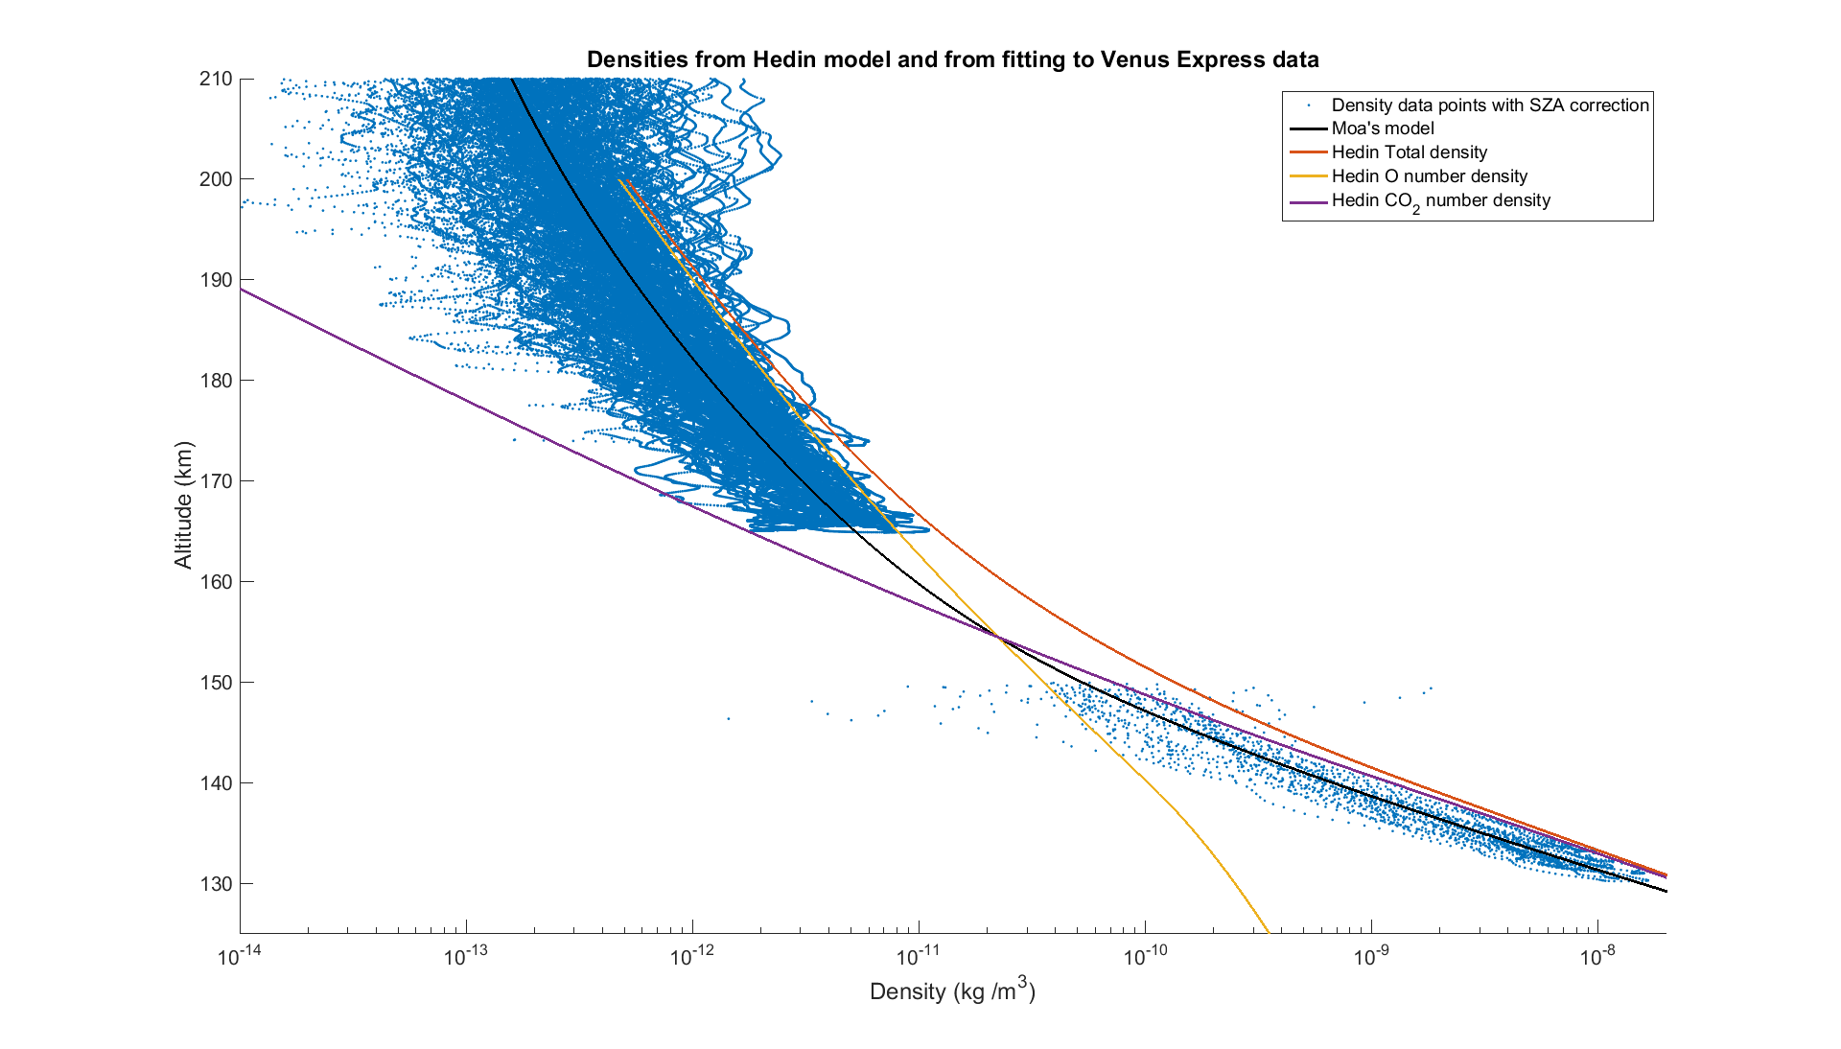
Densities from Torque & aerobraking
Note: all data plotted, with SZA correction
Monatomic O is most abundant species
CO₂ is most abundant species

Slide 11
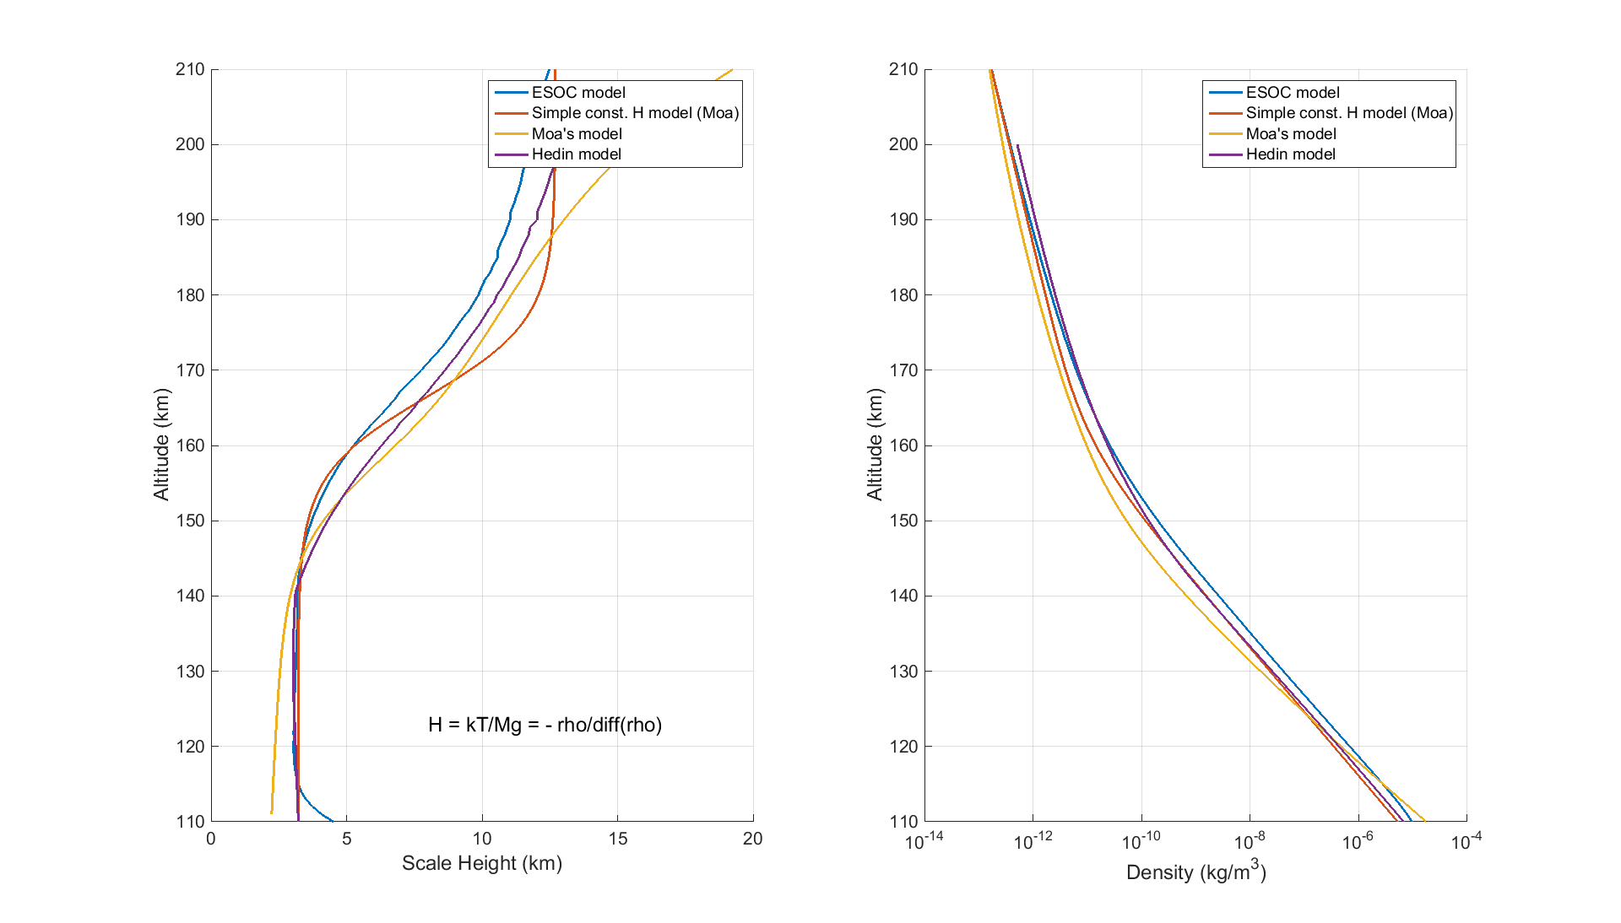
Densities & scale heights from Torque

Slide 12
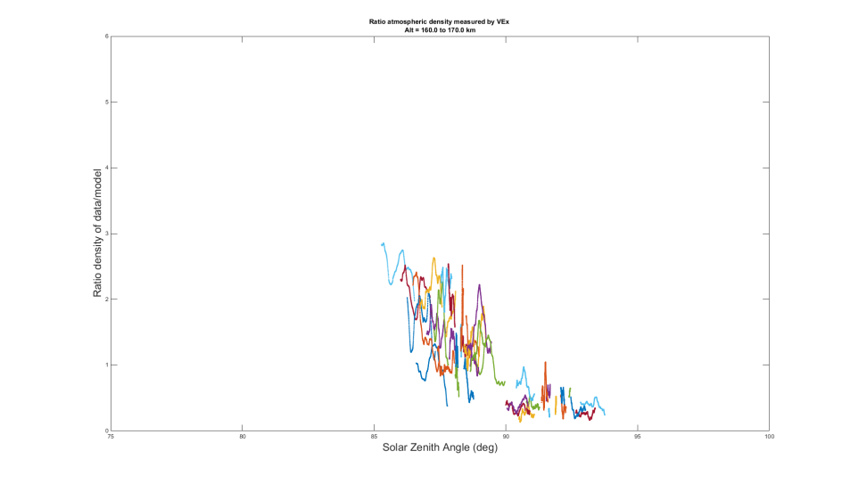
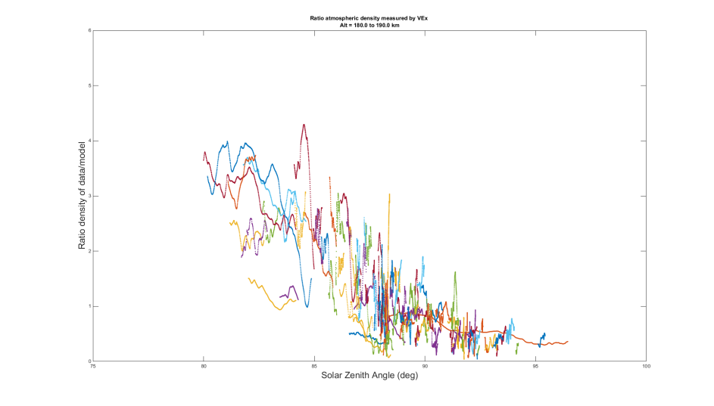
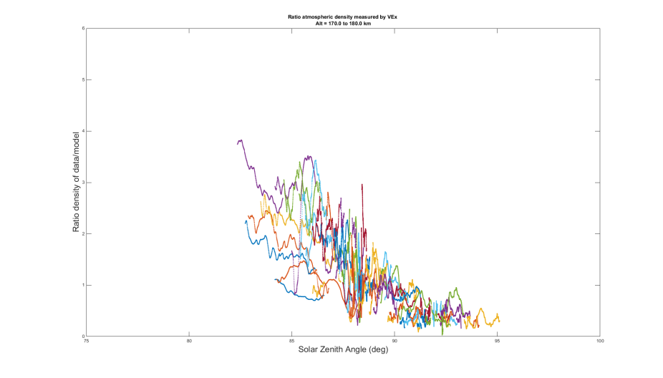
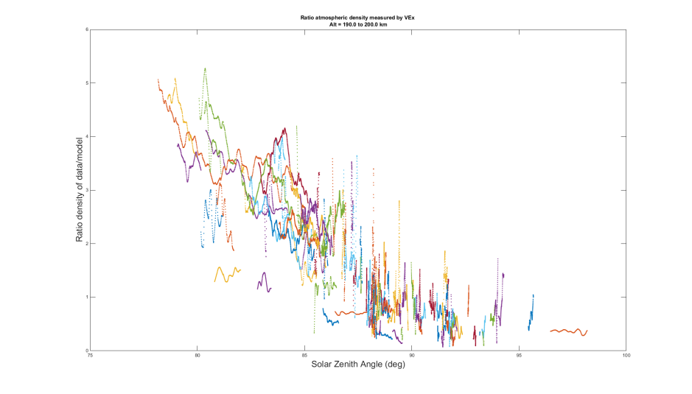
SZA dependence from Torque
160 – 170 km
180 – 190 km
170 – 180 km
190 – 200 km

Slide 13
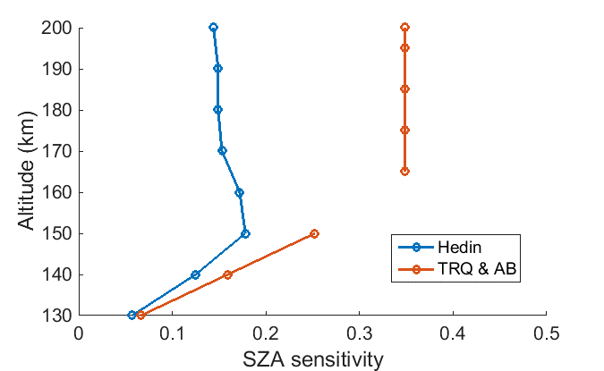
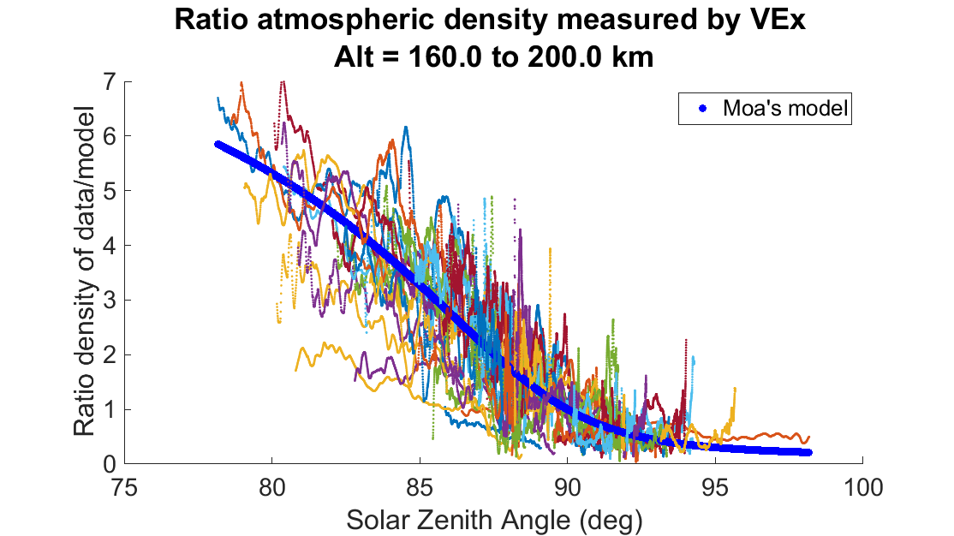
SZA dependence from Torque & AB
The sensitivity of ρ to SZA does not increase with z in the 160-200 km range
The sensitivity to SZA is much greater than predicted by Hedin model

Slide 14
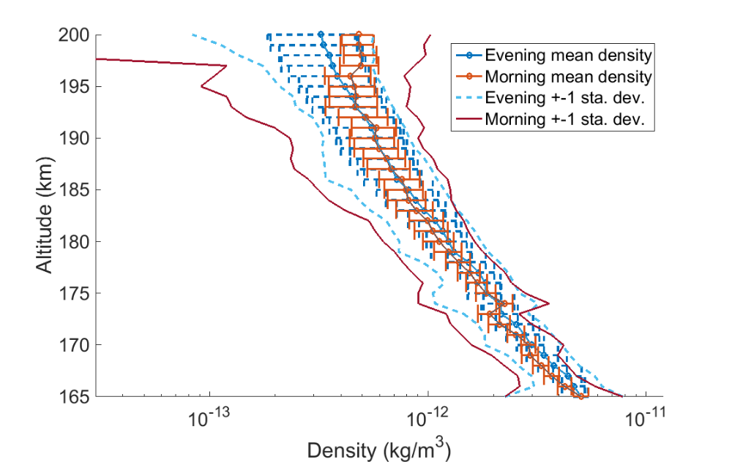
Binned densities for ISSI intercomparison typically ~ 40% less than VIRA densities

Slide 15
Variability
1. Day-to-day variability
2. Gravity Waves

Slide 16
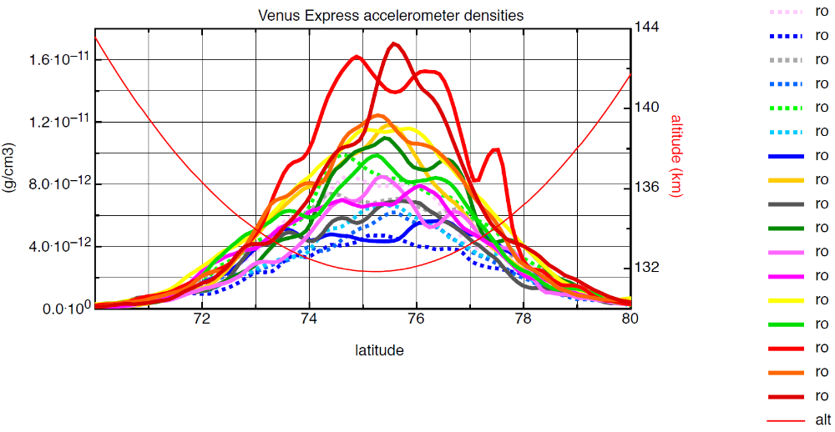
Variability - Gravity waves
Aerobraking - July 2014
Density oscillations – gravity waves?
Horizontal wl ~ 100 – 200 km
Δρ/ρ ~ 20 % (at 130 km)

Slide 17
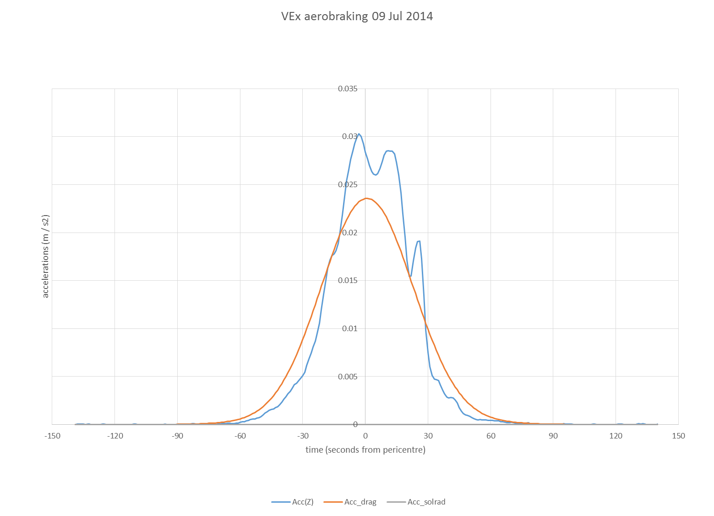
Density oscillations – gravity waves?
Horizontal wl ~ 100 – 200 km
Δρ/ρ ~ 20 % (at 130 km)

Slide 18
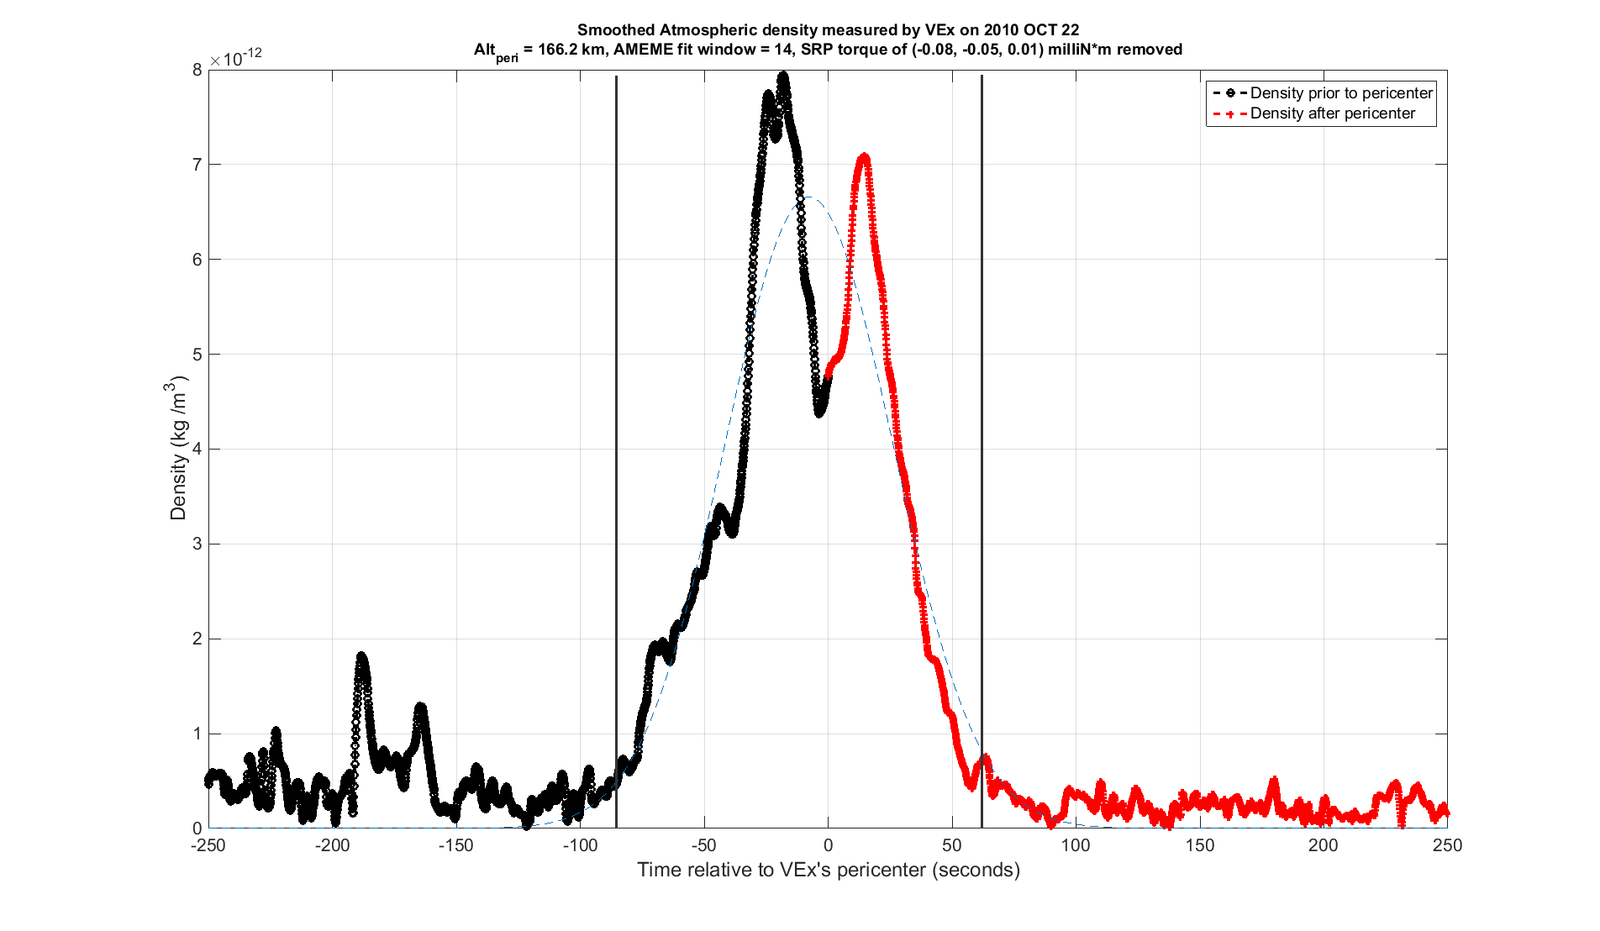
Variability 2 - Gravity waves
VEx Torque - Oct 2010
Density oscillations – gravity waves?
Horizontal wl ~ 100 – 200 km
Δρ/ρ ~ 30 % (at 170 km)
Day/night asymmetry:
Increasing with altitude

Slide 19
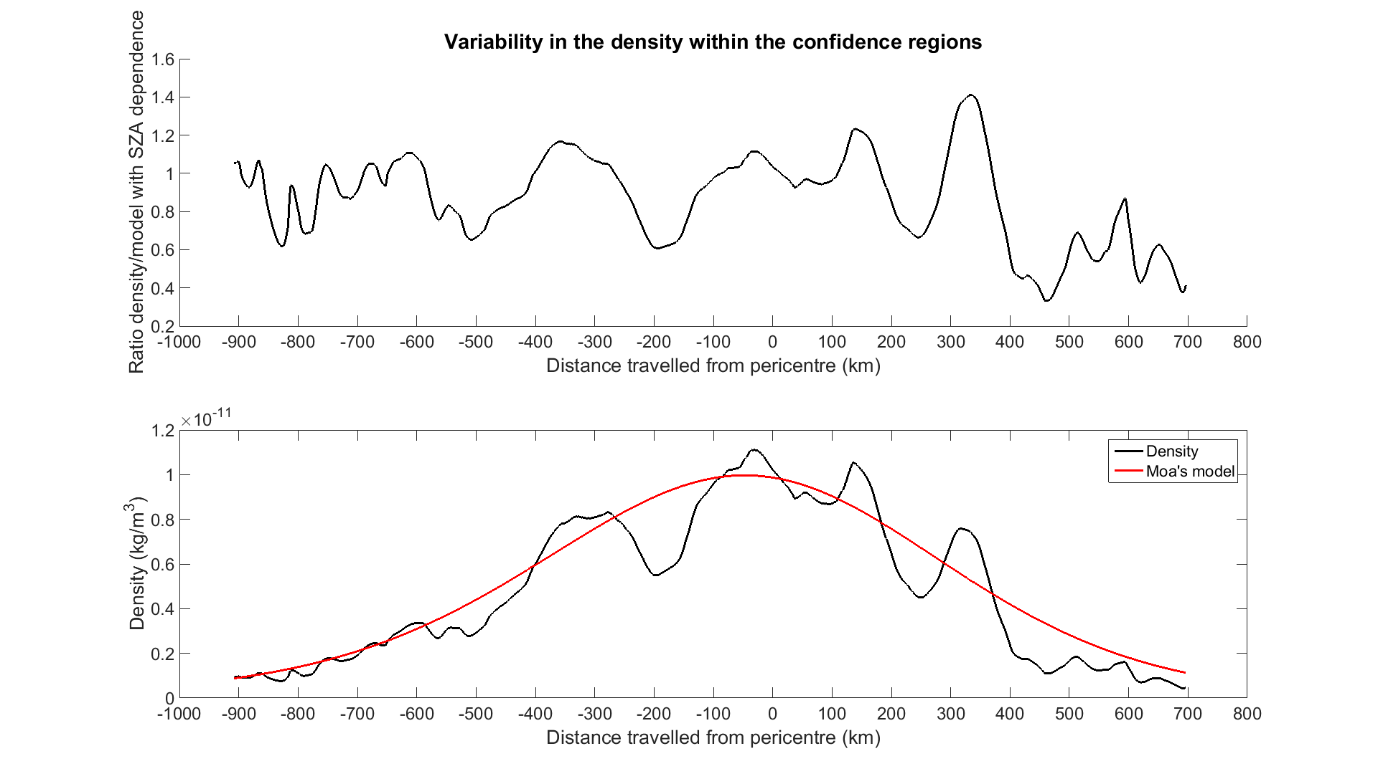
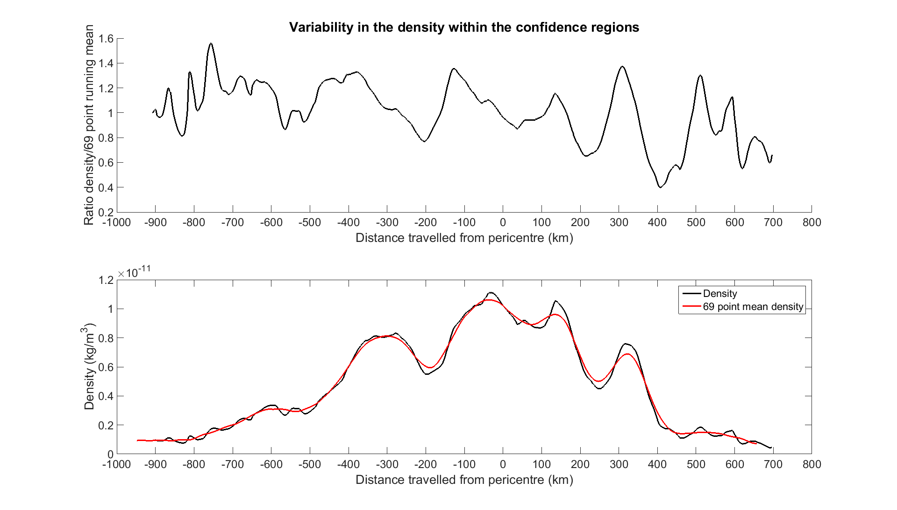
Gravity Waves – VEx Torque
Density oscillations – gravity waves?
Horizontal wl ~ 100 – 300 km
Δρ/ρ ~ 30%

Slide 20
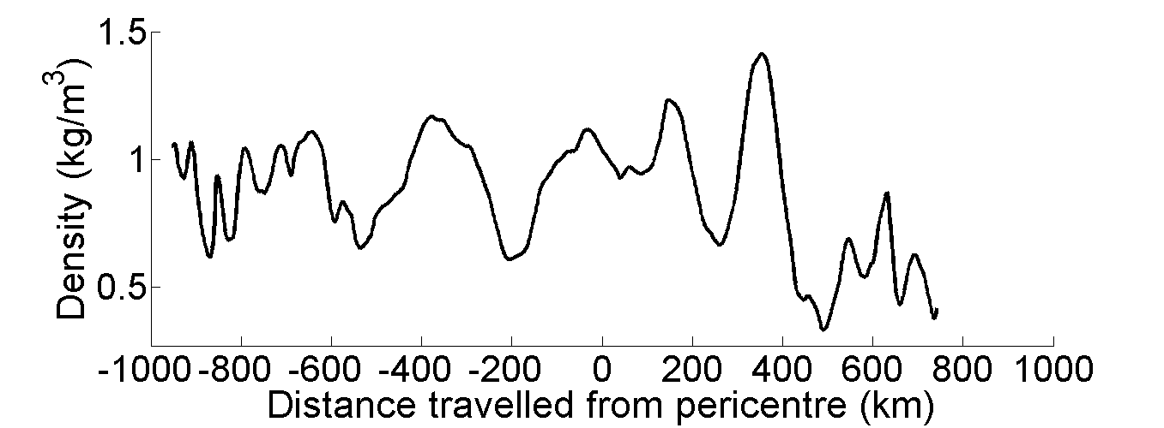
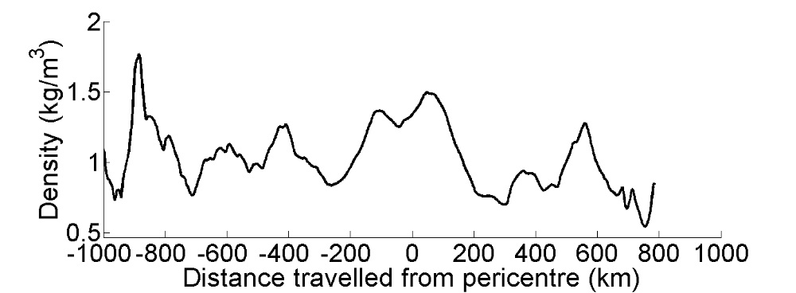
Gravity Waves – VEx Torque
23 May 2011
Pericentre altitude: 167 km
Observed / model
27 May 2011
Pericentre altitude: 167 km
Observed / model

Slide 21
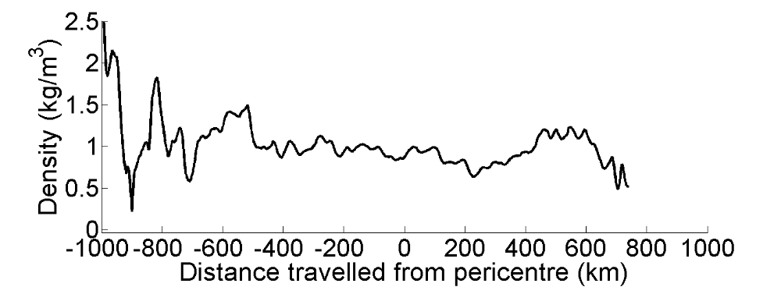
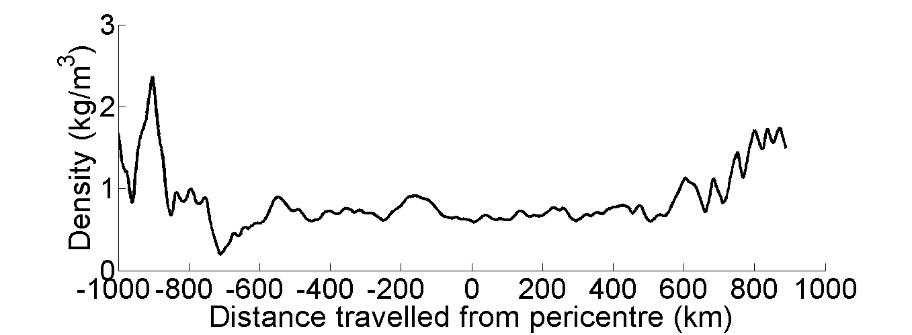
Gravity Waves – VEx Torque
12 Jan 2011
Pericentre altitude: 176 km
Observed / model
03 May 2012
Pericentre altitude: 166 km
Observed / model

Slide 22
What causes the density oscillations?

Slide 23
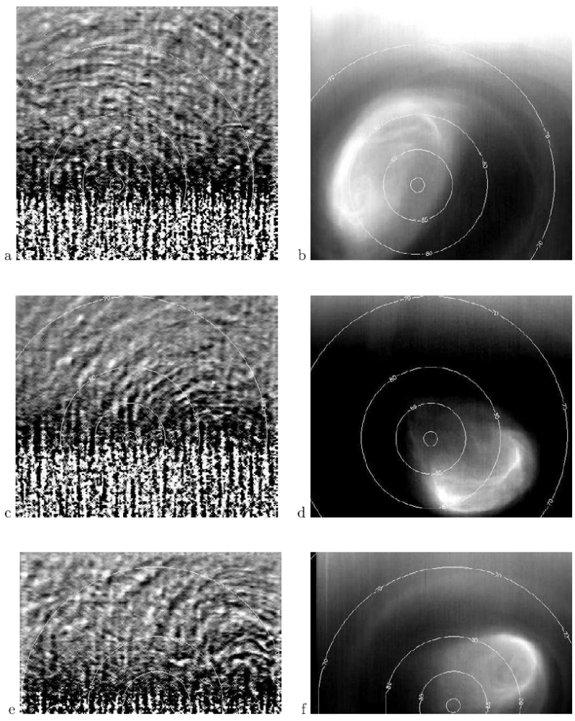
What causes the density oscillations?
Gravity waves at 130 km were seen in non-LTE CO2 emission by VEx/VIRTIS
Horizontal wavelengths ~100-200 km
Waves appear to be triggered by polar vortex
But these are very small radiance variations, on order of 1% - much smaller than density variations observed in VExADE

Slide 24
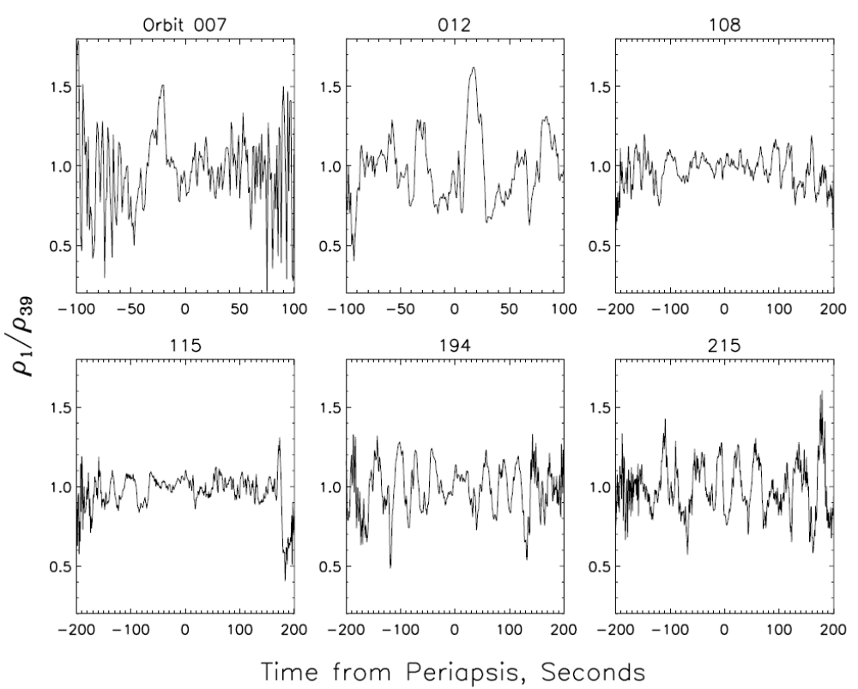
Gravity waves on Mars
Gravity waves from MRO aerobraking
(Fritts et al 2006)
Typical wavelengths of 100 km
Typical Δρ/ρ ~ 20%

Slide 25
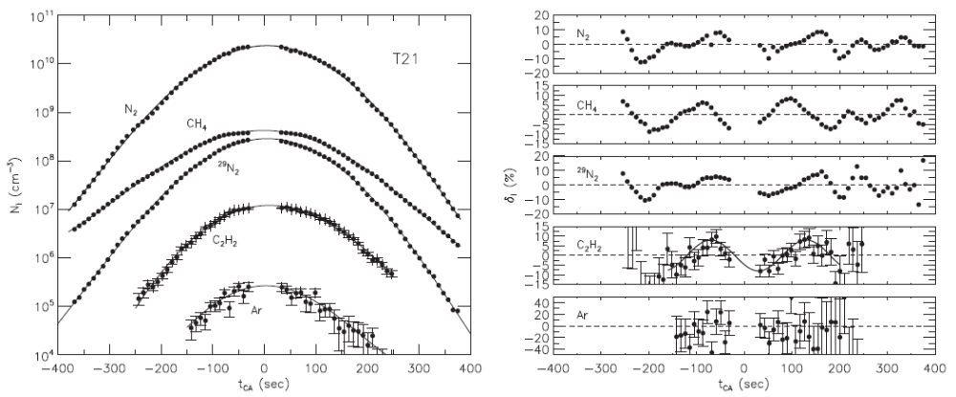
Titan thermospheric density variations
Cui et al. JGR 2013
Wavelength = 110 s
At 6 km/s this corresponds to 660 km
Scaling laws … ?

Slide 26
Next steps
Write up results
  Mean ρ(z, SZA) from Torque & aerobraking
  First-order characterization of waves and day-to-day variability.
Get torque densities ready for ingestion to PSA.
Variability
  gravity waves: investigate possible relationship with VIRTIS non-LTE observations
  Day-to-day variability: compare variability Δρ/ρ as a function of p on different planets.
Implement this technique on future missions!

