Slide 1



Stability of Pyrite under Venusian Surface Conditions
S. T. Port¹, E. Kohler^{1,2}, P.I. Craig³, and V. Chevrier¹
¹Arkansas Center for Space and Planetary Sciences, University of Arkansas, Fayetteville, AR, 72701; ²Harriett G. Jenkins NASA Pre-doctoral Research Fellow; ³Lunar and Planetary Institute, Houston, TX 77058.
saraport@uark.edu

Slide 2
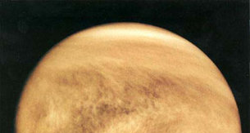
Introduction
Sulfur in atmosphere
Source and sink of sulfur?
  Pyrite (FeS₂)
  Anhydrite (CaSO₄ )

Slide 3
Introduction
Pyrite is temperature sensitive
Pyrite-Magnetite Buffer:
  3FeS₂ + 16CO₂(g)= Fe₃O₄ + 6SO₂(g)+ 16CO (g)

Slide 4
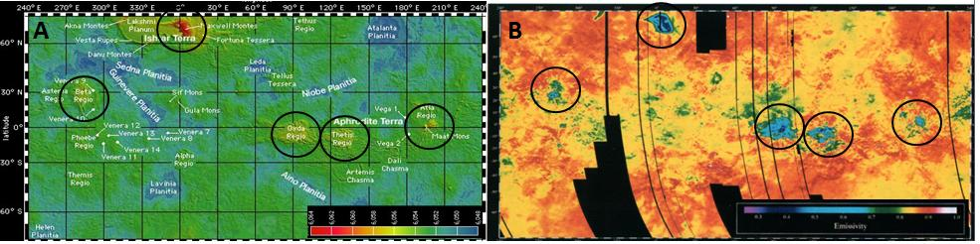
Radar Anomaly
Highly reflective surfaces concentrated on the highlands
Result between some unknown interaction of the atmosphere and the surface
Pyrite has high dielectric constant
(Pettengill et al., 1992)

Slide 5
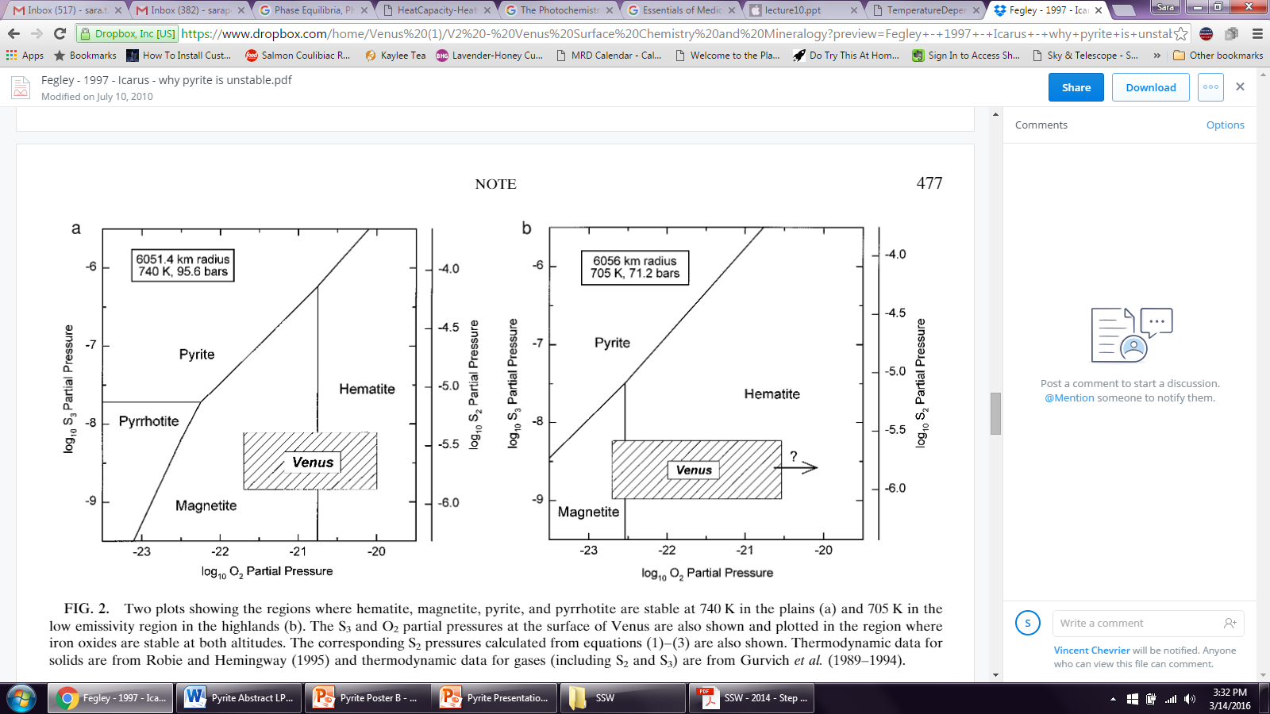
Introduction
Pyrite is unstable at the surface
Venus pressures were not considered in previous experiments
This work intends to investigate the stability of pyrite under Venus temperatures, pressures, and atmospheric conditions
(Fegley 1997)
(Fegley, 1997)
Notes:
Past thermodynamic modeling and experiments demonstrated that pyrite is unstable at surface

Slide 6
Methods
Pyrite powder
Two scenarios:
  Lindberg Tube Oven
  Venus Simulation Chamber
Each experiment lasted 18 hours
All samples analyzed via X-Ray Diffraction (XRD)

Slide 7
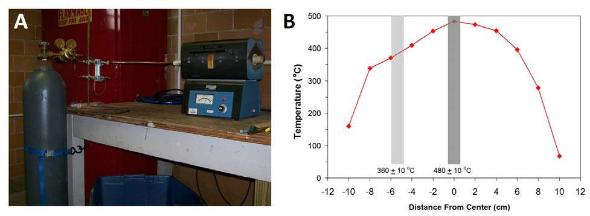
Methods: Oven
Lindberg Tube Oven
Tested atmospheric compositions:
  100% CO₂
  96.5% CO₂, 3.5% N₂, 150 ppm SO₂
Tested temperatures:
  Surface condition
    460°C
  Highland condition
    380°C

Slide 8
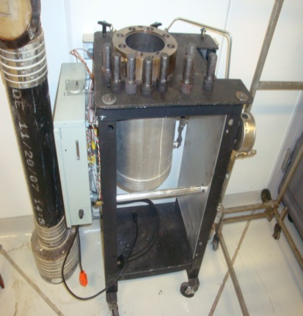
Methods: Chamber
Venus Simulation Chamber
Tested atmospheric compositions:
  100% CO₂
  96.5% CO₂, 3.5% N₂, 150 ppm SO₂
Tested temperatures/pressures:
  Surface condition
    460°C/95bar
  Highland condition
    380°C/55bar
Notes:
Located at NASA Goddard Space Flight Center

Slide 9
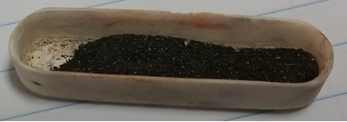
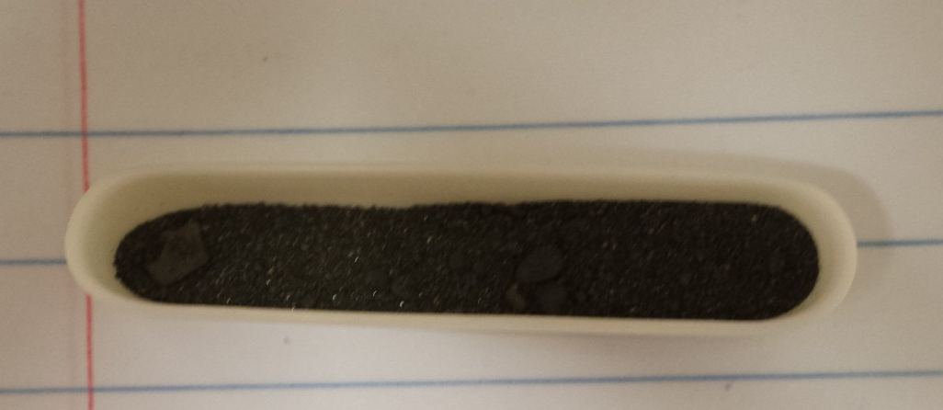
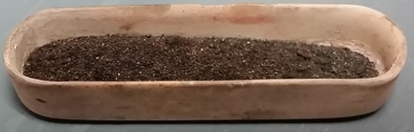
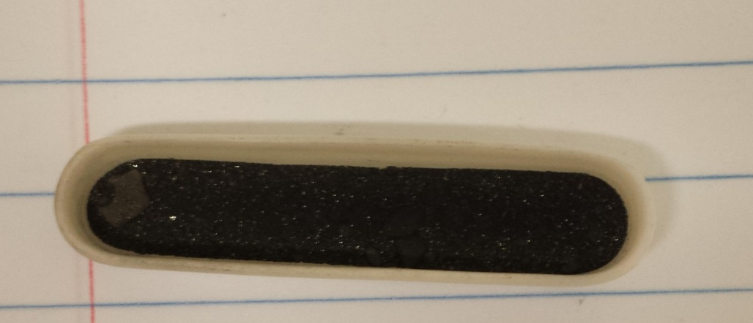
Results
A
C
B
D
Pyrite before (A) and after (B) 18 hours under 380°C and 1 bar in the mixed atmosphere
Pyrite before (C) and after (D) 18 hours under 380°C and 55 bar in the mixed atmosphere

Slide 10
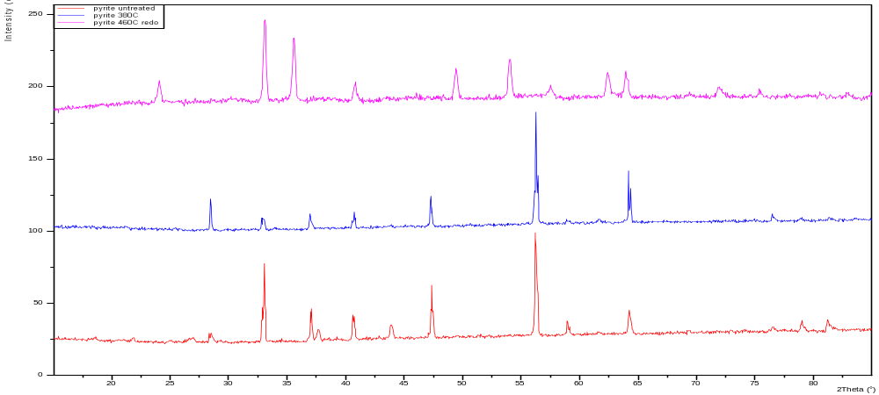
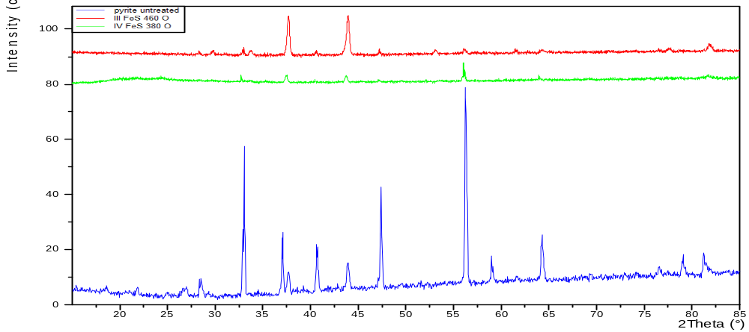




XRD Results (Oven)
460°C
$$Intensity (cps)$$
CO₂
380°C
Untreated Pyrite
Hematite
Pyrrhotite
Sulfur
Magnetite
$$2Theta(degrees)$$
0 20 25 30 35 40 45 50 55 60 65 70 75 80 85
460°C
380°C
Mix
$$Intensity (cps)$$
Untreated Pyrite
0 20 25 30 35 40 45 50 55 60 65 70 75 80 85
$$2Theta(degrees)$$

Slide 11
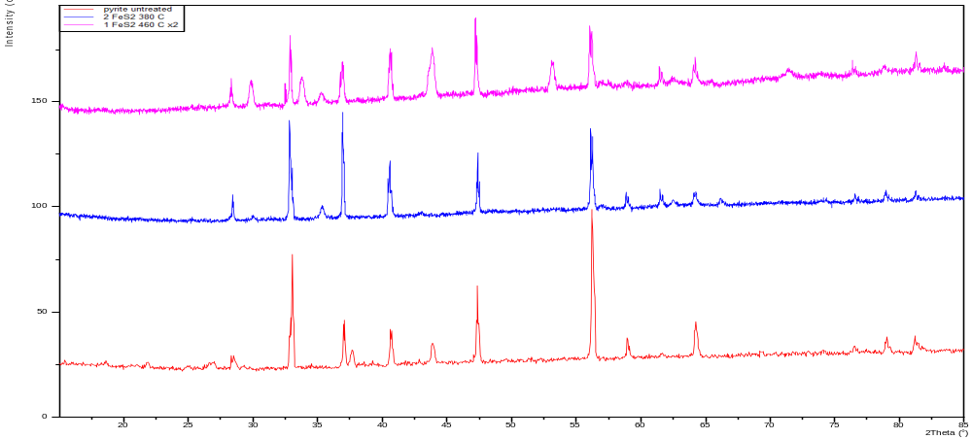
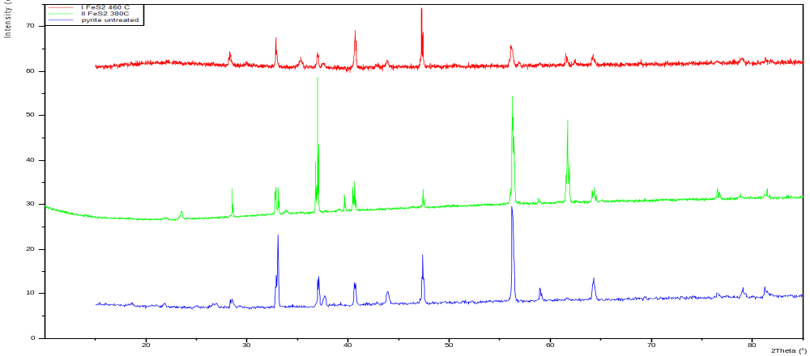




XRD Results (Chamber)
460°C
$$Intensity (cps)$$
380°C
CO₂
Untreated Pyrite
Hematite
Pyrrhotite
Sulfur
Magnetite
$$2Theta(degrees)$$
0 20 25 30 35 40 45 50 55 60 65 70 75 80 85
460°C
Mix
380°C
$$Intensity (cps)$$
Untreated Pyrite
0 20 25 30 35 40 45 50 55 60 65 70 75 80 85
$$2Theta(degrees)$$

Slide 12
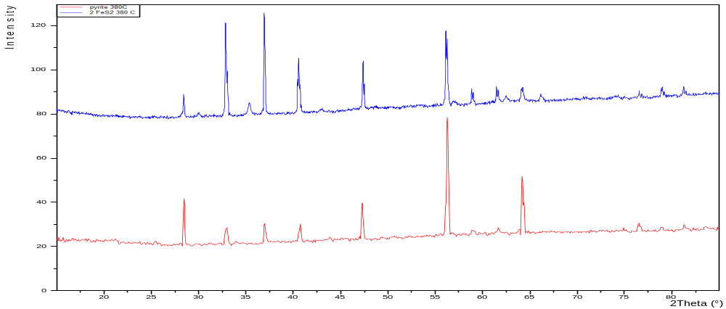
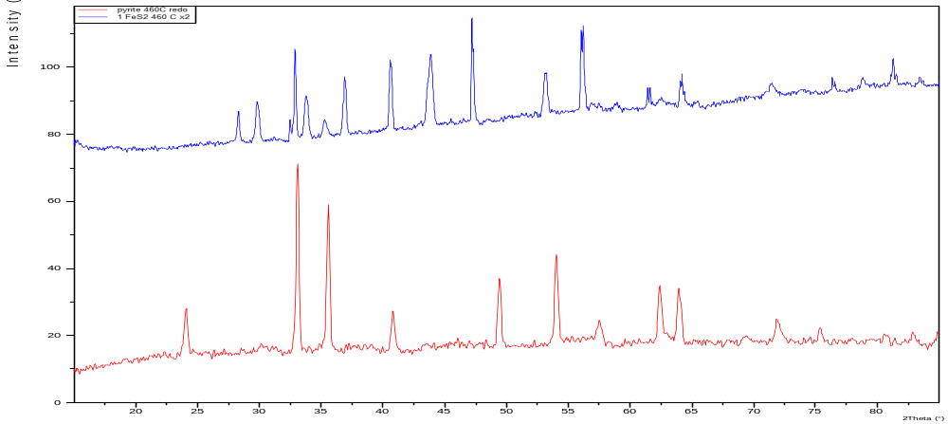




XRD Results (CO₂)
Chamber
$$Intensity (cps)$$
380°C
Oven
Hematite
Pyrrhotite
Sulfur
Magnetite
0 20 25 30 35 40 45 50 55 60 65 70 75 80 85
$$2Theta(degrees)$$
Chamber
$$Intensity (cps)$$
Oven
460°C
$$2Theta(degrees)$$
0 20 25 30 35 40 45 50 55 60 65 70 75 80 85

Slide 13
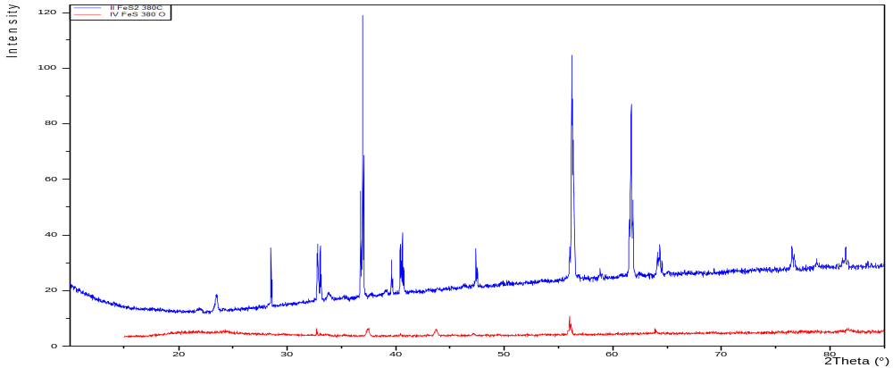
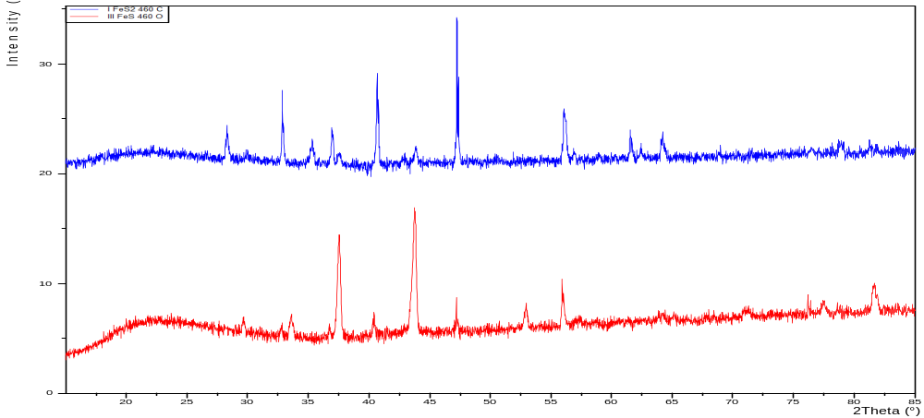




XRD Results (Mixed Atm)
$$Intensity (cps)$$
Chamber
380°C
Oven
Hematite
Pyrrhotite
Sulfur
Magnetite
$$2Theta(degrees)$$
0 20 25 30 35 40 45 50 55 60 65 70 75 80 85
Chamber
$$Intensity (cps)$$
Oven
460°C
$$2Theta(degrees)$$
0 20 25 30 35 40 45 50 55 60 65 70 75 80 85

Slide 14
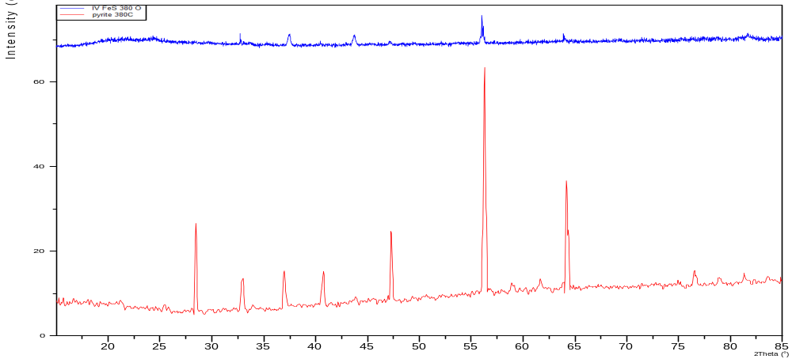
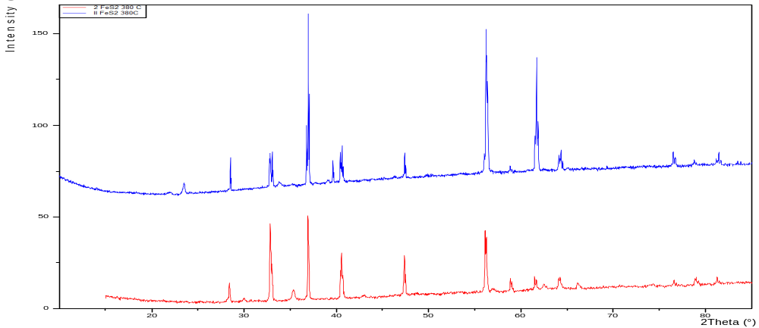




XRD Results (380°C)
  Mix
$$Intensity (cps)$$
Oven
  CO₂
Hematite
Pyrrhotite
Sulfur
Magnetite
$$2Theta(degrees)$$
0 20 25 30 35 40 45 50 55 60 65 70 75 80 85
  Mix
$$Intensity (cps)$$
Chamber
  CO₂
0 20 25 30 35 40 45 50 55 60 65 70 75 80 85
$$2Theta(degrees)$$

Slide 15
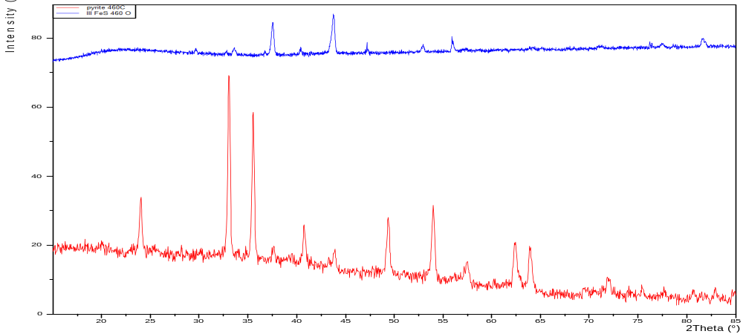
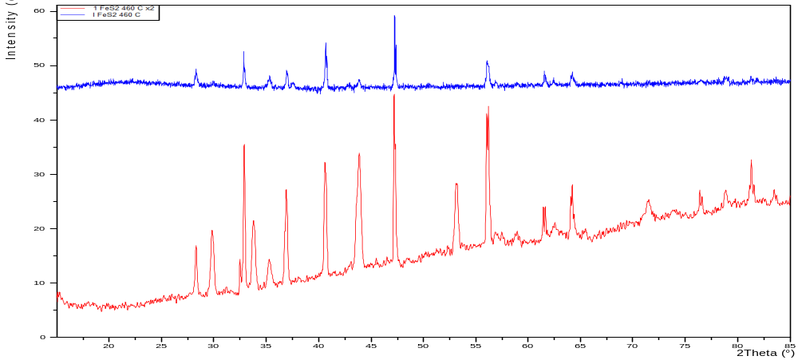




XRD Results (460°C)
  Mix
$$Intensity (cps)$$
Oven
  CO₂
Hematite
Pyrrhotite
Sulfur
Magnetite
0 20 25 30 35 40 45 50 55 60 65 70 75 80 85
$$2Theta(degrees)$$
  Mix
  CO₂
$$Intensity (cps)$$
Chamber
$$2Theta(degrees)$$
0 20 25 30 35 40 45 50 55 60 65 70 75 80 85

Slide 16
Results (Oven)
Atmosphere | 460°C, 1 bar (Lowlands) |  | 380°C, 1 bar (Highlands)
CO₂ (100%) | Fe₂O₃ | 100% | FeS₂ Fe₂O₃ | 88% 12%
CO₂ (96.5%), N₂ (3.5%), SO₂ (150 ppm) | Fe_{0.875}S S | 70% 30% | FeS₂ | 100%
Notes:
Oxidation of pyrite in CO2 experiments

Slide 17
Results (Chamber)
Atmosphere | 460°C, 95 bar (Lowlands) |  | 380°C, 55 bar (Highlands)
CO₂ (100%) | FeS₂ Fe_{0.875}S | 65% 35% | FeS₂ Fe₃O₄ | 90% 10%
CO₂ (96.5%), N₂ (3.5%), SO₂ (150 ppm) | FeS₂ | 100% | FeS₂ S | 85% 15%

Slide 18
Summary
Pyrite was unstable in CO₂
Pyrite was stable in mixed atmosphere
  Lowland temperature in the oven resulted in disappearance of pyrite
  SO₂ in the atmosphere prevents oxidation of pyrite
Source of sulfur (s) in the 380°C and 55 bar experiment unknown:
  Pyrite
  SO₂
Pressure plays a major role
Notes:
Due to the lack of other iron mineral assemblages, the solid sulfur is most likely originating from the SO2

Slide 19
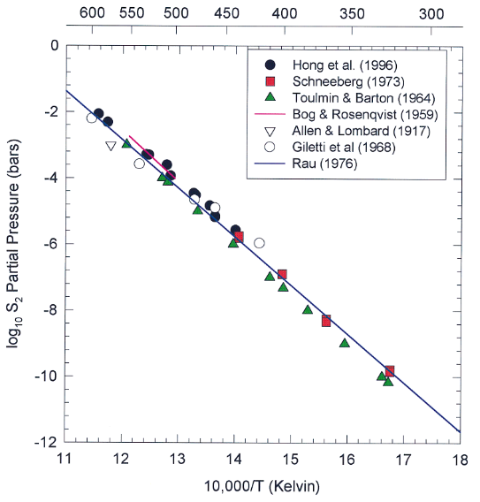
Discussion
(Fegley, 1997)
Notes:
Demonstrates that when pyrite decomposes sulfur is found in the atm. Therefore this explains our CO2 experiments where pyrite decomposes to form pyrrhotite and sulfur enters the atm. If sulfur is in the atm it will probably stabilize pyrite.

Slide 20
Discussion
Expect CO₂ as driving factor:
  Formation of magnetite from pyrite and CO₂ :
    3 FeS₂ (s)+ 4 CO₂ (g) ↔ Fe₃O₄ (s)+ 4 COS (g) + S₂ (g)
  Formation of hematite from magnetite:
    2 Fe₃O₄ (s)+ CO₂ (g) ↔ 3 Fe₂O₃(s) + CO (g)

Slide 21
Discussion
However, possible that O₂ was the driving factor:
  Magnetite and hematite could form from pyrite and O₂:
    3 FeS₂ (s)+ 2 O₂ (g) ↔ Fe₃O₄(s) + 3 S₂ (g)
    12 FeS₂ (s)+ 9 O₂ (g) ↔ 6 Fe₂O₃(s) + 12 S₂ (g)

Slide 22
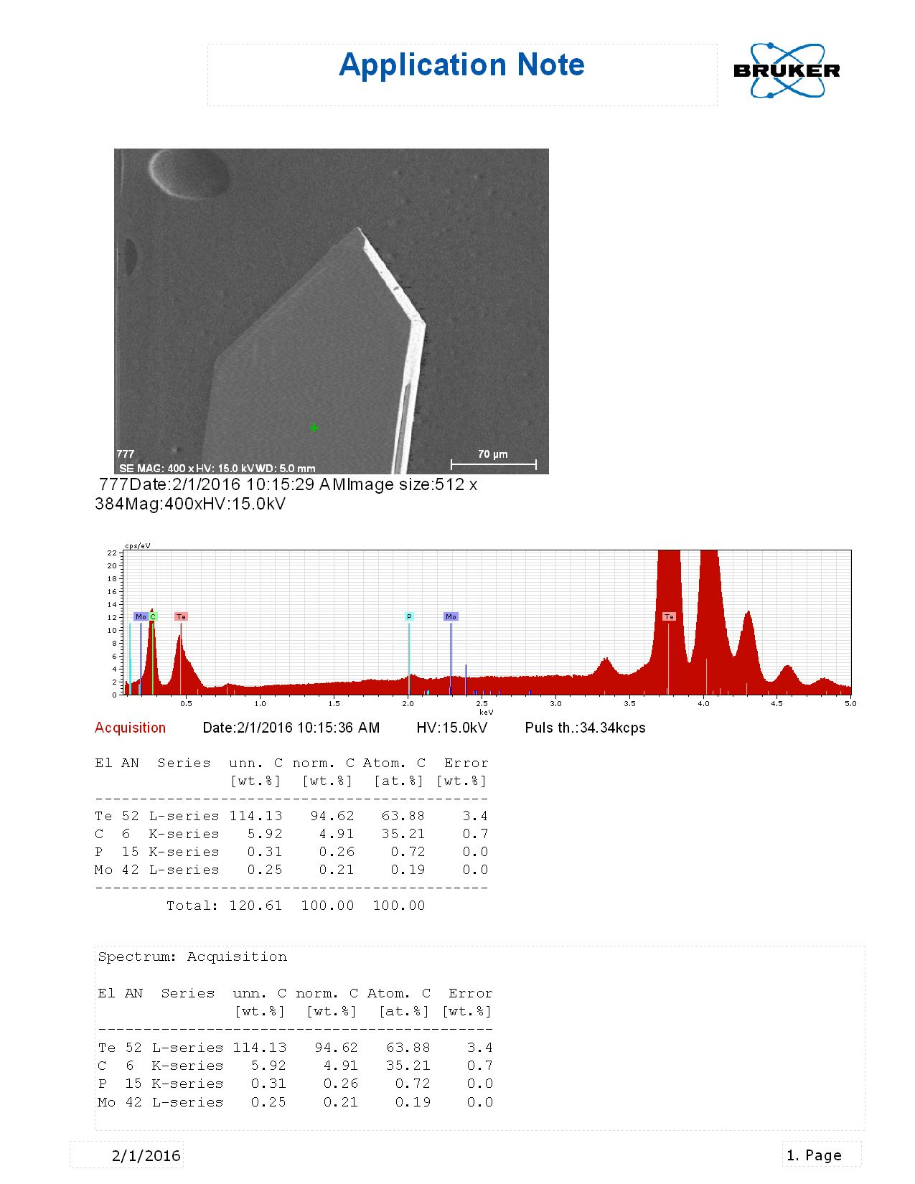
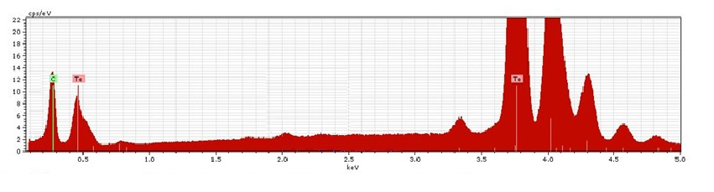
Discussion
C
Te
Te
0.5 1.0 1.5 2.0 2.5 3.0 3.5 4.0 4.5 5.0
(KeV)
SEM results of tellurium powder inserted into CO₂ filled Lindberg Tube Oven at 460°C for 24 hours.
Notes:
In a parallel experiment we are doing with tellurium powder and the oven, tellurium needle crystals formed at 460C.

Slide 23
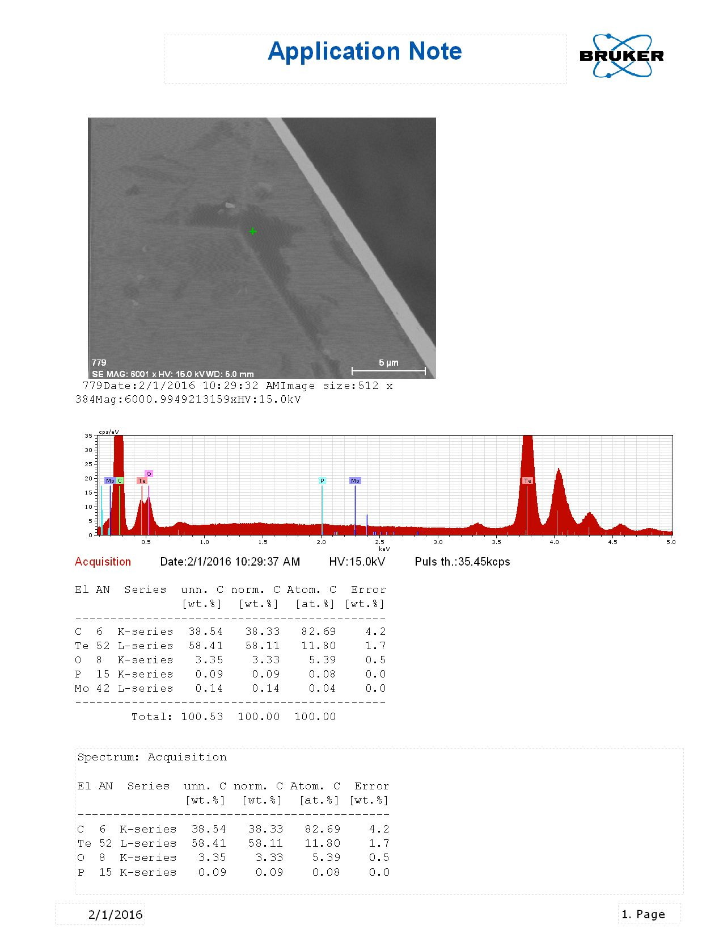
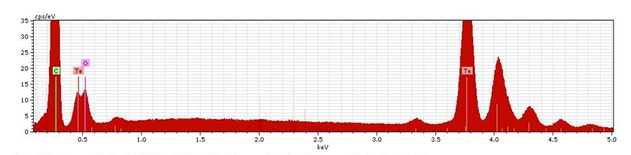
Discussion
B
Te
C
O
Te
0.5 1.0 1.5 2.0 2.5 3.0 3.5 4.0 4.5 5.0
(KeV)
SEM results of dark smears located on surface of tellurium crystals.
Notes:
When we specifically analyze dark streaks on the crystal it is almost all carbon with some oxygen. Therefore possible that CO2 dissociates to make O2 and C and the O2 reacts with pyrite.

Slide 24
Conclusion
Pyrite oxidized in a pure CO₂ environment

Slide 25
Conclusion
Pyrite oxidized in a pure CO₂ environment
Pyrite was mostly stable under pressure in the mixed atmosphere

Slide 26
Conclusion
Pyrite oxidized in a pure CO₂ environment
Pyrite was mostly stable under pressure in the mixed atmosphere
  SO₂ in the venusian atmosphere should stabilize pyrite

Slide 27
Conclusion
Pyrite oxidized in a pure CO₂ environment
Pyrite was mostly stable under pressure in the mixed atmosphere
  SO₂ in the venusian atmosphere should stabilize pyrite
  Pressure greatly affects chemical reaction

Slide 28
Conclusion
Pyrite oxidized in a pure CO₂ environment
Pyrite was mostly stable under pressure in the mixed atmosphere
  SO₂ in the venusian atmosphere should stabilize pyrite
  Pressure greatly affects chemical reaction
  Pyrite unlikely source of radar anomaly

Slide 29
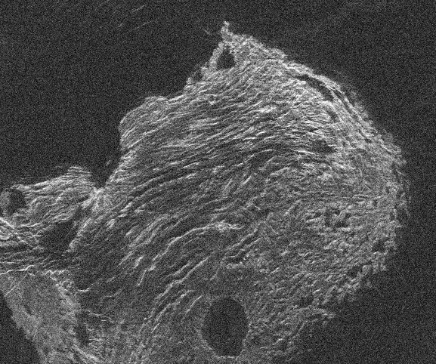


Acknowledgements
This study was supported by Arkansas Space Grant Consortium grant #UAF2140 YR 21 and NASA Grant #NNX13AR94H
(Image courtesy of NRAO/AUI and Campbell et al., NRAO, NAIC)

