Slide 1
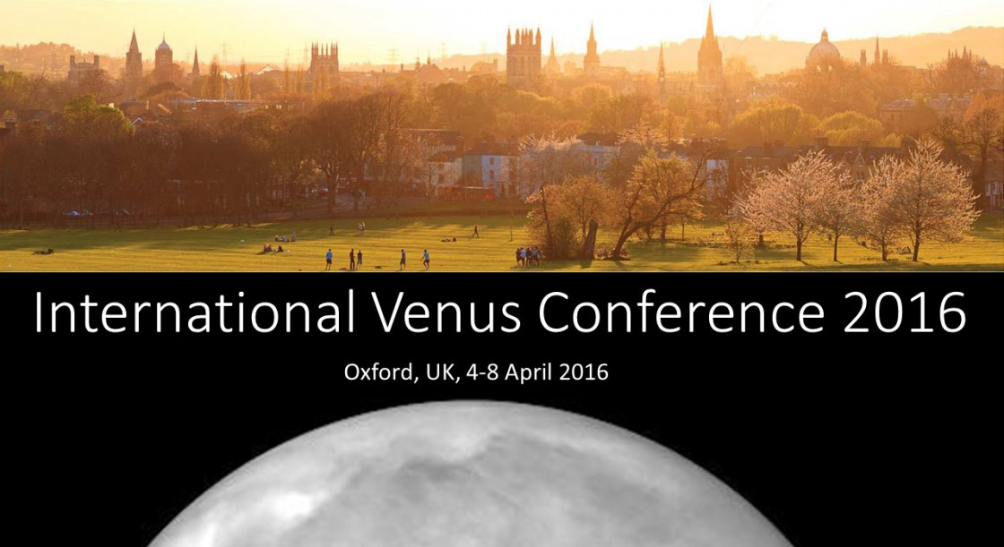
Dynamics and Circulation of the Venus Atmosphere:
Expected Contributions of Akatsuki Observations.
G. Schubert, S. Lebonnois, , F. Lefevre, and A. Solzenbach

Slide 2
Research Plans and Expected Akatsuki Contributions
Use the Laboratoire de Météorologie Dynamique (LMD)
VGCM to interpret Akatsuki data and constrain model calculations.
Akatsuki will provide very good coverage of cloud-top winds
and temperatures in the equatorial region, both on the dayside
and nightside.
Compared to Venus-Express, Akatsuki will give better coverage
of the equatorial region and help to distinguish hemispheric
differences in the circulation.
Akatsuki will provide winds in the lower regions of the cloud
on the nightside.
Akatsuki's images should help constrain the mixing processes
in the upper cloud near the subsolar point.

Slide 3
Research Plans and Expected Akatsuki Contributions
Monitoring of SO₂ and CO by Akatsuki will help us understand
the circulation and discriminate among proposed explanations
for the observed long term variations in SO₂ concentration above
the clouds. The LMD VGCM includes a photochemical model to
study these distributions in a coupled dynamics/photochemistry
analysis.
It is is now timely, given 9 years of data from Venus Express and
observations from Akatsuki to use data assimilation to extrapolate
the observations in space and time with a model to recover the
state of the atmosphere as completely and accurately as possible.

Slide 4
Analysis of the LMD VGCM Planetary Boundary Layer (PBL)
G. Schubert, S. Lebonnois, , F. Lefevre, and A. Solzenbach

Slide 5
The Planetary Boundary Layer
Perhaps the most important region in Venus’ atmosphere and the
region least constrained by observations is the boundary layer at the
surface of the planet.
Vertical transport in the boundary layer by convection and/or
small scale turbulence transfers energy and momentum between
the surface and the atmosphere.
The proper representation of this region is crucial for understanding
how the bulk of Venus’ atmosphere acquires its angular momentum.
In the absence of observations it makes sense to learn what we can
about the boundary layer from theoretical considerations, in particular,
GCM calculations.

Slide 6
Parameterization of the Dry Convective Boundary Layer
in the LMD VGCM
The parameterization utilizes a Mellor and Yamada (1982) scheme, adapted to the LMDZ GCM by Hourdin et al. (2002). It has been successfully applied to Mars and Titan (Charnay & Lebonnois 2012) GCMs.
The parameterization of vertical mass flux in the boundary layer is based on an idealization of convective rolls and thermals. It incorporates the physics of convection.
At the surface of Venus the GCM calculates temperature from a
balance of solar and infrared heating and sensible heat flux, the
latter determined by the boundary layer parameterization.
The code thus calculates where the surface layer is stable and where instability leads to a convective boundary layer. CBL structure and fluxes are determined.

Slide 7
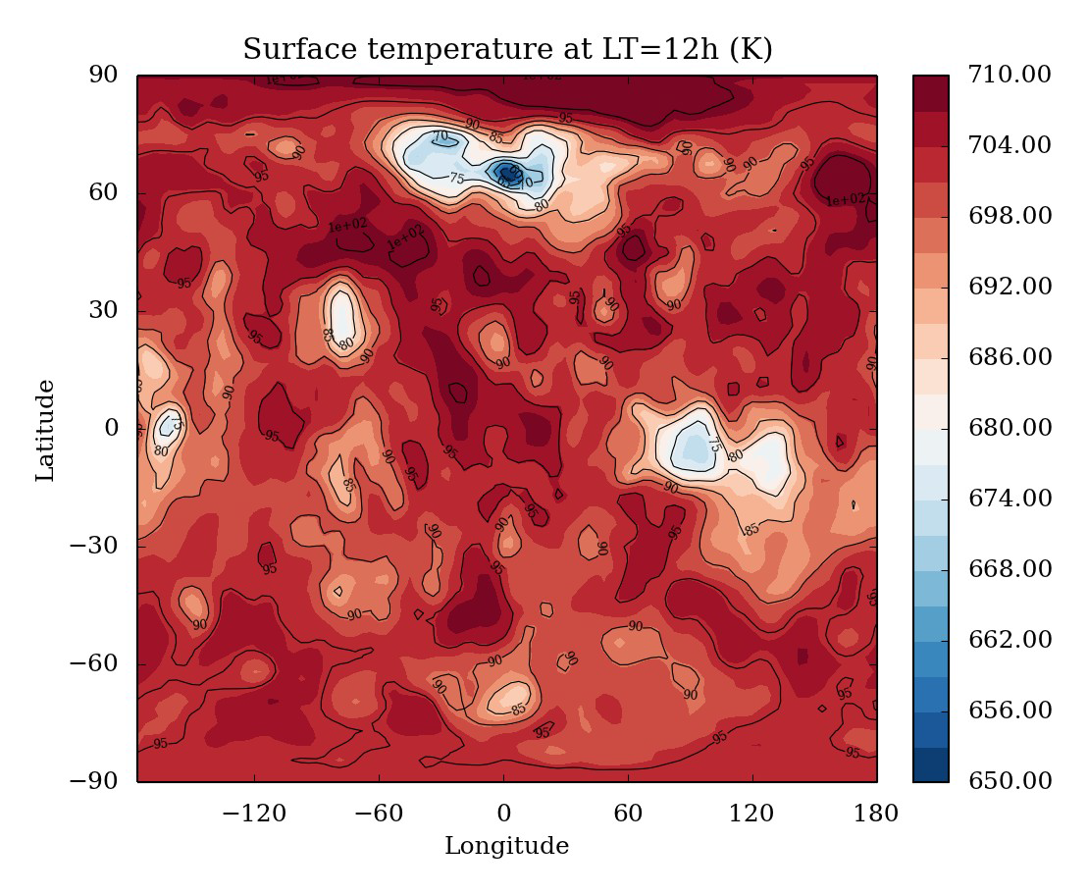
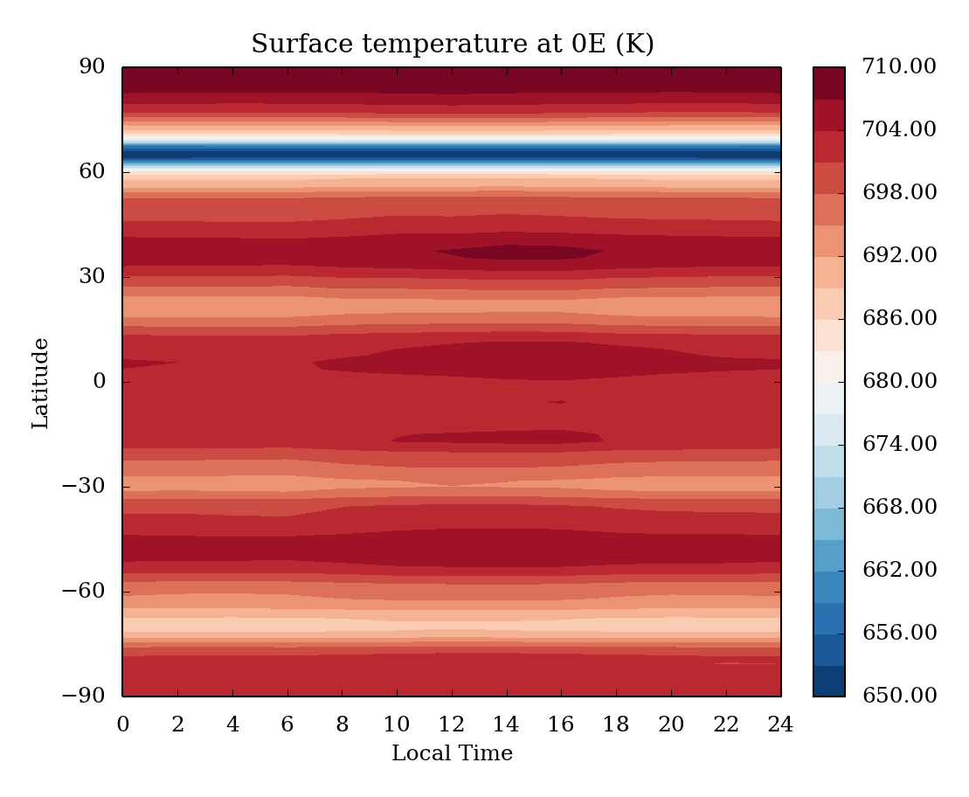
What the GCM tells us about Surface Conditions on Venus
Surface temperature map at noon.
Every grid point is taken at LT=12h.
Temperature is roughly 20 K lower than
observations.
Contours are surface pressure (in bar).
Diurnal cycle.
Temperature variations with LT are
small (of the order of a couple of K).

Slide 8
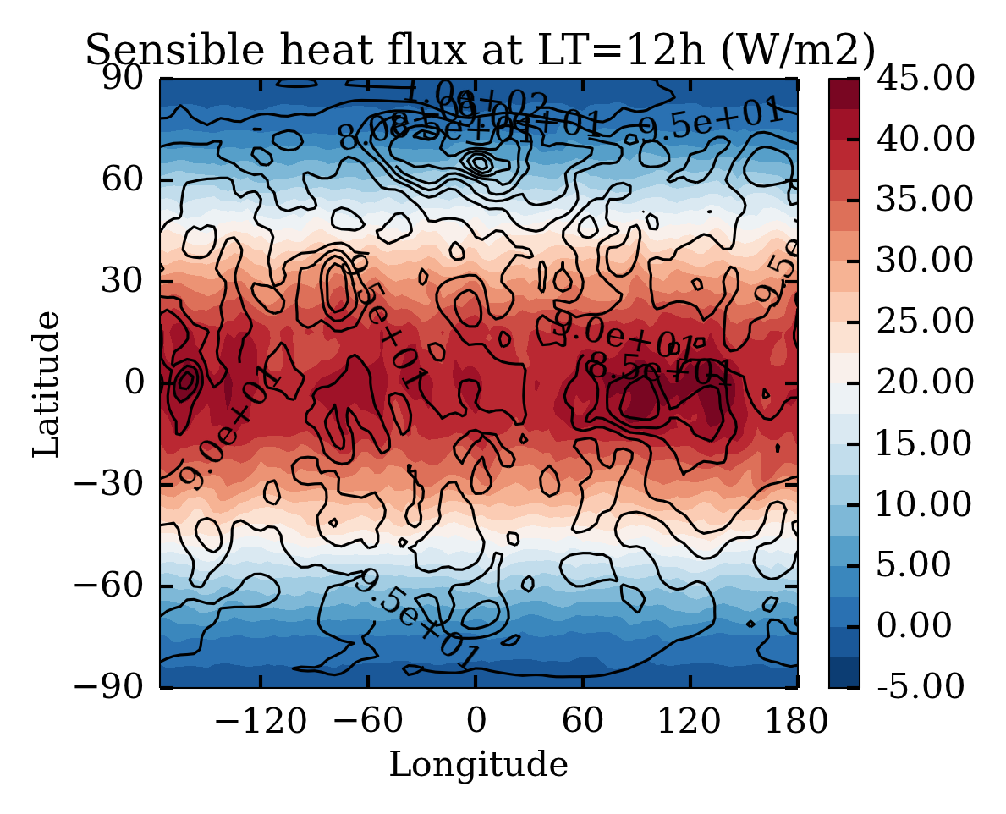
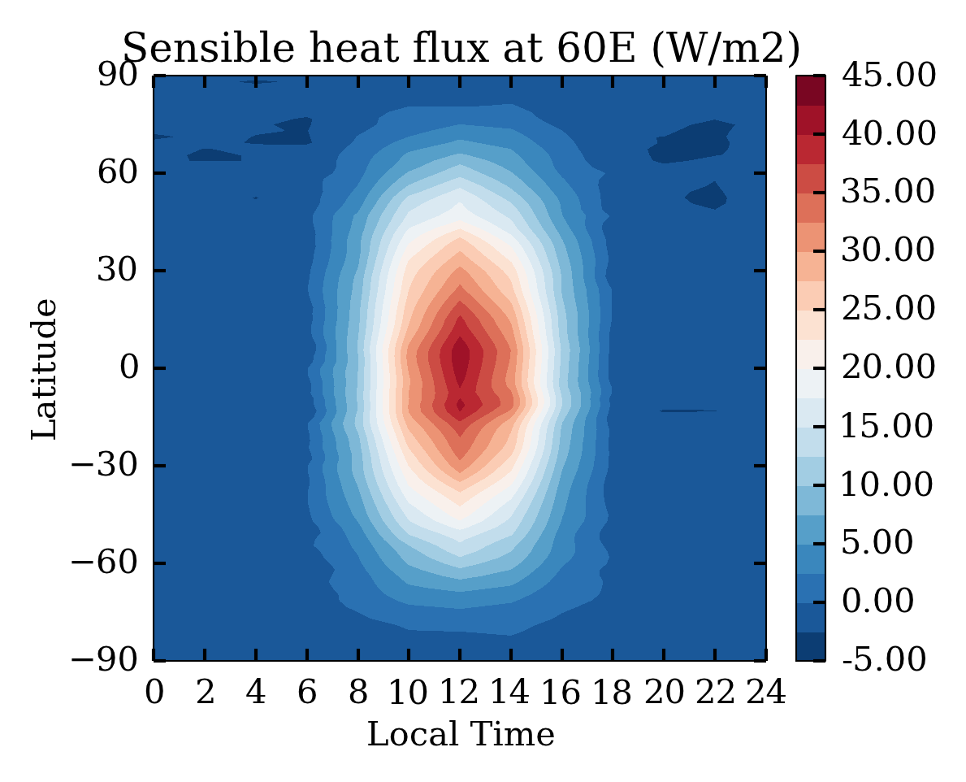
Sensible Heat Flux
Map at noon.
Every grid point is taken at LT=12h.
Contours are surface pressure (in bar).
Heat flux is upward in the equatorial
region and downward at high latitudes.
There is a small effect of topography
in the equatorial band.
Diurnal cycle.
Sensible heat flux variations with
LT are correlated with the solar cycle.

Slide 9
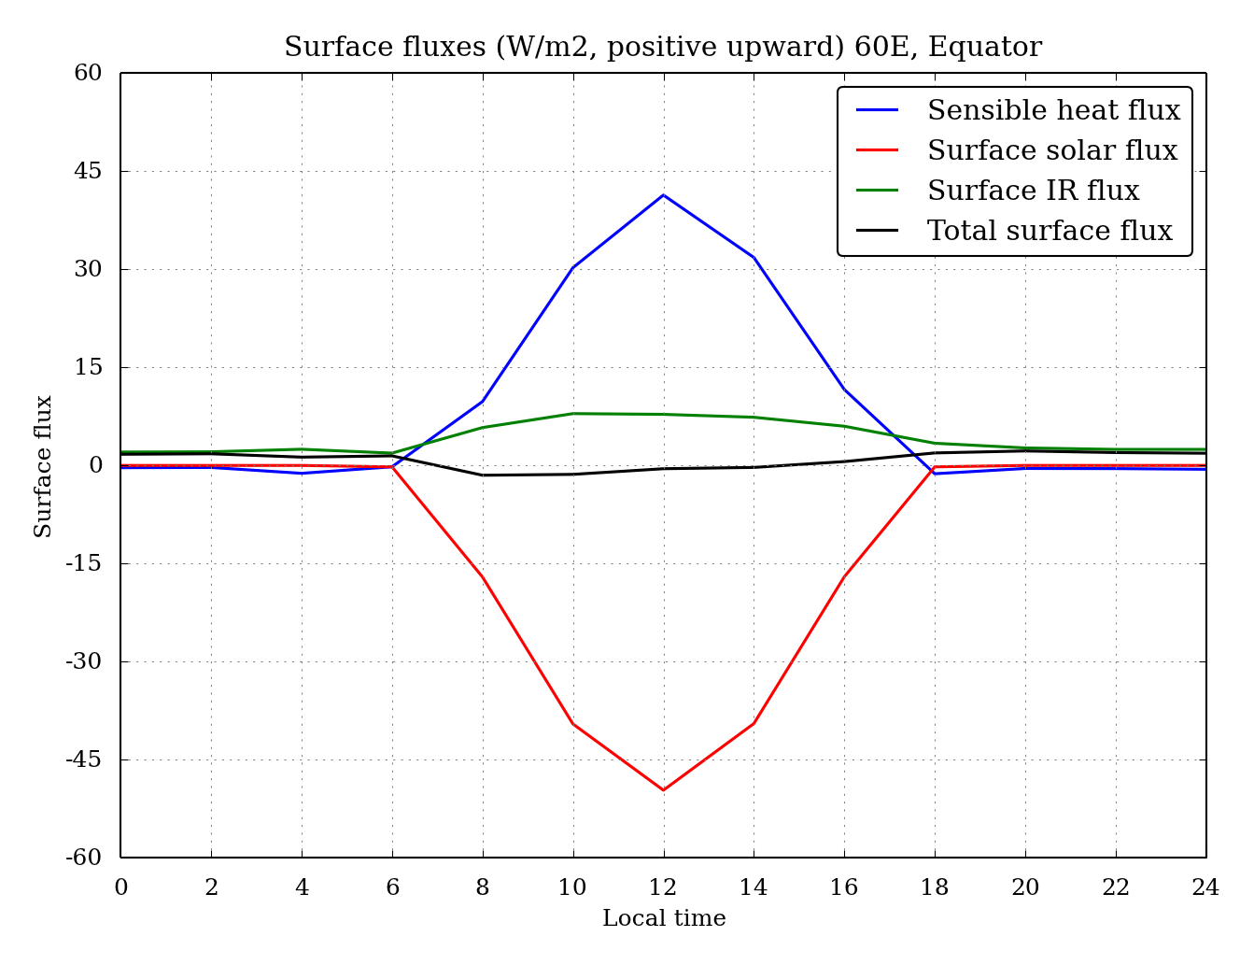
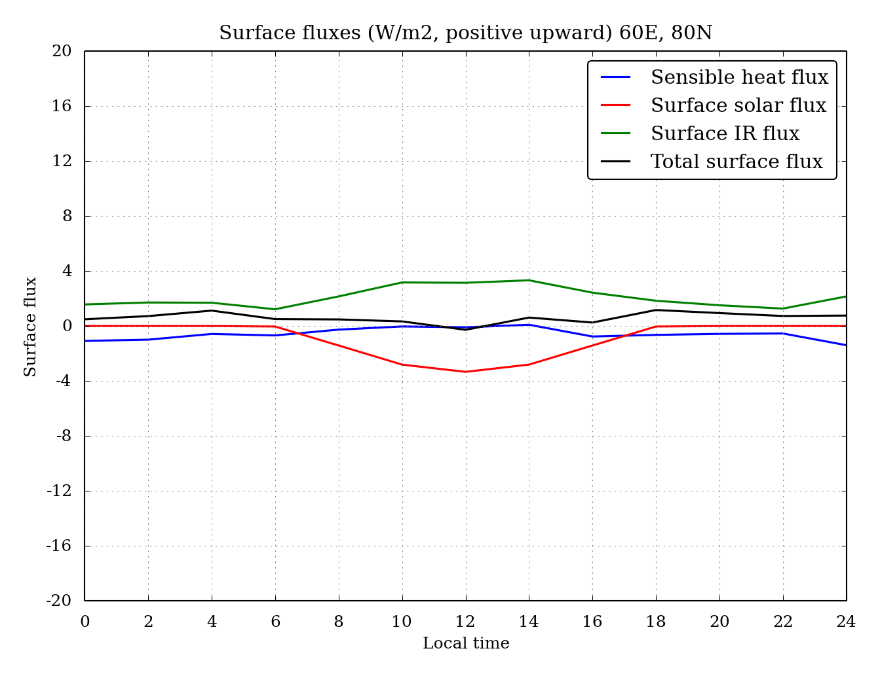
Surface Energy Fluxes
at the Equator and at a
High Northern Latitude.

Slide 10
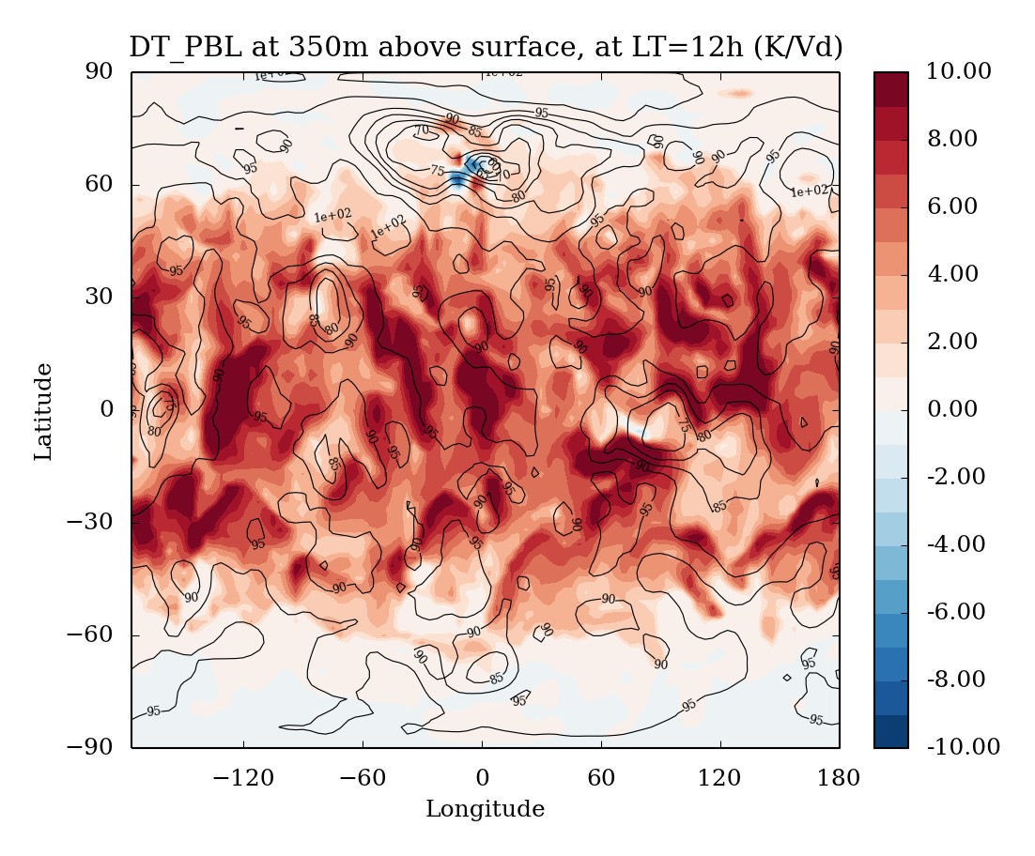
Heating Rates Close to the Surface
Map at noon. Every grid point is taken at LT=12h. Contours are surface pressure ( bar).
Heating rates due to the PBL are shown at 350 m altitude.

Slide 11
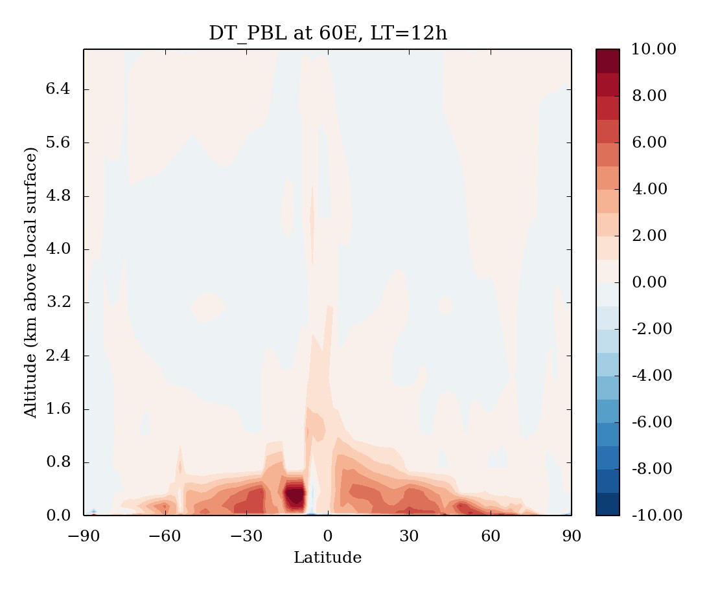
Heating Rates (K/Vd) as a Function of Latitude

Slide 12
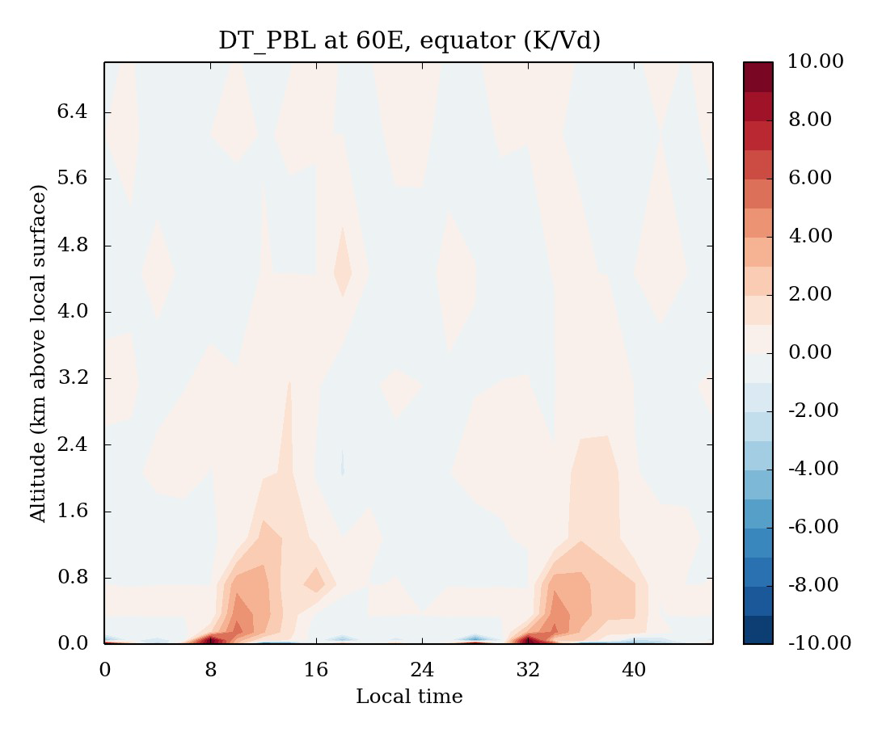
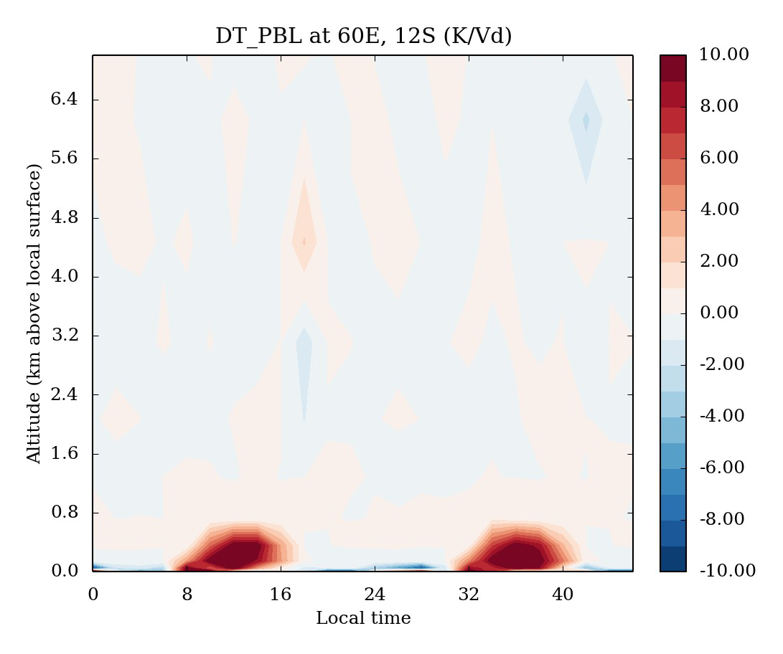
Heating Rate as a
Function of Local Time

Slide 13
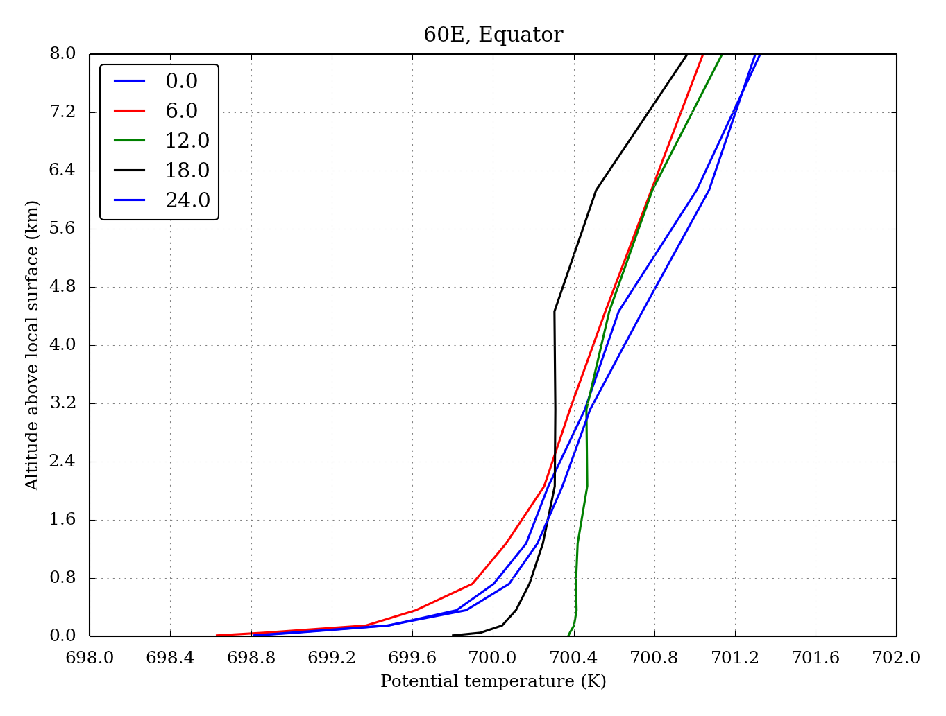
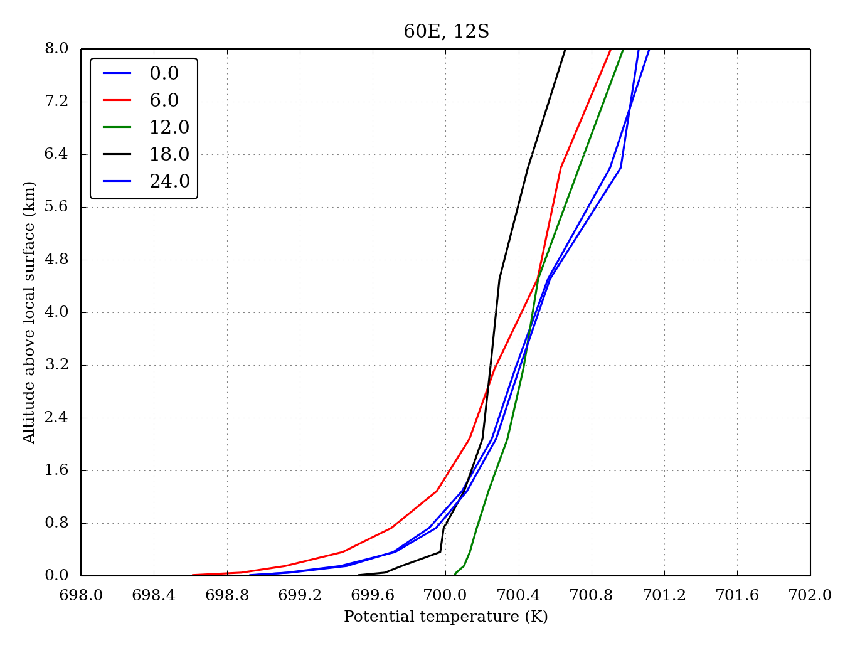
Potential Temperature
as a Function of
Local Time

Slide 14
CONCLUSIONS
1. Akatsuki will tell us if the atmospheric circulation is hemispherically symmetric.
2. Measurements of SO₂ by Akatsuki will help explain the observed secular change in the concentration of SO₂ above the clouds.
3. Sensible heat flux variations strongly correlate with the solar cycle.
4. Sensible heat flux in the PBL is upward in low and middle latitudes and much smaller and downward at high latitudes.
5. The convective PBL is active mainly at low latitudes during daytime.
6. The maximum thickness of the PBL is about 1-2 km, reaching ~5 km in some locations.
7. The vertical extension of the PBL depends on local conditions (T, vertical and horizontal winds).

Slide 15
Additional Slides

Slide 16
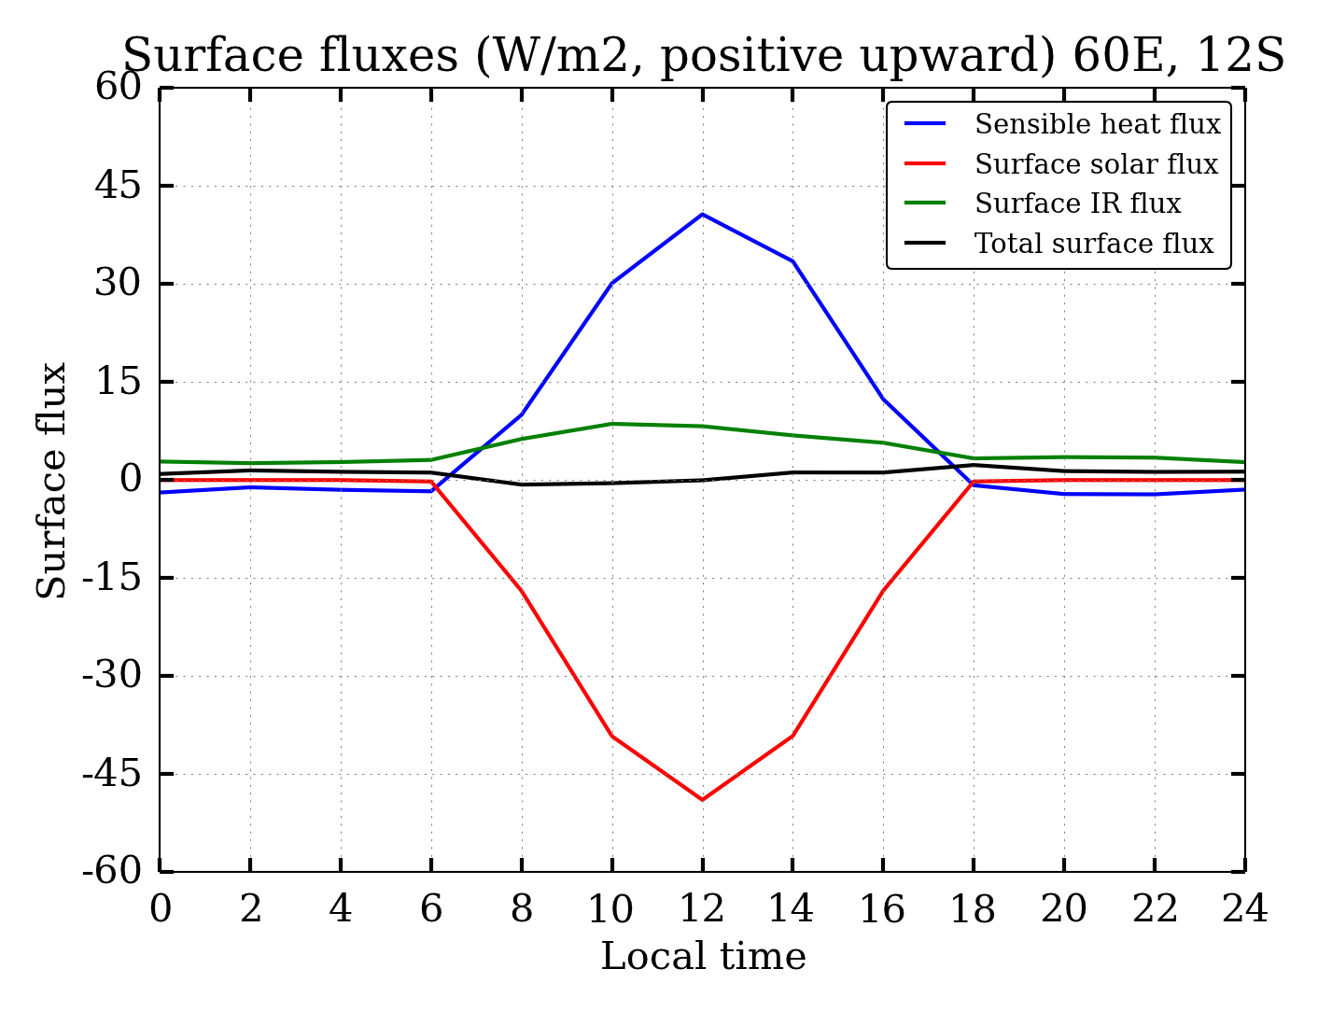

Slide 17
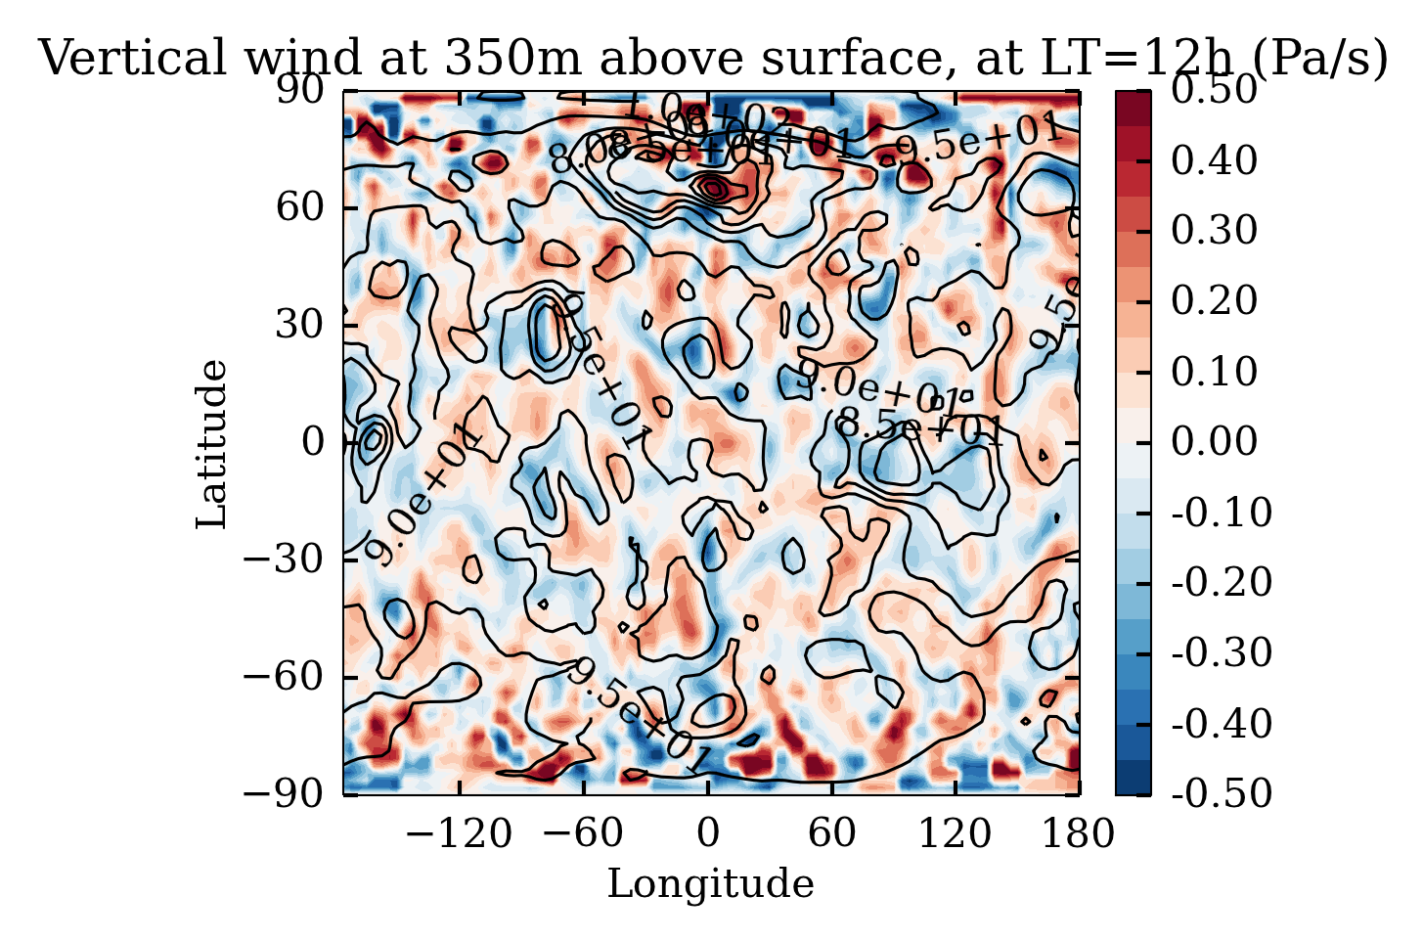
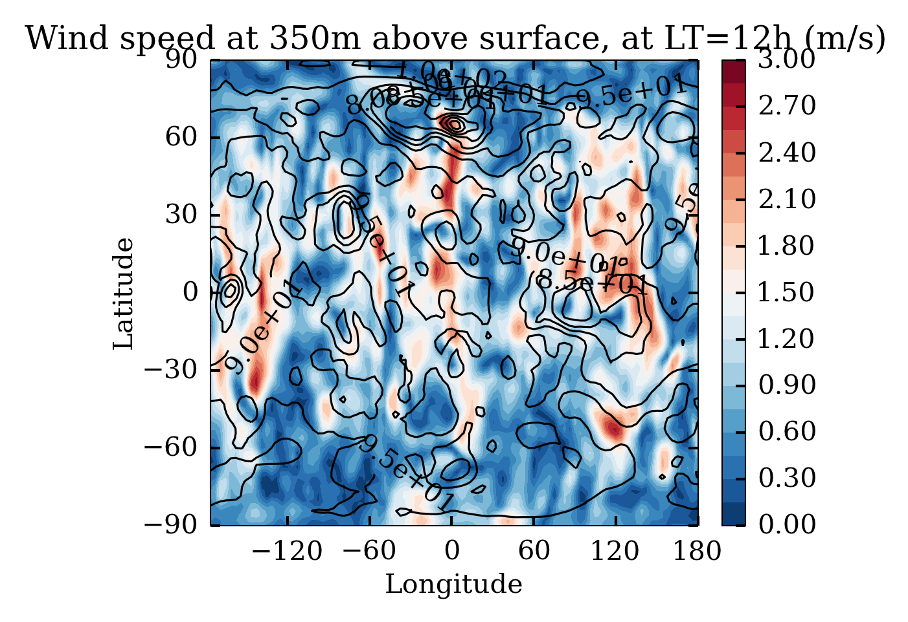

Slide 18
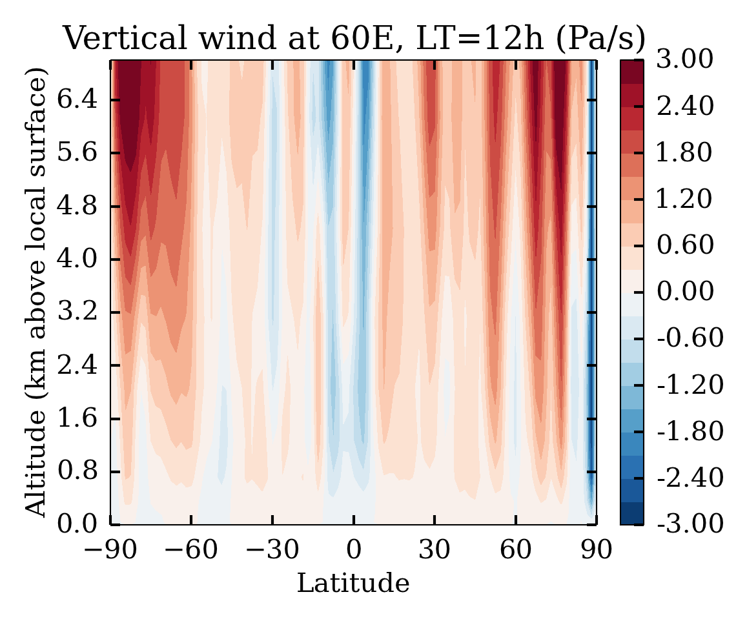
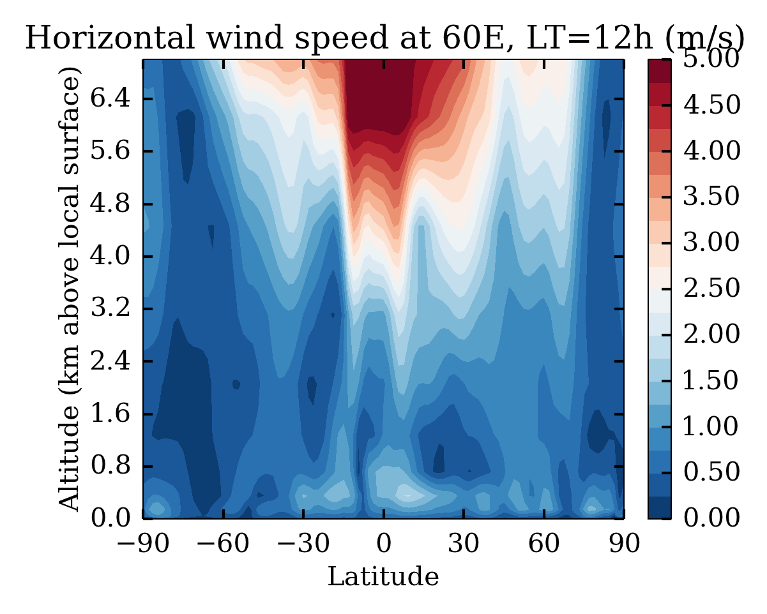

Slide 19
