Slide 1
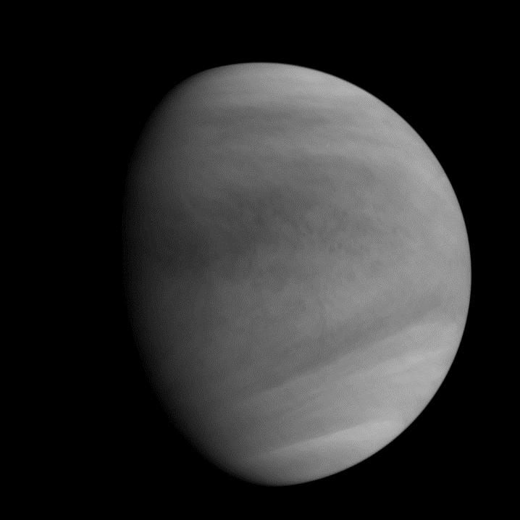
Three-dimensional modelling of Venus photochemistry
Franck Lefèvre¹, Aurélien Stolzenbach¹,
Anni Määttänen¹, Slimane Bekki¹,
Sébastien Lebonnois², Gabriella Gilli²
¹LATMOS, Paris, France
²LMD, Paris, France

Slide 2
Towards a consistent representation of the dynamics-radiation-photochemistry-microphysics
...from the surface up to the thermosphere
Photochemistry (this talk)
Microphysics (Sabrina Guilbon, poster #23)
Extension to thermosphere (Gabriella Gilli, poster #22)
Mesoscale modelling (Maxence Lefèvre, poster #12)

Slide 3
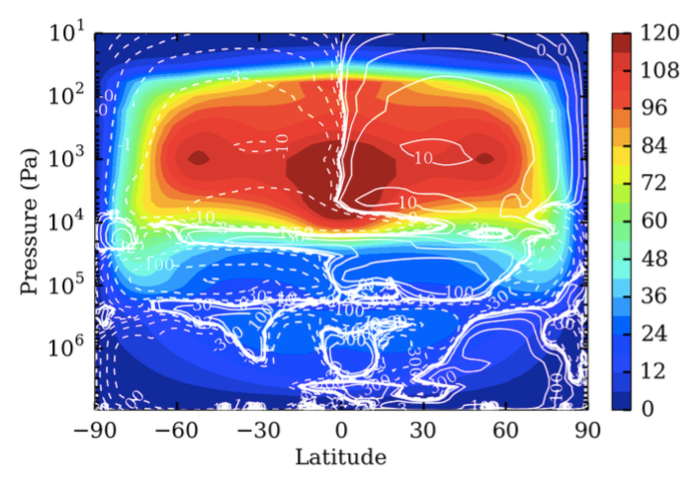
The LMD Venus GCM with photochemistry
LMD general circulation model (Lebonnois et al., 2010)
  surface to 100 km (50 levels)
  7.5° latitude × 5.6° longitude
Coupled photochemical package
  adapted from Mars photochemical model (Lefèvre et al., 2008)
  comprehensive chemistry of CO_{x}, HO_{x}, O_{x}, S_{x}, Cl_{x}
  35 chemical species
  no thermochemistry yet (except H₂SO₄ dissociation)
Cloud model
  H₂SO₄-H₂O aerosols at equilibrium, 3 modes, fixed radius (Knollenberg and Hunten, 1980)
  input: p, T, H₂O, H₂SO₄
  output: aerosol number density, composition, sedimentation rate
Zonal wind (m.s⁻¹) and meridional stream function (10⁹ kg.s⁻¹) simulated by the LMD general circulation model (Lebonnois et al., submitted).
Notes:
You cannot proceed without a representation of the clouds

Slide 4
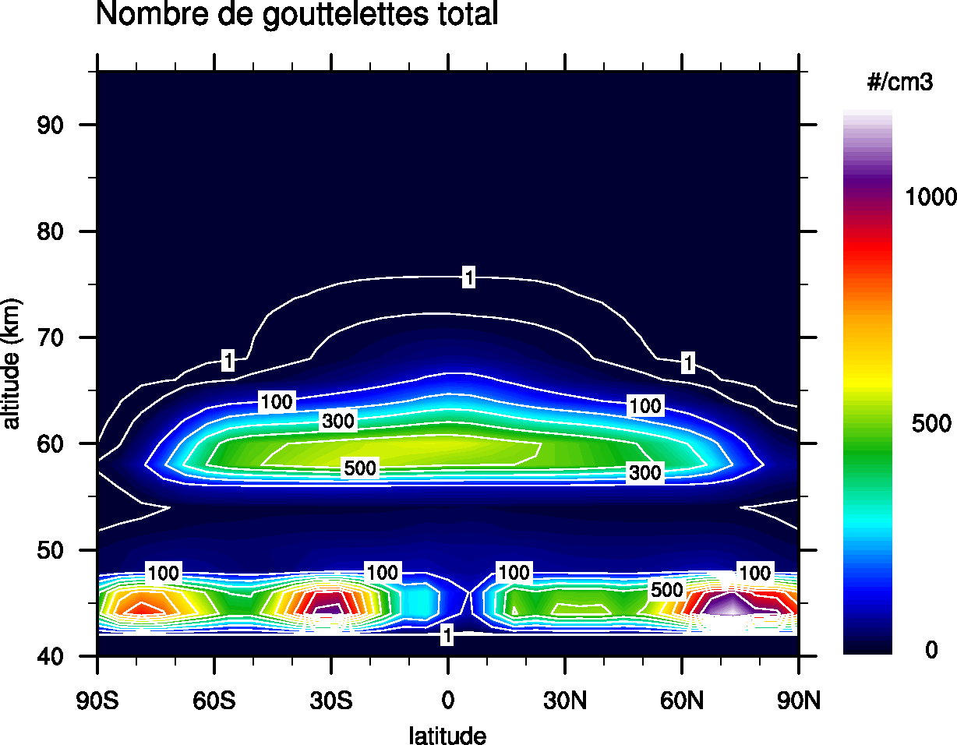
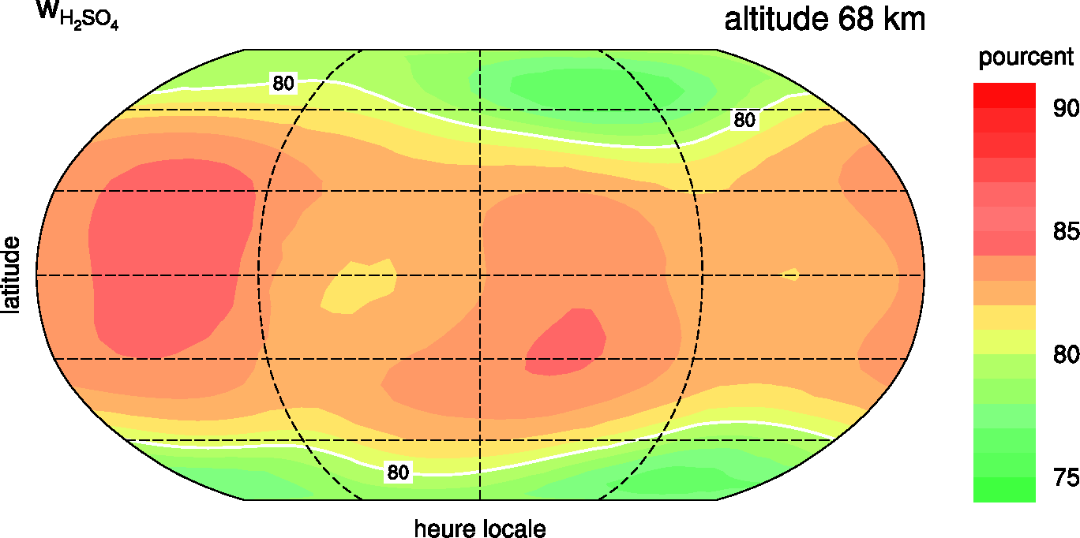
Cloud model results
Aerosol number density (cm⁻³)
Aerosol acidity (%H₂SO₄) at 68 km
mode 1
mode 1 + 2
mode 1 + 2
Number densities of modes 1 and 2 in line with Pioneer/LCPS (Knollenberg and Hunten, 1980)
Lack of large particles (mode 3) : only 1 cm⁻³
Aerosol composition in good agreement with VIRTIS-H measurements around 68 km (Cottini et al., 2012)

Slide 5
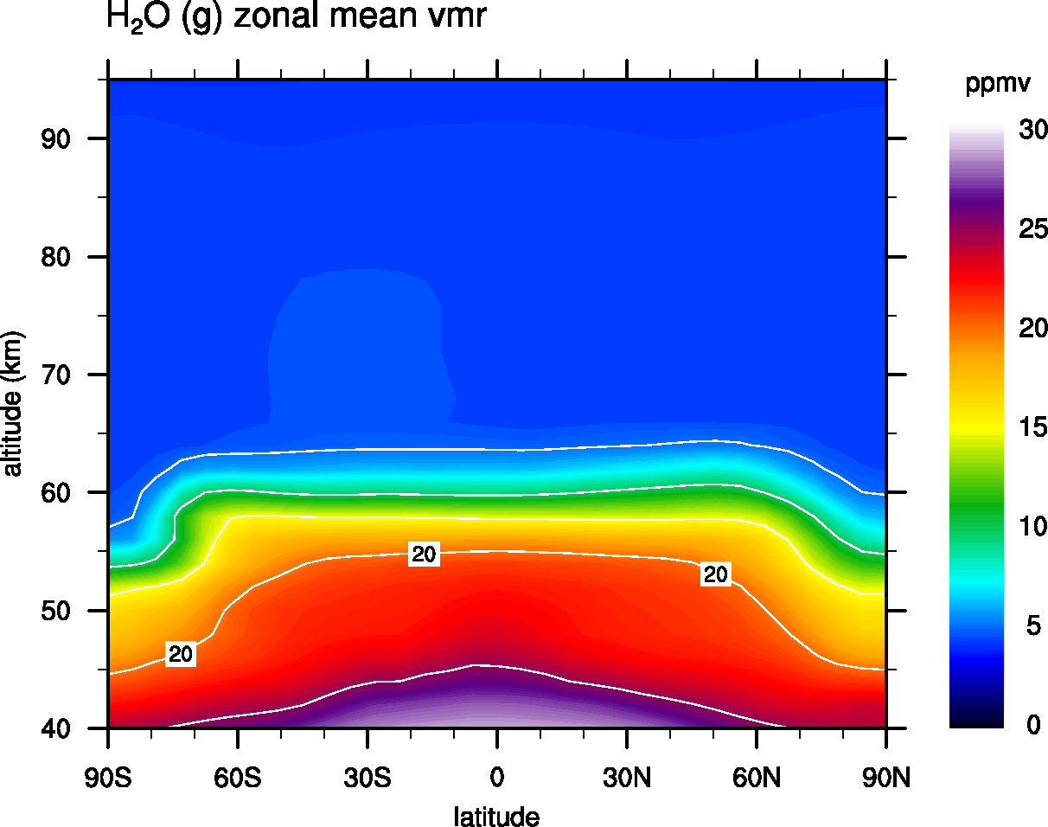
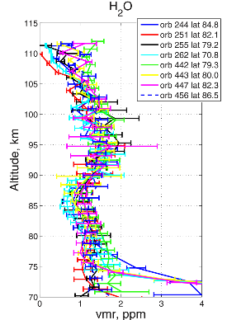
Gas-phase H₂O
SOIR/VEx measurements
(Fedorova et al., 2008)
Deep atmosphere SO₂ (ppmv) | 100 | 30 | 15 | 10
H₂O above the clouds (ppmv) | 0 | 0 | 1 | 4

Slide 6
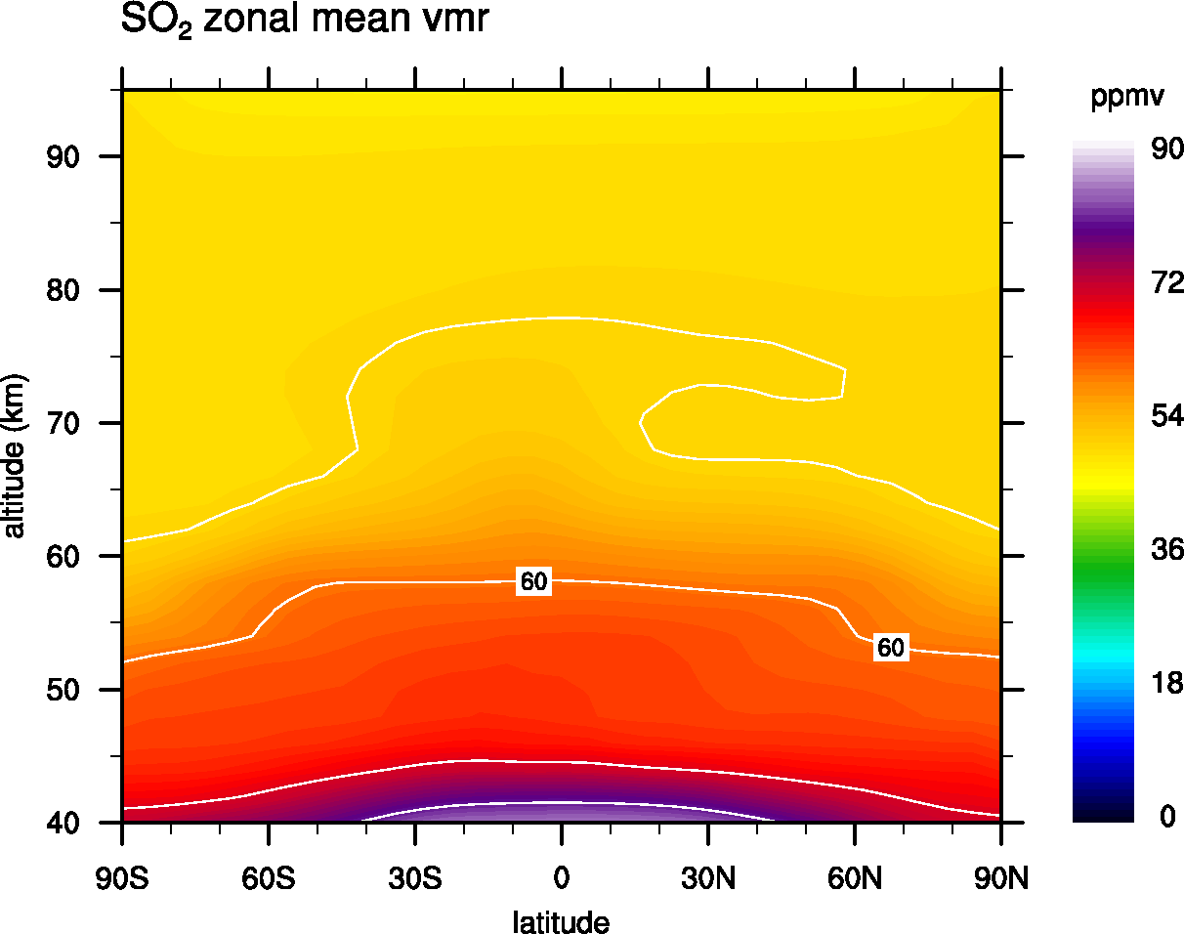
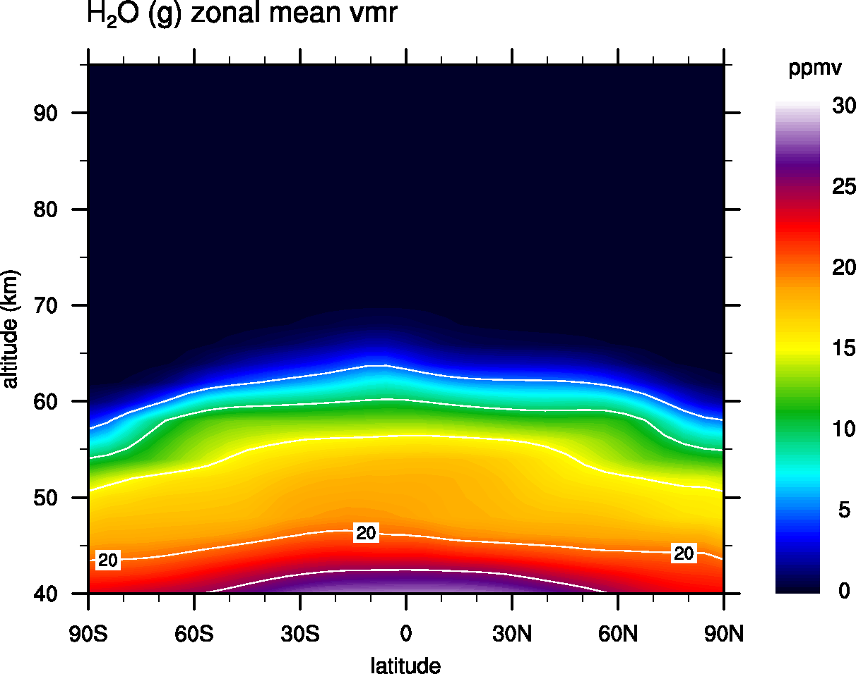
Impact of 100 ppmv of SO₂ in the deep atmosphere
< 0.1 ppmv
SO₂
Initialised to 100 ppmv in the deep atmosphere (VIRTIS-H, Marcq et al., 2008)
50 ppmv are transported above the clouds (still increasing after 30 Venus days)
H₂O
Initialised to 30 ppmv in the deep atmosphere (VIRTIS-H, Marcq et al., 2008)
Totally transferred to the liquid phase above the clouds.

Slide 7
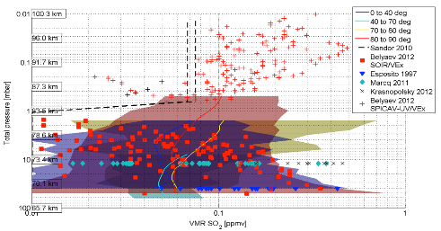
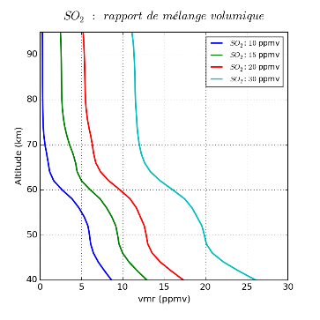
SO₂ above the clouds
80 km
Observed SO₂
SO₂ between 0.01-0.4 ppmv above the clouds (Mahieux et al., 2015)
Strong short and long-term variability (Marcq et al., 2012)
Increase with altitude (Belyaev et al., 2012)
Modelled SO₂
Strongly dependent on deep atmosphere SO₂
Observed SO₂ above the clouds requires less than 15 ppmv in the deep atmosphere
Notes:
To get around this difficulty

Slide 8
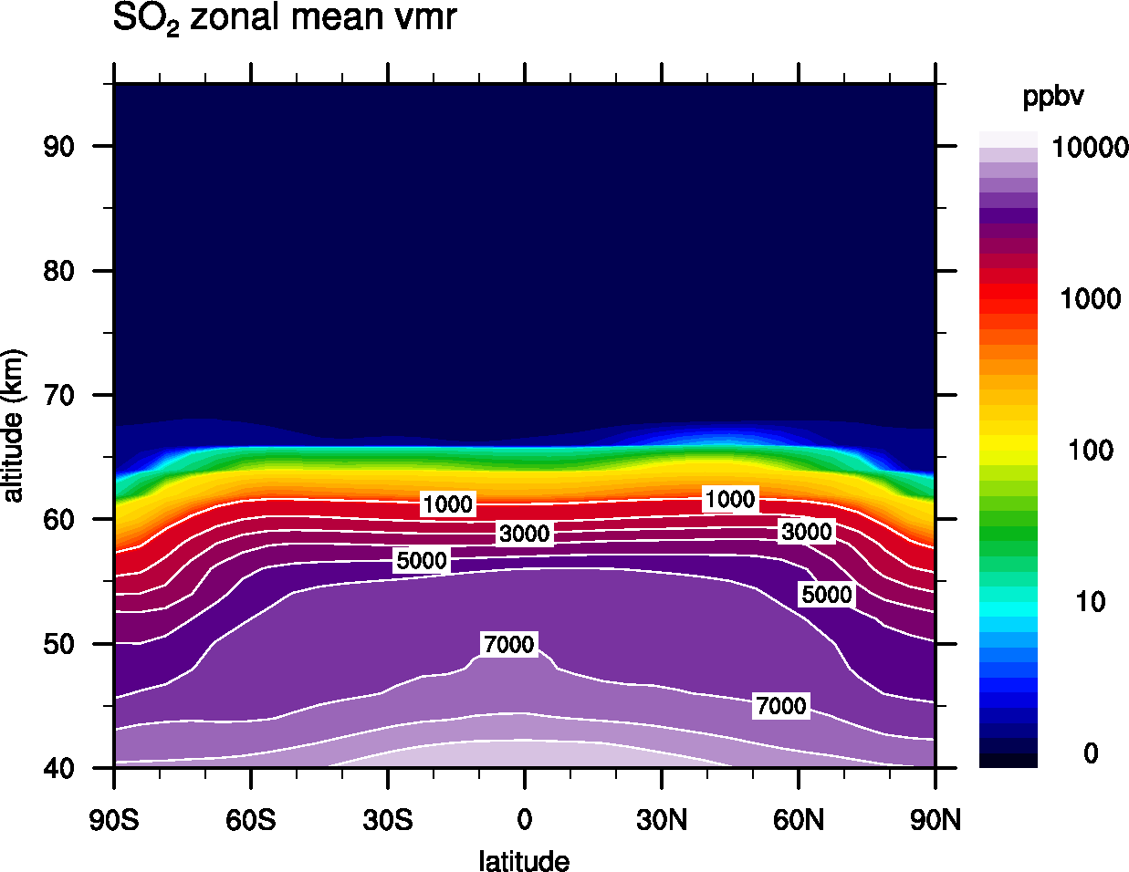
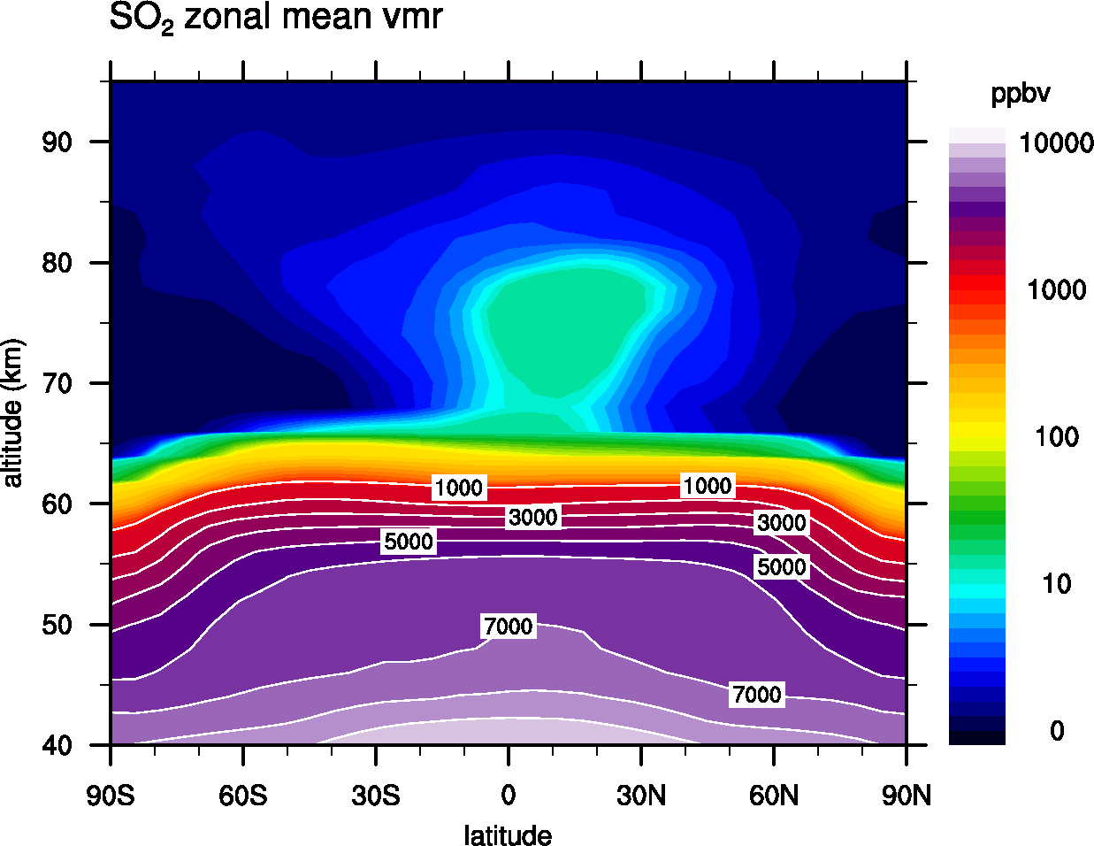
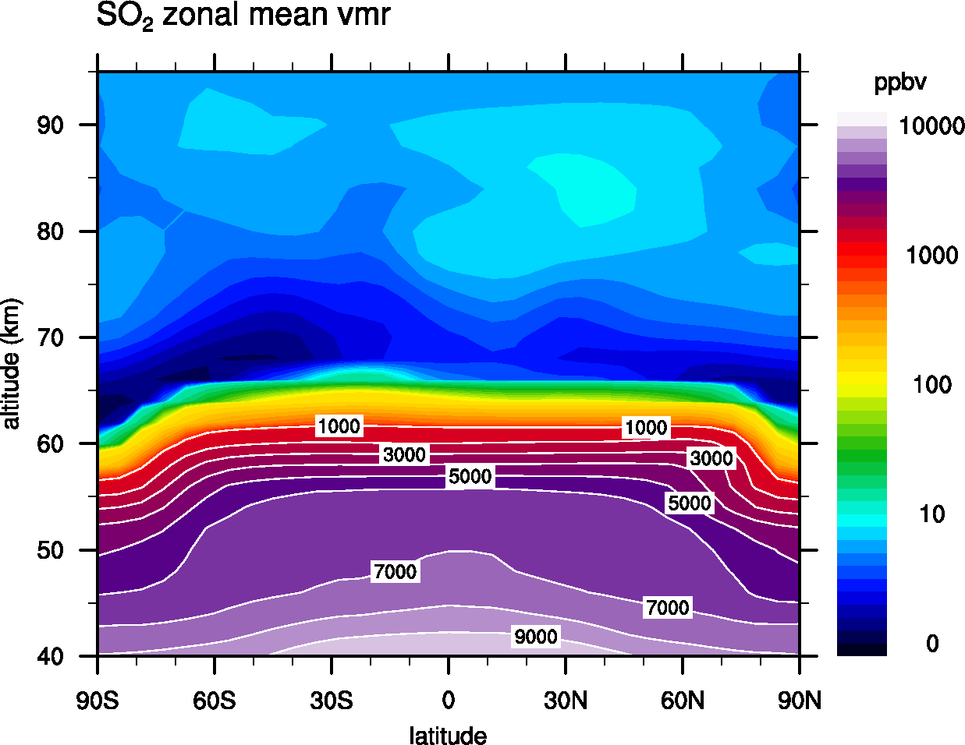
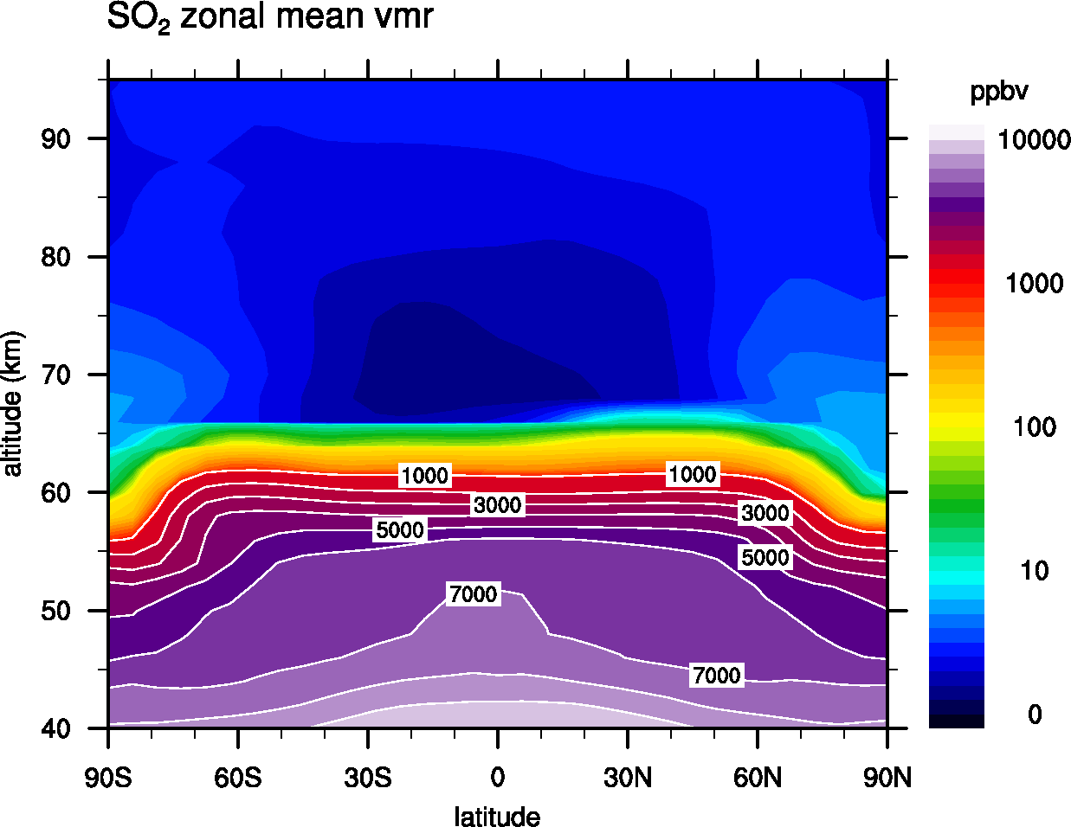
SO₂
1 ppbv
10 ppbv
1 month later
2 months later

Slide 9
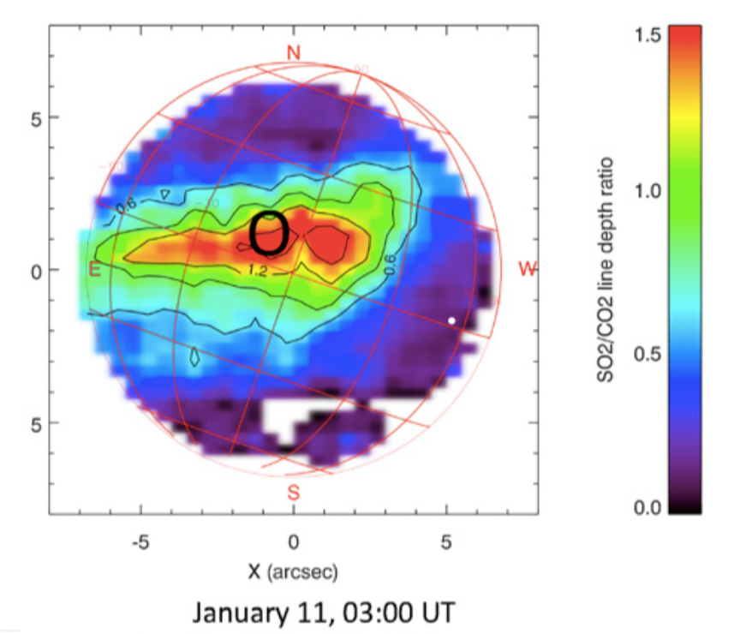
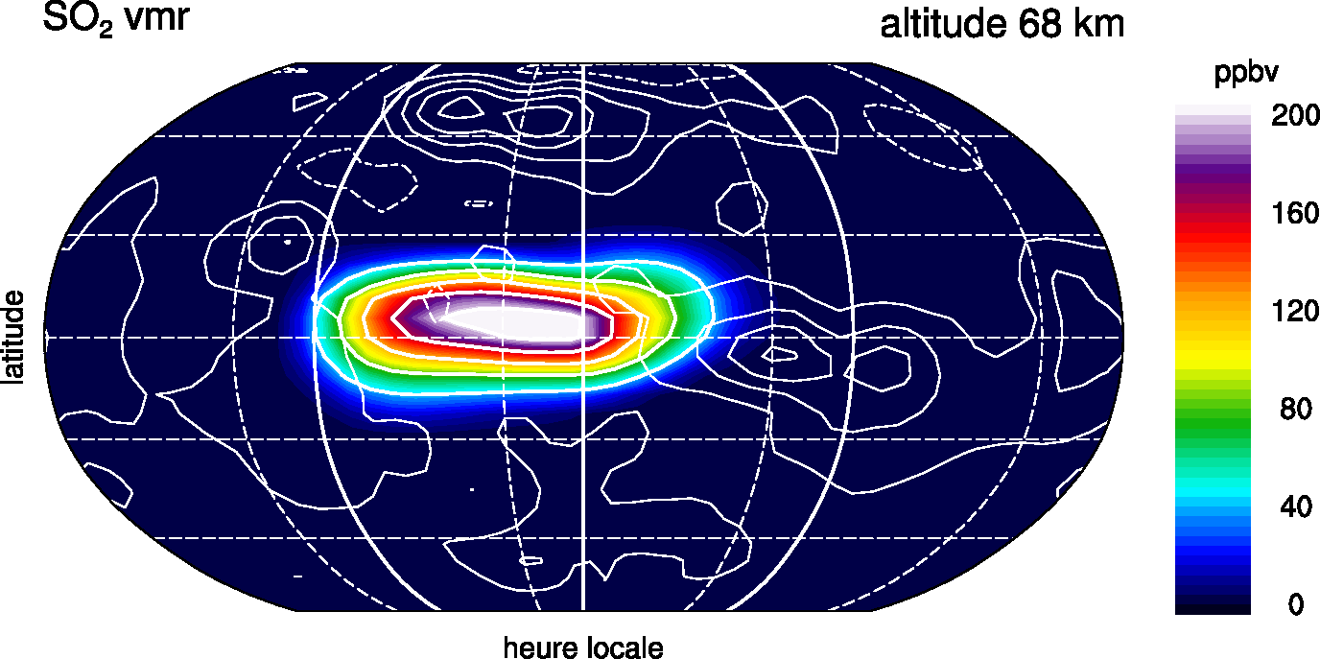
SO₂ equatorial injection
TEXES, 70 km (Encrenaz et al., 2012)
SO₂ max ≈ 100 ppbv
GCM, 68 km
SO₂ max ≈ 200 ppbv

Slide 10
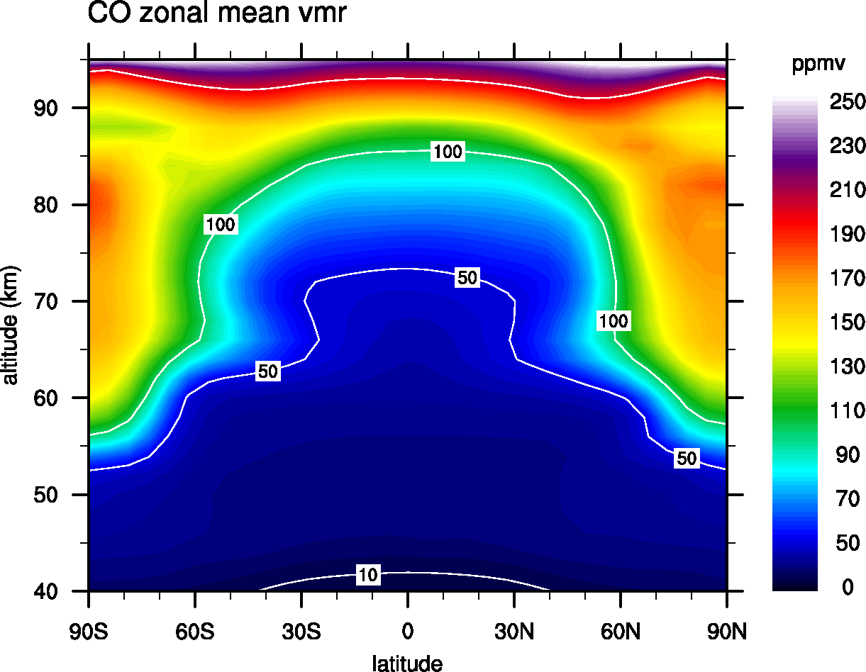
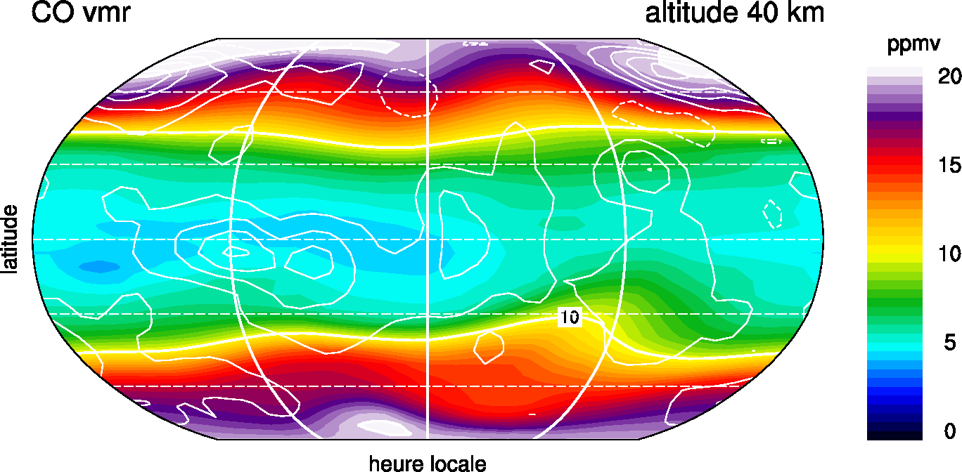
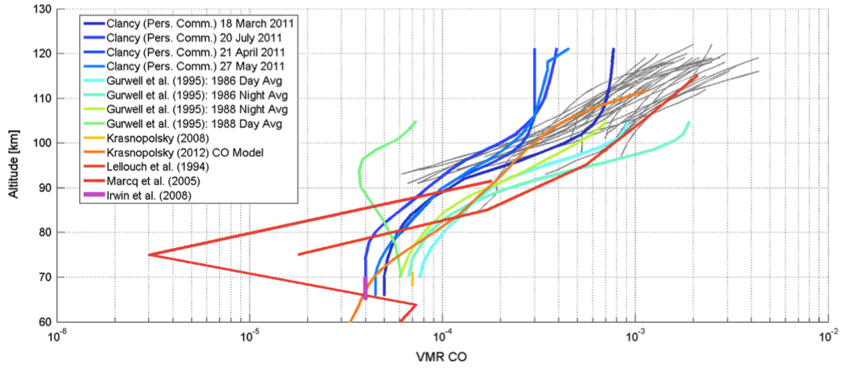
Carbon monoxide CO
Strong Hadley cell signal in the CO distribution
The signal propagates down to the lower atmosphere as observed by VIRTIS (Marcq et al., 2008; Tsang et al., 2008)
Reasonable quantitative agreement above the clouds
40-100 ppmv at 80 km
Vandaele et al., 2015

Slide 11
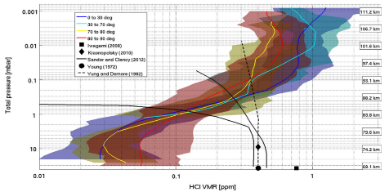
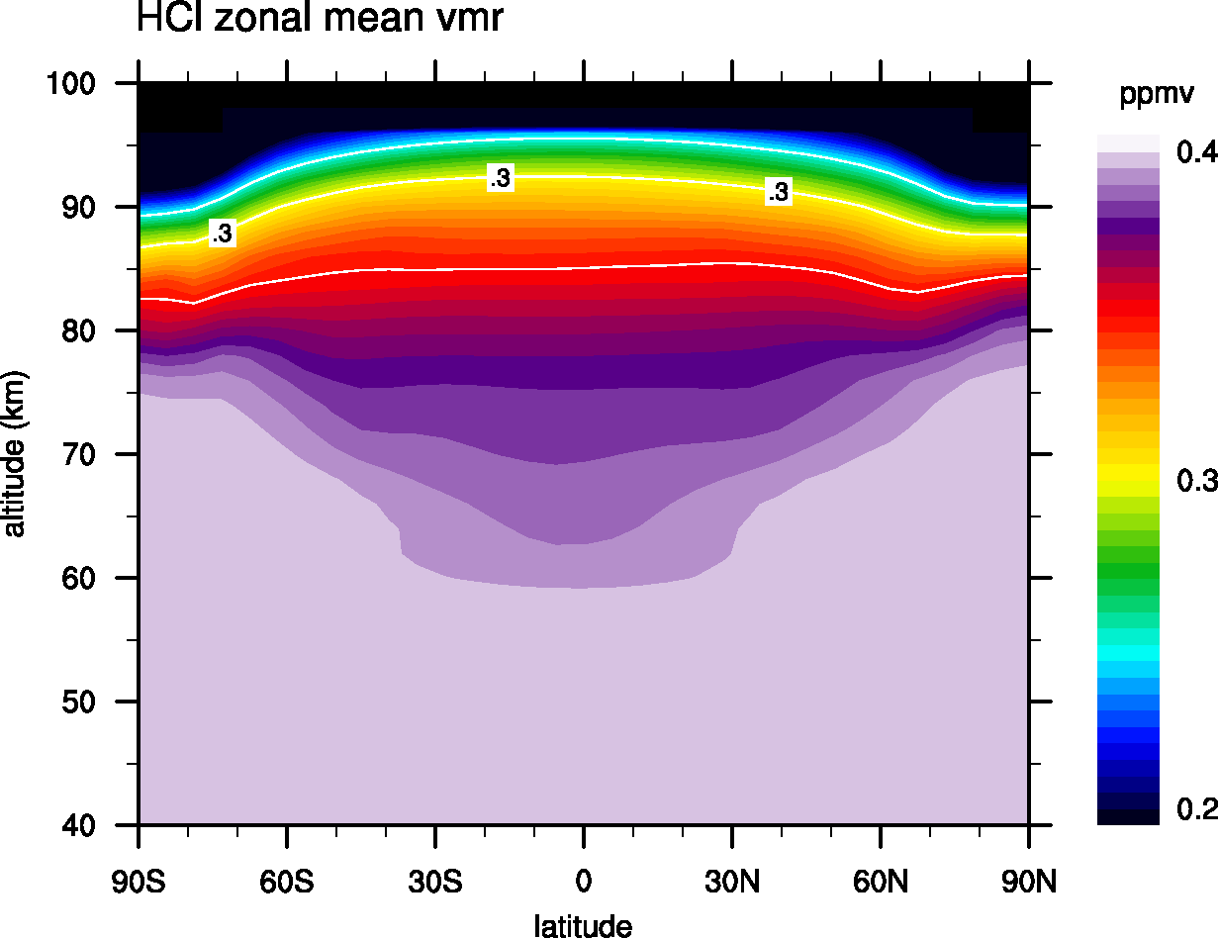
Hydrogen chloride HCl
80 km
Observed HCl
Strong disagreement between ground-based and SOIR data (Mahieux et al., 2015)
Modelled HCl
Constant mixing ratio up to 60-70 km
HCl decrease at higher altitudes consistent with ground based measurements (Krasnopolsky, 2010; Sandor and Clancy, 2012)

Slide 12
Summary
First surface-to-mesosphere photochemical model of Venus
Cloud layer
  number densities and composition ok but almost no mode 3 particles
H₂O
  condensation barrier well reproduced
  if the clouds are only made of H₂SO₄/H₂O liquid aerosols, the observed H₂O above the clouds requires deep atmosphere SO₂ < 15 ppmv
SO₂ above the clouds
  strongly overestimated (x1000) if the deep atmosphere SO₂ = 100 ppmv
  a good match with the observations requires deep atmosphere SO₂ = 10-15 ppmv
  episodic (5-8 Venus days) injections lead to SO₂ variability throughout the mesosphere in the GCM
CO
  distribution driven by CO₂ photolysis and Hadley circulation
HCl
  good agreement with ground-based measurements, SOIR/VEx data problematic

Slide 13
backup

Slide 14
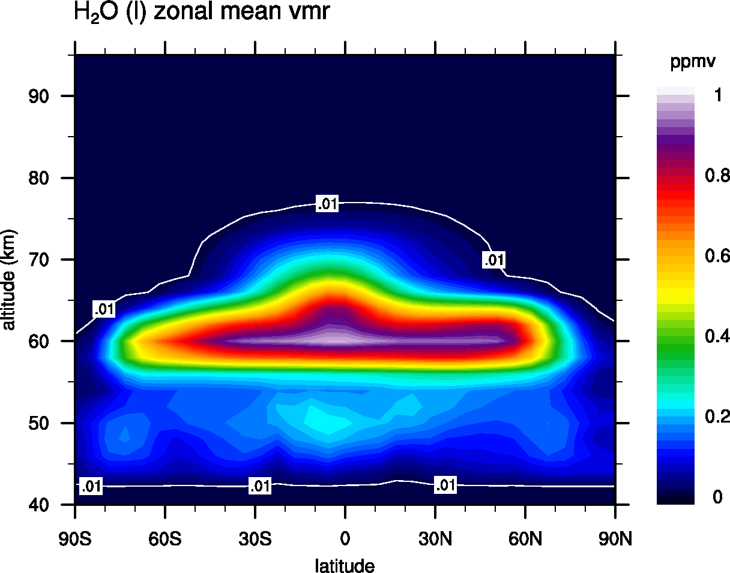
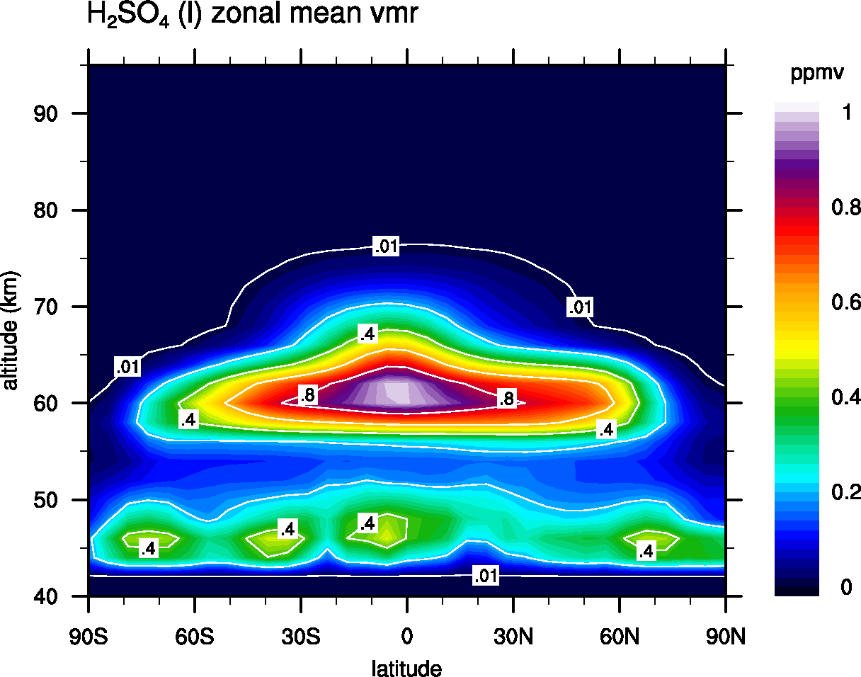
H₂SO₄ and H₂O in the liquid phase

Slide 15
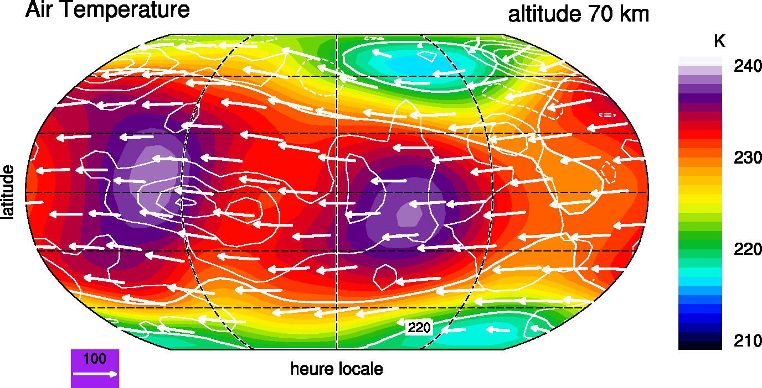

Slide 16
Cloud model
Multimodal parameterisation of H₂SO₄-H₂O aerosols at equilibrium
Input:
  radius of each mode : r₁ + σ₁, r₂ + σ₂, r₃ + σ₃ Knollenberg and Hunten, 1980
  mass distribution between each mode fixed, altitude-dependent
  T, p, H₂O and H₂SO₄ total densities calculated by the GCM
Output:
  binary H₂SO₄-H₂O composition
  condensed H₂O and H₂SO₄ mass
  particle number density (cm⁻³) for each mode
  aerosol sedimentation rate

Slide 17
